Slide 1
South African Revenue Services
Additional Medical and Disability Expenses Tax Credit
Koenraad Burger

Slide 2
Objective
Understand the Additional Medical Expenses Tax Credit as it relates to out-of-pocket expenses for:
medical/physical impairment expenses incurred and paid; and
disability expenses incurred and paid.

Slide 3
Clarification of Terms
“Dependant”
A dependant is:
a person’s spouse;
a person’s child and the child of his or her spouse;
any other member of a person’s family in respect of whom he or she is liable for family care and support; or
any other person who is recognised as a dependant of that person in terms of the rules of a medical scheme or fund.

Slide 4
Clarification of Terms
“Spouse”
Is a person who is in a:
marriage or customary union recognised in terms of the law of the Republic;
union recognised as a marriage in accordance with the tenets of any religion; or
same-sex or heterosexual union which the Commissioner is satisfied is intended to be permanent.

Slide 5
Clarification of Terms
“Child”
Is a child of a person or the child of a spouse, who was alive during any portion of the year of assessment, and who was unmarried and is:
under the age of 18 years;
over the age of 18 years but under the age of 21 years;
over the age of 21 years but was wholly or partially dependant for maintenance upon the person and has not become liable for the payment of Income Tax;

Slide 6
Clarification of Terms
“Child”
over the age of 26 years and was wholly or partially dependent for maintenance upon the person and has not become liable for the payment of Income Tax and is a full-time student at an educational institution of a public character; or
incapacitated by a disability unable to maintain himself/ herself and wholly or partially dependent for maintenance upon the person and has not become liable for the payment of normal tax.

Slide 7
Clarification of Terms
Who is not “Child”
A foster child – the period that the child is in your care does not play any role;
a child who has not yet been legally adopted; or
a child who is under your custodianship.

Slide 8
Clarification of Terms Used
“Disability”
Means “a moderate to severe limitation of any person’s ability to function or perform daily activities as a result of a physical, sensory, communication, intellectual or mental impairment, if the limitation:
(a) has lasted or has a prognosis of lasting more than a year; and
(b) is diagnosed by a duly registered medical practitioner in accordance with criteria prescribed by the Commissioner.ʺ

Slide 9
Clarification of Terms
“Physical Impairment”
It has been interpreted as a disability that is less restraining than a “disability” as defined. This means the restriction on the person’s ability to function or perform daily activities is mild.
A person with a physical impairment may claim the expenses as listed in the List of Qualifying Physical Impairment or Disability Expenditure (Revised on 29 October 2021, effective date: 1 March 2020), but it will be limited.
If the person is under 65 then the Additional Medical Expenses Tax Credit will be 25% of qualifying expense incurred and paid, which exceeds 7.5% of a taxpayer’s taxable income

Slide 10
Additional Medical Expenses Tax Credit
“Qualifying Medical Expenses”
Any amounts (other than amounts recoverable by a person or his or her spouse) which were paid by the person during the year of assessment to any duly registered:
medical practitioner, dentist, optometrist, homeopath, naturopath, osteopath, herbalist, physiotherapist, chiropractor, or orthopedist for professional services rendered or medicines supplied to the person or any dependant of the person;

Slide 11
Additional Medical Expenses Tax Credit
“Qualifying Medical Expenses”
nursing home or hospital or any duly registered or enrolled nurse, midwife or nursing assistant (or to any nursing agency in respect of services of such nurse, midwife or nursing assistant) in respect of the illness or confinement of the person or any dependant of the person; or
pharmacist for medicines supplied on the prescription of any person or any dependant of the person

Slide 12
Additional Medical Expenses Tax Credit
“Qualifying Medical Expenses”
Any amounts (other than amounts recoverable by a person or his or her spouse) which were paid by the person during the year of assessment in respect of expenditure incurred outside the Republic on services rendered or medicines supplied to the person or any dependant of the person; and
Qualifying medical expenses incurred and paid for a physical impairment/disability of the person, spouse or dependant of the person.

Slide 13
Additional Medical Expenses Tax Credit
Can medicine/vitamins bought over the counter be claimed?
Medicines/vitamins can only be claimed if the over-the-counter medicines/vitamins are supplied by a pharmacist on the prescription.

Slide 14
Additional Medical Expenses Tax Credit
What is out-of-pocket medical expenses?
These are:
the co-payments required by the medical aid;
“qualifying expenses” paid but not covered by the medical aid;
“qualifying expense” paid but not claimed from the medical aid; and
listed physical impairment and disability expenses paid, but not claimable from the medical aid
If you paid an expense upfront and your medical aid reimburses you later, that portion of the expense reimbursed is no longer an out-of-pocket expense.

Slide 15
Claiming Out-of-Pocket Medical Expenses
What documents are needed for your Income Tax Return?
The certificate from your medical aid stating the contributions you had made and the amounts not covered by the medical aid; and
proof payment for your out-of-pocket medical expenses paid. Retain your proof of payment; SARS may request it
Prepare a schedule of the out-of-pocket expenses.

Slide 16
Claiming Medical and Disability Expenses
What documents are needed for your Income Tax Return?
This schedule must contain:
The date on which the payment was made;
to whom was the payment made;
a short description of the goods or services rendered (e.g. pharmacist medicine);
the person to whom the goods or services rendered; and
the amount paid.

Slide 17
Calculating the Additional Medical Expenses Tax Credit
Persons under 65 or a person with a physical impairment
25% of qualifying expense incurred and paid, which exceeds 7.5% of a taxpayer’s taxable income.

Slide 18
The Meaning of Disability
Background
Unlike many countries, in South Africa disability is not legislated for in one piece of legislation.
For example, “disability” is defined in Social Assistance Act, Employment Equity Act, and the Income Tax Act.
While the core of these definitions is in accordance with the
UN Convention on the Rights of Persons with Disabilities and the SA White Paper on the Rights of Persons with Disabilities, there are subtle differences to serve the specific objectives of each of these Acts.

Slide 19
The Meaning of Disability
Background
This means that while a person may be recognised as a person with disability under for example the Employment Equity Act; it does not automatically mean that the person will be recognised as a person with disability under the Income Tax Act.
The Income Tax Act has its own criteria which a person must meet to be recognised as a person with disability.

Slide 20
The Meaning of Disability
For purposes of the Additional Medical Expenses Tax Credit disability is defined as:
ʺa moderate to severe limitation of any person’s ability to function or perform daily activities as a result of a physical, sensory, communication, intellectual or mental impairment, if the limitation:
(a) has lasted or has a prognosis of lasting more than a year; and
(b) is diagnosed by a duly registered medical practitioner in accordance with criteria prescribed by the Commissioner.ʺ

Slide 21
The Meaning of Disability
Prescribed Criteria for Disability
The Commissioner has prescribed criteria for moderate to severe physical, sensory, communication, intellectual or mental impairment.
These criteria seek to assess the functional impact of the impairment on a person’s ability to perform daily activities and not the diagnosis of a medical condition. So a medical condition is not a disability.
A person must either meet the criteria for moderate to severe physical, sensory, communication, intellectual or mental impairment before that person is recognised as a person with disability for income tax purposes.
This criteria can be found on the Confirmation of Diagnosis of Disability (ITR-DD) Form.

Slide 22
Confirmation of Diagnosis of Disability (ITR-DD)
Who must Complete the ITR-DD?
The ITR-DD must be completed and endorsed by a duly registered medical practitioner who is qualified to express an opinion on the disability, i.e.:
Vision – Practitioner trained to use the Snellen chart (e.g. an optometrist or ophthalmologist)
Hearing – Practitioner trained to perform or conduct a battery of Diagnostic Audiometry tests. (e.g. an Ear, Nose and Throat Specialist or Audiologist)
Speech – (e.g. Speech-Language Pathologist).

Slide 23
Confirmation of Diagnosis of Disability (ITR-DD)
Who must Complete the ITR-DD?
Physical – (e.g. Orthopedic Surgeon, Neuro Surgeon, Physiotherapist or Occupational Therapist)
Intellectual – (e.g. Psychiatrist or Clinical Psychologist)
Mental – (E.g. Psychiatrist or Clinical Psychologist)
A General Practitioner may complete an ITR-DD as long as the GP is in possession of a report from a practitioner above confirming the disability.

Slide 24
Confirmation of Diagnosis of Disability (ITR-DD)
What must the Medical Practitioner Complete?
Part B of the ITR-DD – The medical practitioner must complete the appropriate diagnostic criteria.
Part C of the ITR-DD – the medical practitioner must, amongst other things:
indicate and describe if the functional limitations with respect to performing activities of daily living are regarded as either “mild” or “moderate to severe”; and
indicate if the disability has lasted, or is expected to last for a continuous period of more than 12 months.

Slide 25
Confirmation of Diagnosis of Disability (ITR-DD)
For How long is the ITR-DD Valid?
If the disability is temporary (the disability is expected to last for 12 months or less) – the ITR-DD is valid for 12 months.
If the disability is permanent (the disability is expected to last for more than 12 months):
If the person qualified as a person with a disability for the first time on or after 1 March 2019, the ITR-DD will be valid for 10 years; and

Slide 26
Confirmation of Diagnosis of Disability (ITR-DD)
For How long is the ITR-DD Valid?
If the person qualified as a person with a disability for the first time before 1 March 2019 and, on 1 March 2019, that person held a valid ITR-DD form expiring after that date, that ITR-DD will be valid for a further five years from its date of expiry.
It is not necessary to complete a new ITR-DD until the date of expiry of that ITR-DD.
The bottom line is that if the disability of a person is permanent then a “new” ITR-DD need not be obtained for every year! A “new” ITR-DD must only be obtained once the validity period of an ITR-DD has lapsed.

Slide 27
Disability Expenses
Who’s Disability Expenses can be claimed?
The Taxpayer;
the taxpayer’s Spouse;
the taxpayer’s Child and the Child of the Spouse;
any other member of a taxpayer’s family in respect of whom the taxpayer is liable for family care and support; and
any other person who is recognised as a dependant of that taxpayer’s medical scheme.

Slide 28
Disability Expenses
What is Disability Expenses?
Any expenditure that is prescribed (listed) by the Commissioner;
other than expenditure recoverable by the taxpayer or his or her spouse;
necessarily incurred and paid by the taxpayer;
during the year of assessment;
in consequence of any physical impairment or disability; and
suffered by the taxpayer or any dependant of the taxpayer.

Slide 29
Disability Expenses
What is Listed Expenses?
The prescribed expenditure was listed in the List of Qualifying Physical Impairment or Disability Expenditure (Revised on 29 October 2021, effective date: 1 March 2020).
The list categorises expenses as follows:
personal care attendant expenses;
travel and transportation;
insurance, maintenance, repairs and supplies;

Slide 30
Disability Expenses
What is Listed Expenses?
aids and other devices;
services;
continence products;
service animals; and
alterations or modifications to assets acquired or to be acquired
If an expense has not been listed it cannot be claimed!

Slide 31
Disability Expenses
Is Incontinence a Disability?
Incontinence on its own is a medical condition and not a disability.
However continence products are listed because incontinence is an unfortunate concomitant of a couple of physical disabilities.
For example a person with quadriplegia meets the criteria for physical disability because the person is a wheelchair user. And the injury to the spinal cord, unfortunately, makes the person incontinent.

Slide 32
Disability Expenses
Is School Fees a Claimable Expense?
The claimable expenses include:
school assistant or classroom costs; and
school fees limited to the amount in excess of the fees that would have been payable if the person attended the closest fee-paying public school not specialising in learners with special educational needs.
School not specialising in learners with special educational needs, limited to additional expenses incurred and paid as a result of the disability.

Slide 33
Disability Expenses
Is School Fees a Claimable Expense
Tutoring services used by a person with a disability, and which are supplementary to the primary education of a person with a learning disability or impairment in intellectual or mental functions, and paid to someone in the business of providing such services.

Slide 34
Claiming Medical and Disability Expenses
What documents are needed?
The certificate from your medical aid stating the contributions you had made and the amounts not covered by the medical aid.
A valid ITR-DD.
Proof of payment for your out-of-pocket and disability and medical expenses paid.
If you paid an expense upfront and your medical aid reimburses you later, that portion of the expense reimbursed is no longer an out-of-pocket expense.

Slide 35
Claiming Medical and Disability Expenses
What documents are needed?
Prepare a schedule of the out-of-pocket medical and disability expenses.
The out-of-pocket disability expenses can be added to the same schedule as explained above.
Retain your proof of payment as SARS may request it.
If no proof of payment on request the claim will be disqualified.

Slide 36
Claiming Medical and Disability Expenses
What to include in the submission of the Income Tax Return?
The certificate from your medical aid the stating the contributions you had made and the amounts not covered by medical aid
A valid ITR-DD.
A schedule of the out-of-pocket medical and disability expenses.

Slide 37
Calculating the Additional Medical Expenses Tax Credit
Person over 65 or a person with a disability
33.3% of qualifying expense incurred and paid.

Slide 38
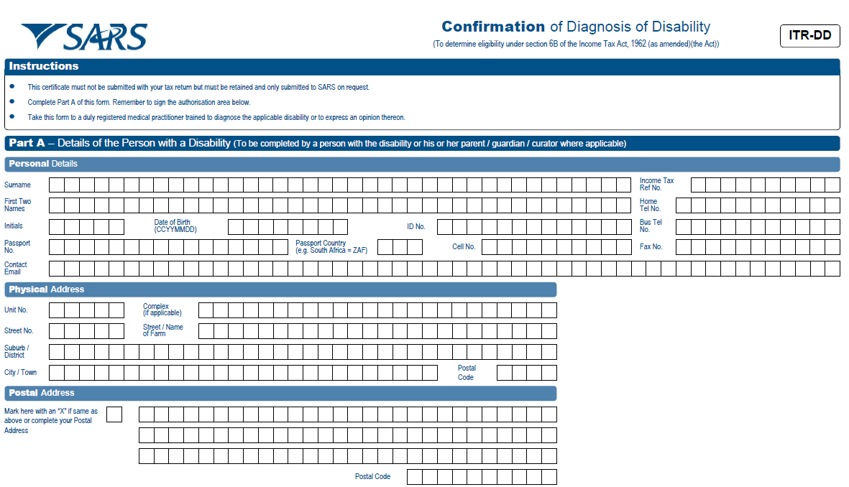
Sample of an ITRDD

Slide 39
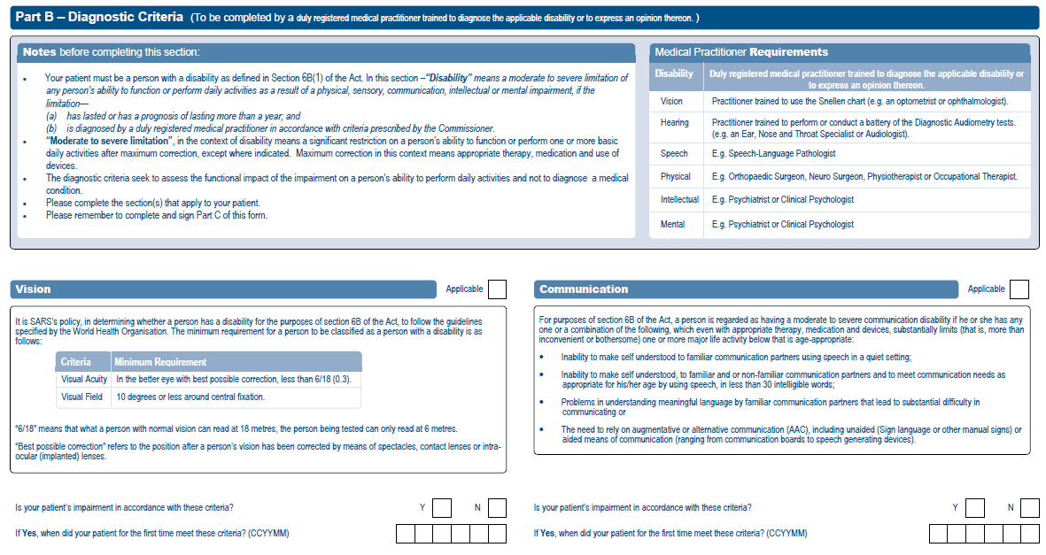
Sample of an ITRDD (Cont.)

Slide 40
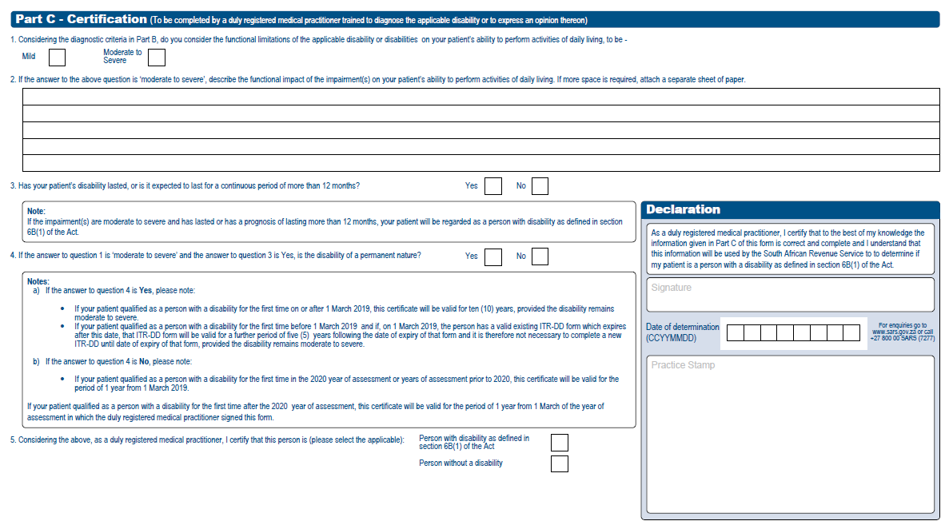
Sample of an ITRDD (Cont.)

Slide 41
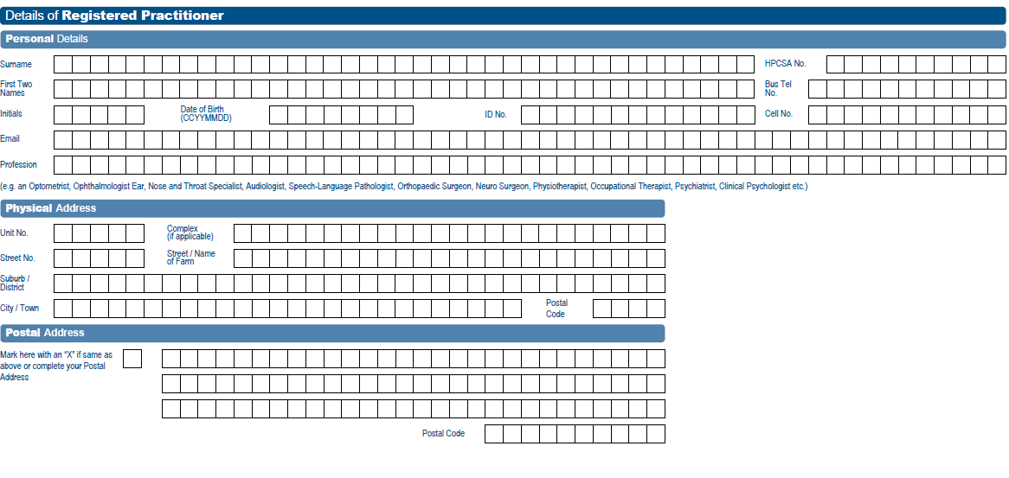
Sample of an ITRDD (Cont.)

Slide 42
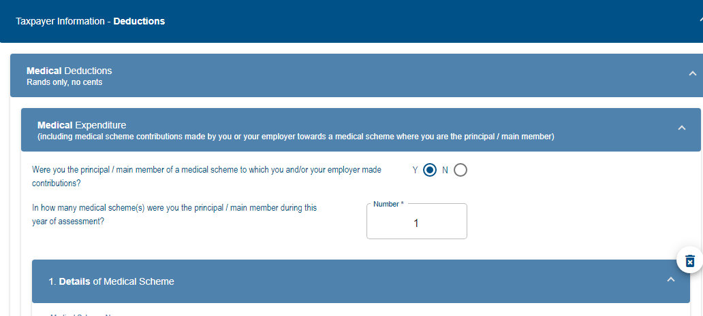
Disability expenses on eFiling- ITR12 Form
On the ITR12 Form, Go to 1.“Taxpayer Information- Deductions>
2. Medical Deductions.
1.
2.

Slide 43
Disability expenses on eFiling- ITR12 Form
Click the “ Disability” container

Slide 44
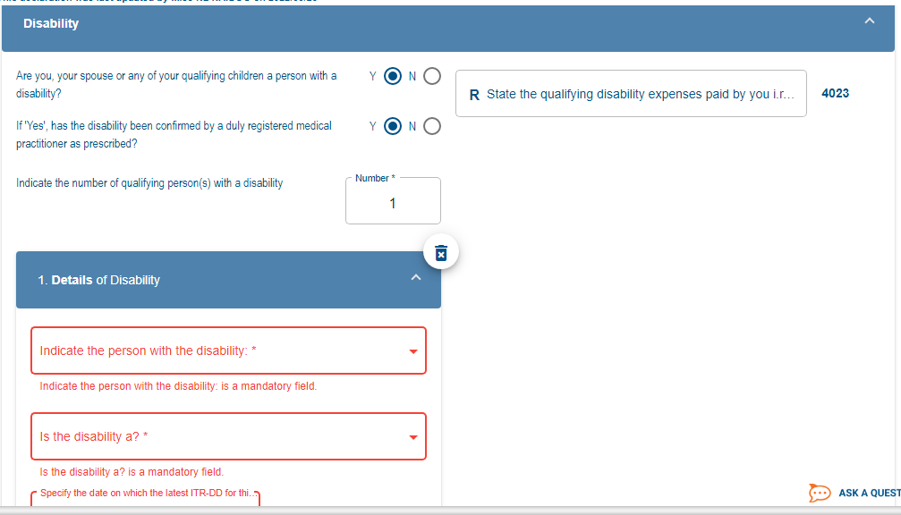
Disability expenses on eFiling- ITR12 Form
Complete the mandatory information by completing the required information as per ITR-DD Form
Disability Expenses must be captured under code:4023

Slide 45
Further Reading
Guide on the Determination of Medical Tax Credits
List of Qualifying Physical Impairment or Disability Expenditure (Revised on 29 October 2021, effective date: 1 March 2020)
Confirmation of Diagnosis of Disability From (ITR-DD)
Available on the SARS website: www.sars.gov.za Individuals → Tax and Disability

