Slide 1

Diesel Refund Registration

Slide 2
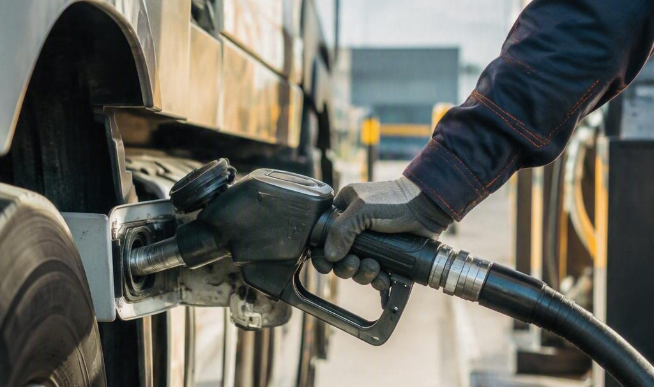
Points of discussion
1. Context and Background
2. New Rules for Diesel Refund Registration
3. Requirement to Register for Diesel Refund
4. Benefits of Modernising Diesel Refunds Scheme
5. Diesel Refund Registration Process
6. Diesel Refund Program Progress
7. eFiling Application Submission
8. Digital Channels and Support
9. Frequently Asked Questions

Slide 3

The Diesel Refund Scheme provides full and/or partial relief of
the diesel bought and used in primary sectors such as farming, forestry, fishing,mining, rail and electricity generation.
Diesel Refund is administered under the Customs and Excise
Act No. 91 of 1964, read with Note 6 to Part 3 of Schedule No. 6 to the Act.
Excise Modernisation introduced a new Diesel Refund system separate from VAT.
All users, including existing VAT-registered claimants must re-register.

Slide 4

New Rules for Diesel Refund Registration
New Registration System
and the Rules
Qualifying Industries
Regrouped into 8 categories
Current users will need to re-register in the new system
Agriculture
Fishing
Sellers of distillate fuel to users are required to register
Mining on Land
Creation of registration profiles by users in terms of Rule 75.25.04
Offshore Mining
Offshore Shipping
Users to declare relationships in terms of Rule 75.25.05
Harbour Shipping
Any person who purchases and uses diesel in the qualifying activities may register and claim refunds, this includes contractors on wet basis
Rail Freight Transport
Electricity Generation
Notes:
Image source: Microsoft 365 content library
If annual turnover exceeds R2.3 million, VAT registration is compulsory. For turnovers between R120,000 and R2.3 million, voluntary VAT registration is available and can be beneficial depending on business circumstances. Below R120,000, VAT registration is generally not permitted, making it important to assess business needs before deciding.

Slide 5

Requirements to Register for Diesel Refund
Merged/Validated by SARS
  Applicants must have a merged and validated profile, which is a prerequisite for applying for Diesel Refund Registration
  SARS will publish a letter on the SARS website that includes guidance and links on how to validate and merge profiles.
  eFiler
  Submit application on eFiling.
  Not an eFiler
  Book a SARS branch appointment for assistance with your application.

Slide 6
Requirements to Register for Diesel Refund
  Register as Seller or User
  Cannot register for both.
  Supporting Documents Required
  Applicants must provide all supporting documents required by SARS to validate eligibility.
  Documents vary by applicant category, for example, Mining on land and offshore applicants, must include DMRE authorisation.

Slide 7
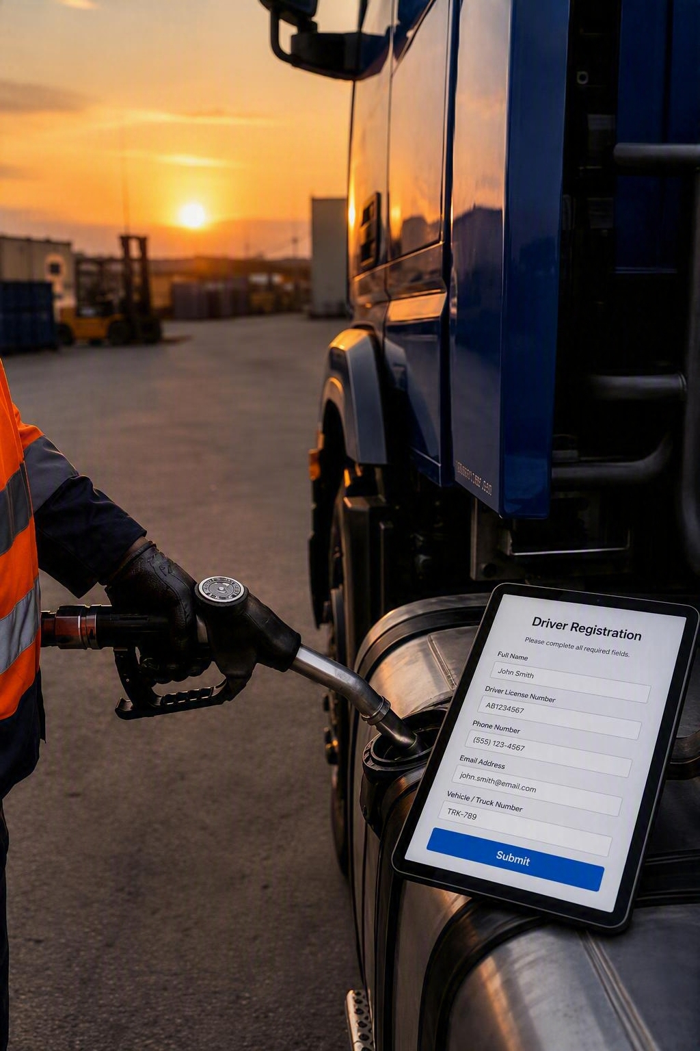
  Faster and Simpler Registration
    A dedicated Diesel Refund system, decoupled from VAT, enables online applications through eFiling on a single RAV01 form, while SARS branches provide support for non eFilers.
    Transparent Application Tracking
    Track applications using the allocated Case Reference Number.
    One Digital Front Door
    Access letters, outcomes, and real-time application updates through the Diesel Refund Dashboard on eFiling.
    Accurate registration information improves risk management, reduces turnaround times.
Benefits of Modernising Diesel Refunds Scheme

Slide 8
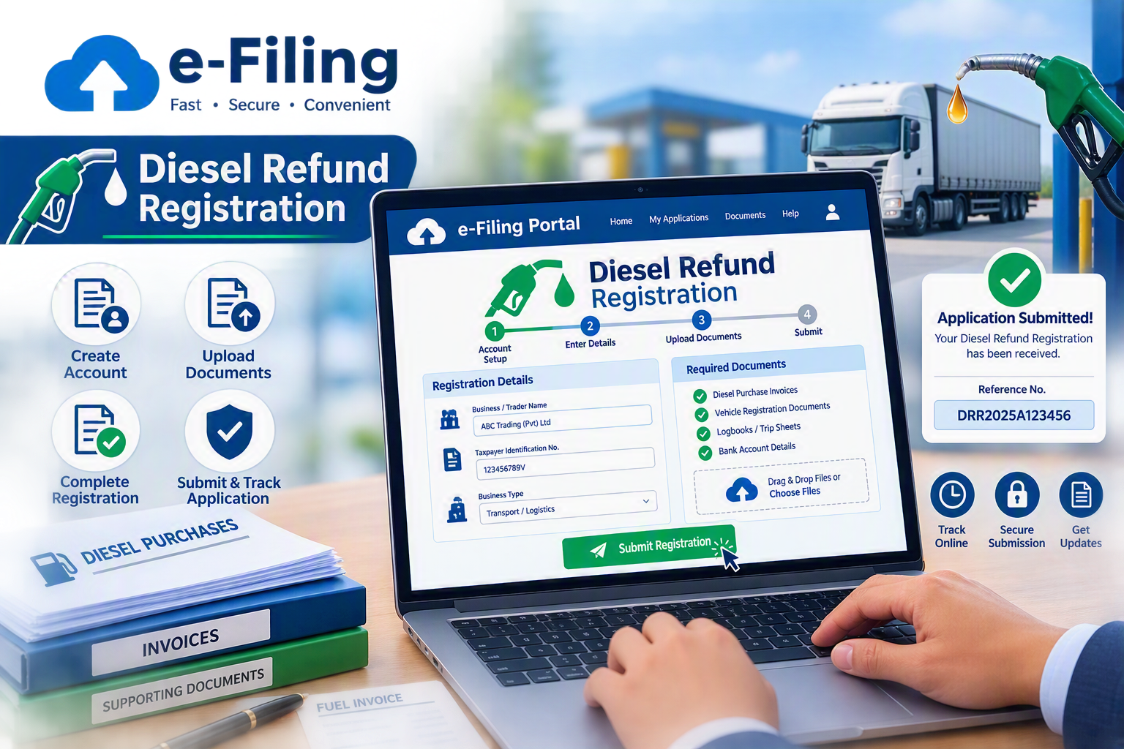

Slide 9
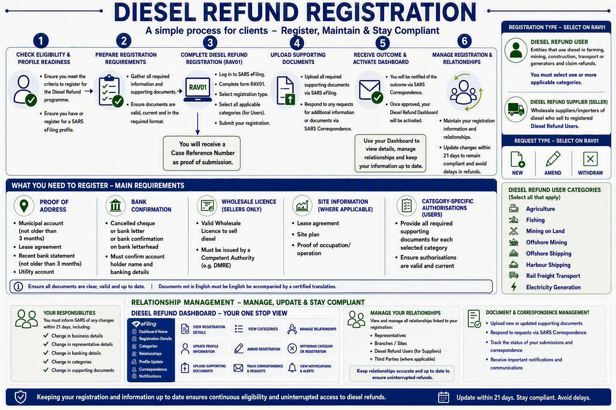

Slide 10
Diesel Refund Program Progress
Dec ’2025
Jan-Feb ’2026
Apr ’2026
Sept ’2026
2026/2027
✓
➜
●
↑
⭐
Phase 1A-
Registration
Pilot
Phase 1B- Relationship
Management
Registration System opens
Remaining Phase
eFiling and branch front-end submission channels.
RAV01 form –DSL decoupled from VAT
SOQS query function
Pilot new registration function
Test system stability and process
User feedback to refine processes
Relationship management with users & sellers and users and users
Client Dashboard
Open phase 1A and 1B for clients to start onboarding
Phase 1C- Profile Registration
Diesel Refund Claim
Our Goal
Deliver a user-friendly, efficient and reliable Diesel Refund Program that supports compliance and fosters strong relationships.
◎
Notes:
Image source: Microsoft 365 content library
If annual turnover exceeds R2.3 million, VAT registration is compulsory. For turnovers between R120,000 and R2.3 million, voluntary VAT registration is available and can be beneficial depending on business circumstances. Below R120,000, VAT registration is generally not permitted, making it important to assess business needs before deciding.

Slide 11
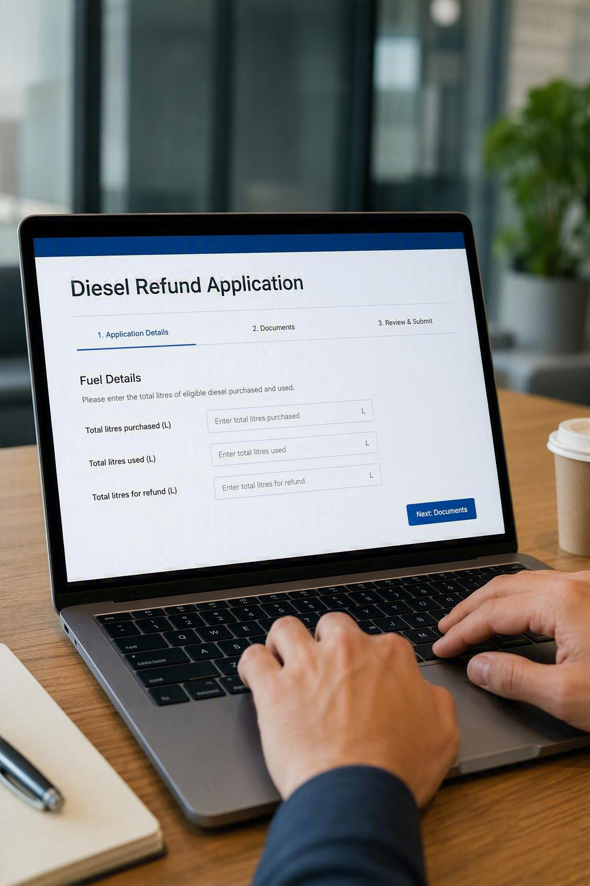

eFiling Application Submission
REGISTRATION SYSTEMS
eFiling Application Submission on RAV01 Form

Slide 12
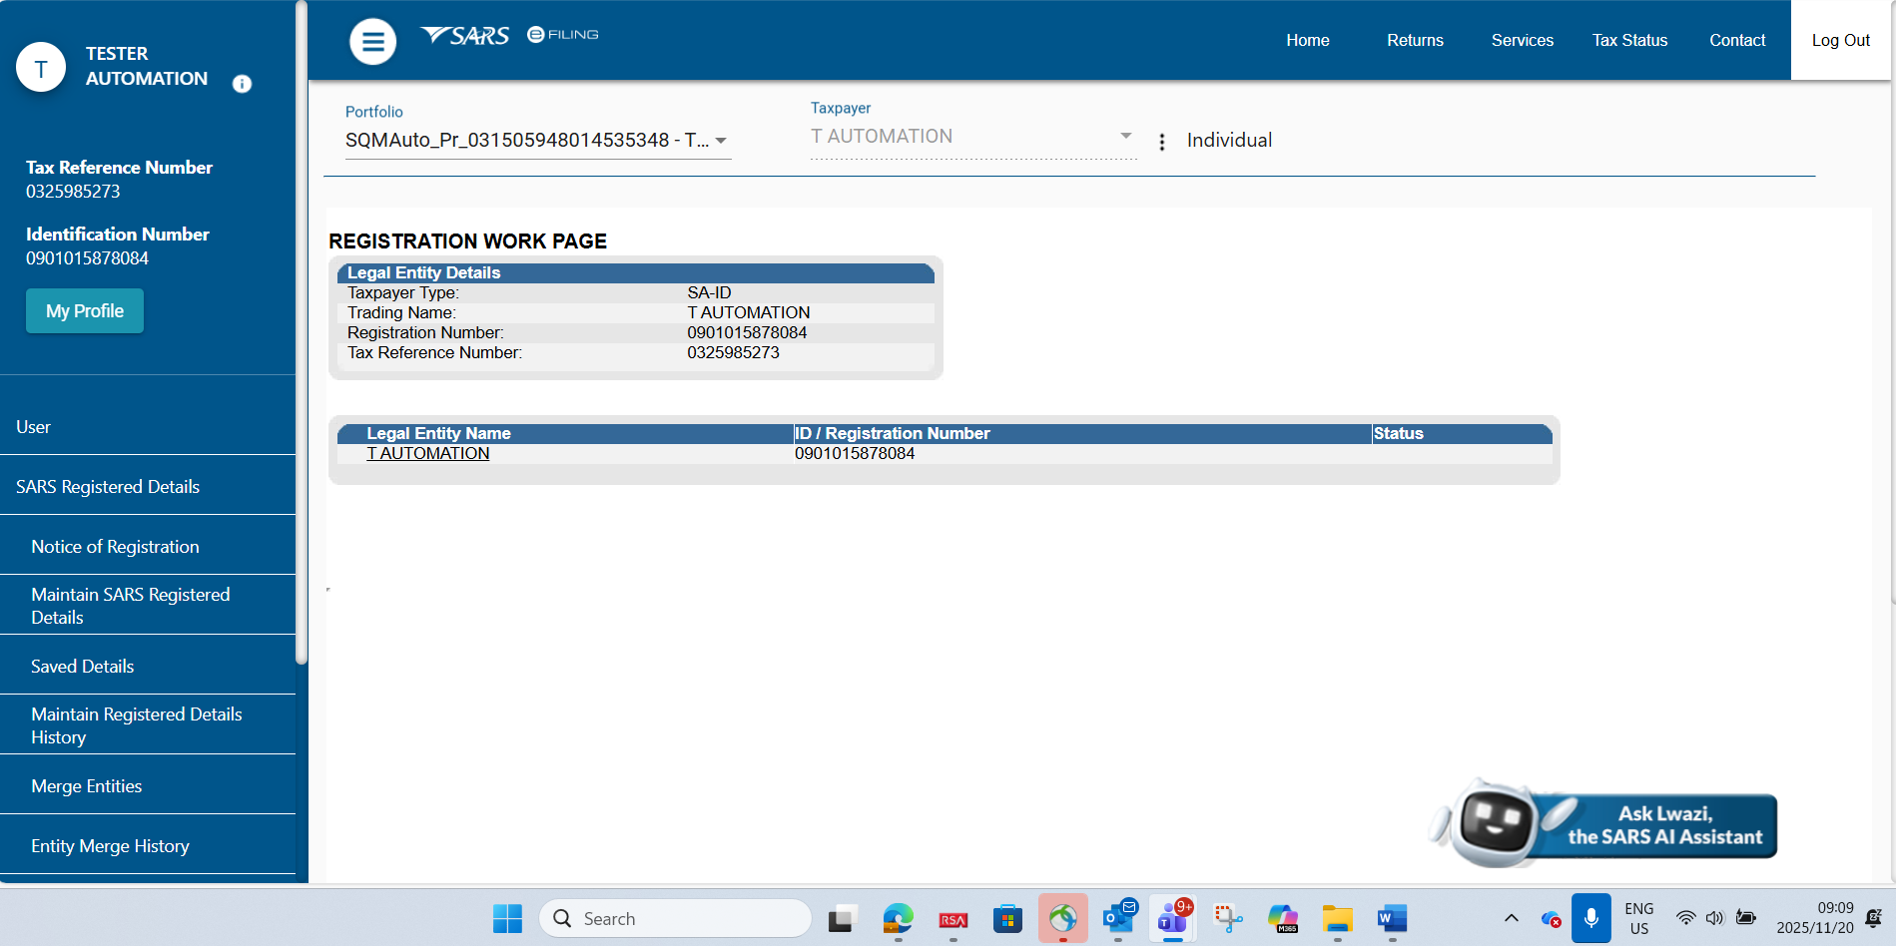
eFiling Registration and Maintaining Registered Details
Once the client has been registered with SARS, the client can then register for eFiling (if not already an eFiler). This can be done by logging on to the SARS website.
To access your registrations, click on “SARS Registered Details” and then “Maintain SARS Registered Details”.
Notes:
Image source: Microsoft 365 content library
If annual turnover exceeds R2.3 million, VAT registration is compulsory. For turnovers between R120,000 and R2.3 million, voluntary VAT registration is available and can be beneficial depending on business circumstances. Below R120,000, VAT registration is generally not permitted, making it important to assess business needs before deciding.

Slide 13
eFiling Registration and Maintaining Registered Details
Once the client has been registered with SARS, the client can then register for eFiling (if not already an eFiler). This can be done by logging on to the SARS website.
To access your registrations, click on “SARS Registered Details” and then “Maintain SARS Registered Details”.
Notes:
Image source: Microsoft 365 content library
If annual turnover exceeds R2.3 million, VAT registration is compulsory. For turnovers between R120,000 and R2.3 million, voluntary VAT registration is available and can be beneficial depending on business circumstances. Below R120,000, VAT registration is generally not permitted, making it important to assess business needs before deciding.

Slide 14
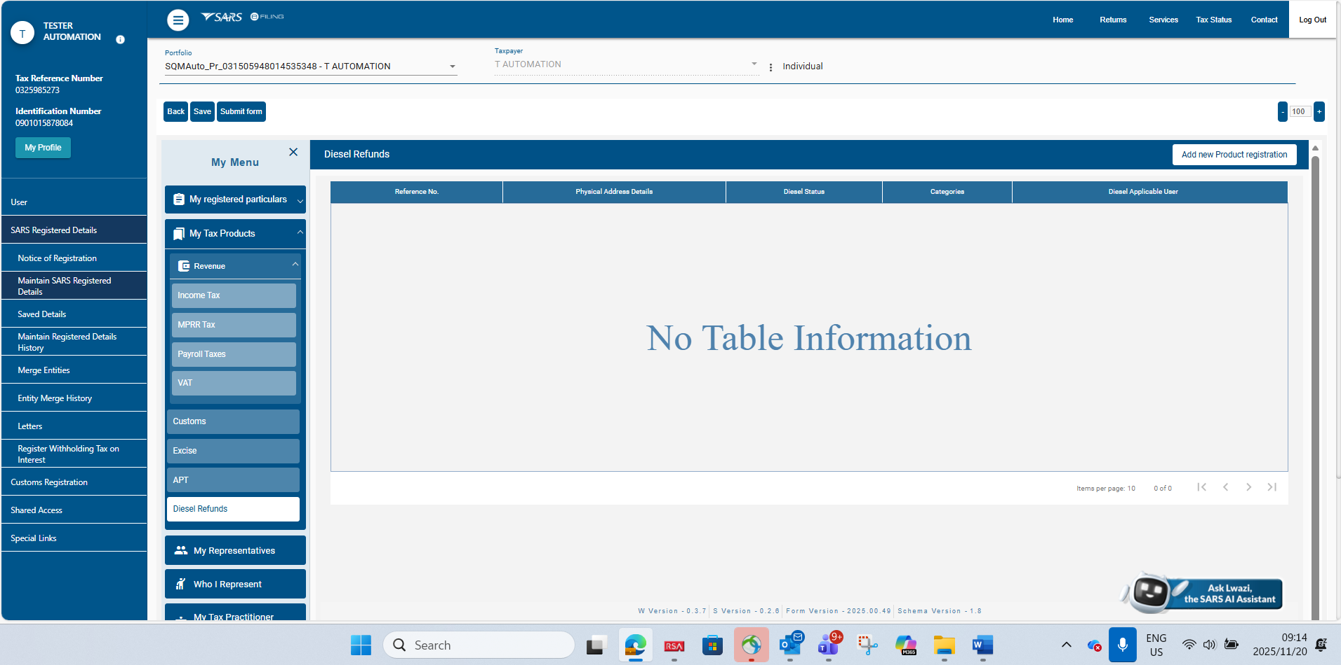
Capture Diesel Refund Registration Application
Your main SARS registration (RAV01) form will open.
Navigate to “My Tax Products”, then “Diesel Refunds”. Click “Add new product registration” to open the Diesel Refund registration application.
Any changes to information such as contact details, addresses and bank details must be managed under “My registered particulars”.
Notes:
Image source: Microsoft 365 content library
If annual turnover exceeds R2.3 million, VAT registration is compulsory. For turnovers between R120,000 and R2.3 million, voluntary VAT registration is available and can be beneficial depending on business circumstances. Below R120,000, VAT registration is generally not permitted, making it important to assess business needs before deciding.

Slide 15
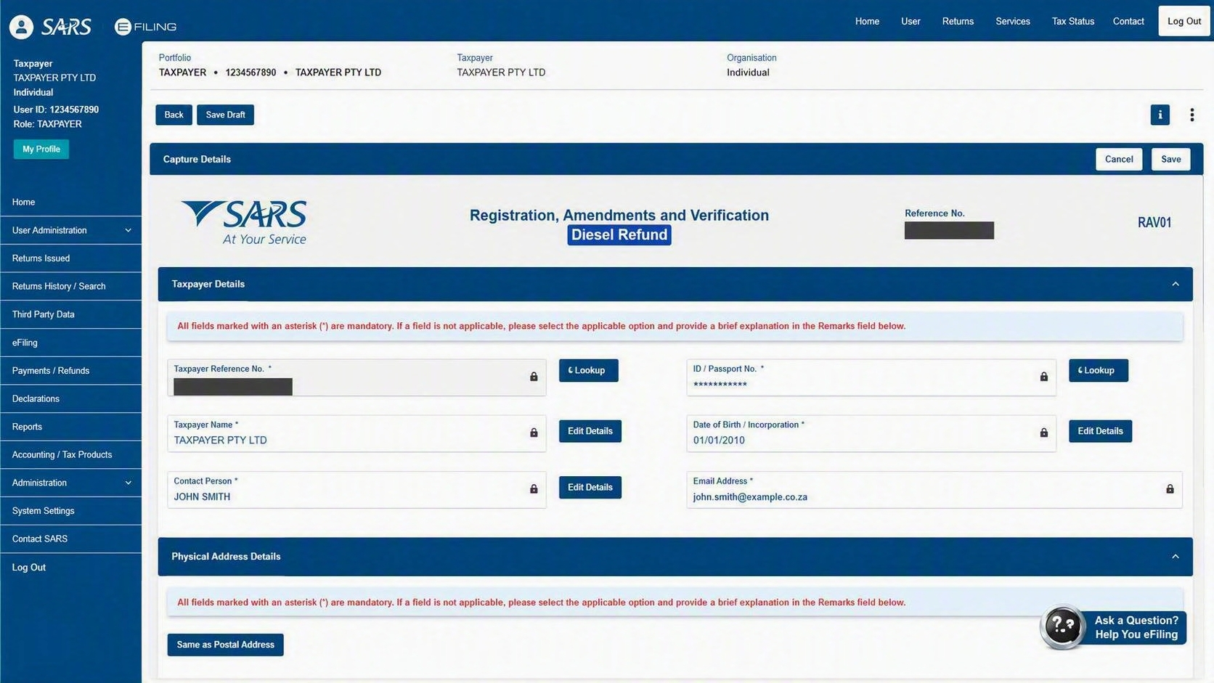
Capture Diesel Refund Registration Application
Indicate the following information that must be used for your Diesel Refund Registration application:
  Contact Details, Physical and Postal Address and Bank details.
You can use only information that is in your entity library; you cannot capture NEW information here.
If you wish to capture information that is not in your library, it must first be captured under “My registered particulars” as indicated on the previous slide. Thereafter, you can use that information on your Diesel Refund registration application.
Notes:
Image source: Microsoft 365 content library
If annual turnover exceeds R2.3 million, VAT registration is compulsory. For turnovers between R120,000 and R2.3 million, voluntary VAT registration is available and can be beneficial depending on business circumstances. Below R120,000, VAT registration is generally not permitted, making it important to assess business needs before deciding.

Slide 16
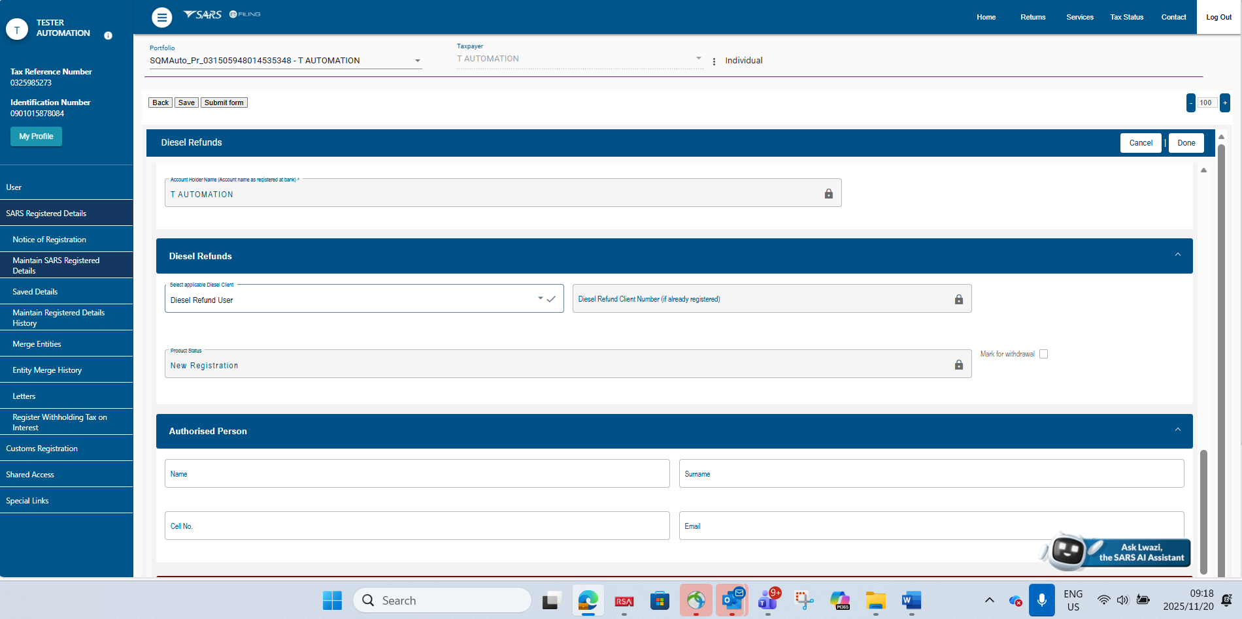
Capture Diesel Refund Registration Application
Select application types as either “Diesel Refund User” or “Diesel Seller”.
Capture “Authorised Person” details, i.e. person responsible for managing Diesel Refund–related matters in your organisation.
Notes:
Image source: Microsoft 365 content library
If annual turnover exceeds R2.3 million, VAT registration is compulsory. For turnovers between R120,000 and R2.3 million, voluntary VAT registration is available and can be beneficial depending on business circumstances. Below R120,000, VAT registration is generally not permitted, making it important to assess business needs before deciding.

Slide 17
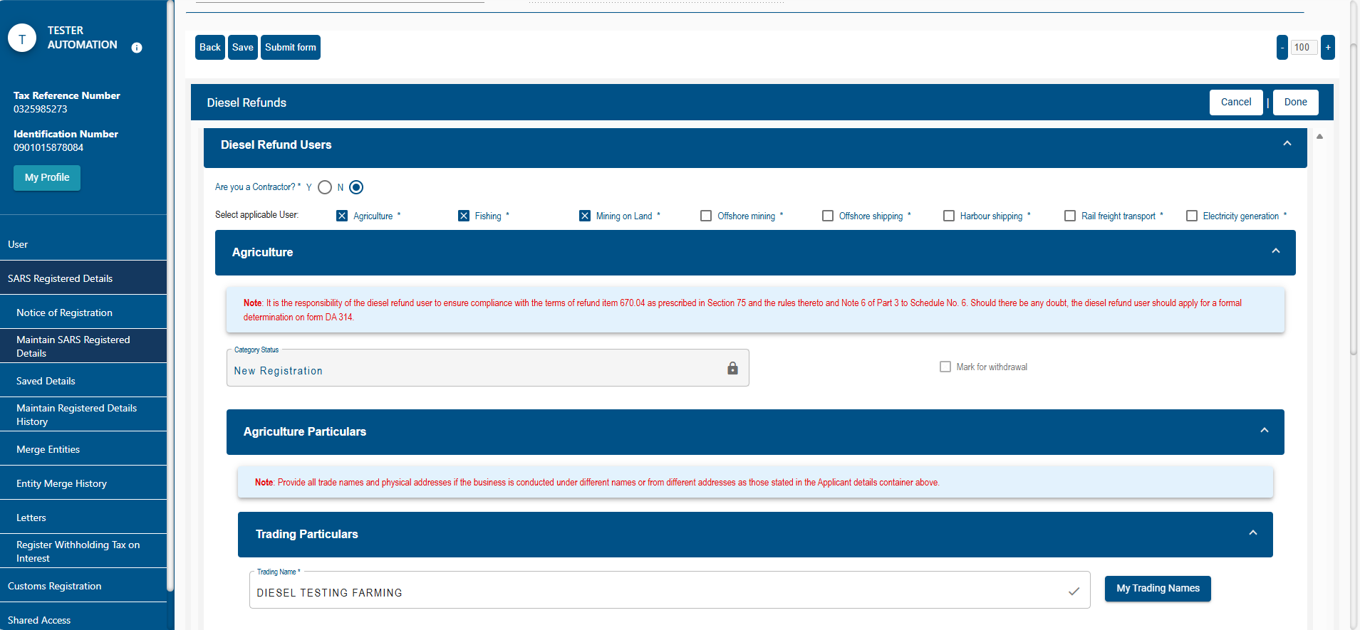
Capture Diesel Refund Registration Application
For a Diesel Refund User, you can select one or more of the eight categories that apply to your potential Diesel Refund activities.
Capture the information applicable to each category, such as trading name or addresses/locations where the activities take place. Once all fields are completed, you can submit the application form.
Notes:
Image source: Microsoft 365 content library
If annual turnover exceeds R2.3 million, VAT registration is compulsory. For turnovers between R120,000 and R2.3 million, voluntary VAT registration is available and can be beneficial depending on business circumstances. Below R120,000, VAT registration is generally not permitted, making it important to assess business needs before deciding.

Slide 18
Capture Diesel Refund Registration Application
Notes:
Image source: Microsoft 365 content library
If annual turnover exceeds R2.3 million, VAT registration is compulsory. For turnovers between R120,000 and R2.3 million, voluntary VAT registration is available and can be beneficial depending on business circumstances. Below R120,000, VAT registration is generally not permitted, making it important to assess business needs before deciding.

Slide 19
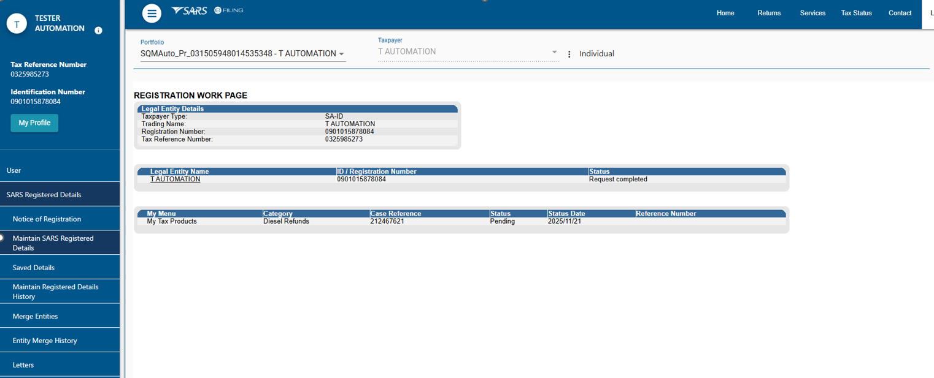
Capture Diesel Refund Registration Application
You will receive a Case Reference Number, which can be used if you want to query the application.
Notes:
Image source: Microsoft 365 content library
If annual turnover exceeds R2.3 million, VAT registration is compulsory. For turnovers between R120,000 and R2.3 million, voluntary VAT registration is available and can be beneficial depending on business circumstances. Below R120,000, VAT registration is generally not permitted, making it important to assess business needs before deciding.

Slide 20
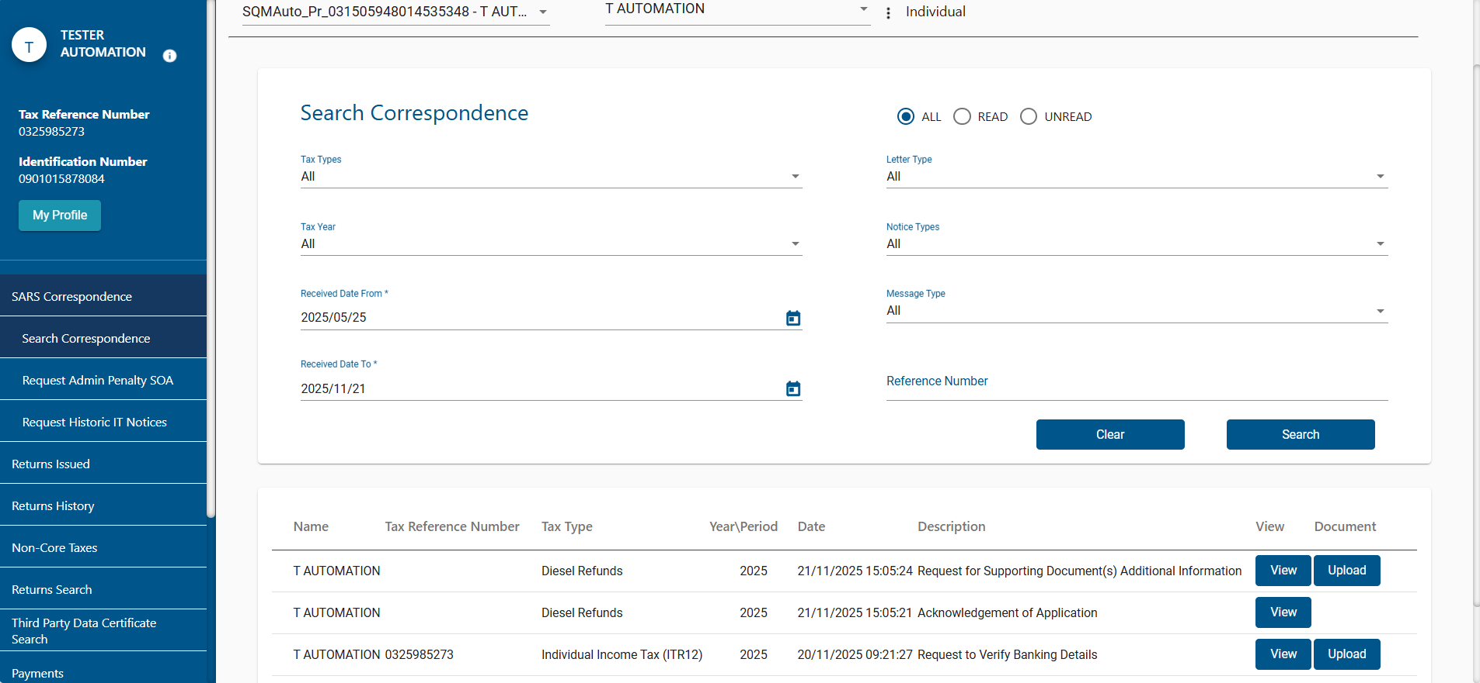
Request to Provide Supporting Documents
Navigate to the “SARS Correspondence” tab and click “Search Correspondence”.
You will see an acknowledgement letter for your application as well as a “Request for Supporting Documents” letter, indicating all the documents required for your application.
Submit these using the “Upload” button or the SARS SOQS channel.
Notes:
I

Slide 21
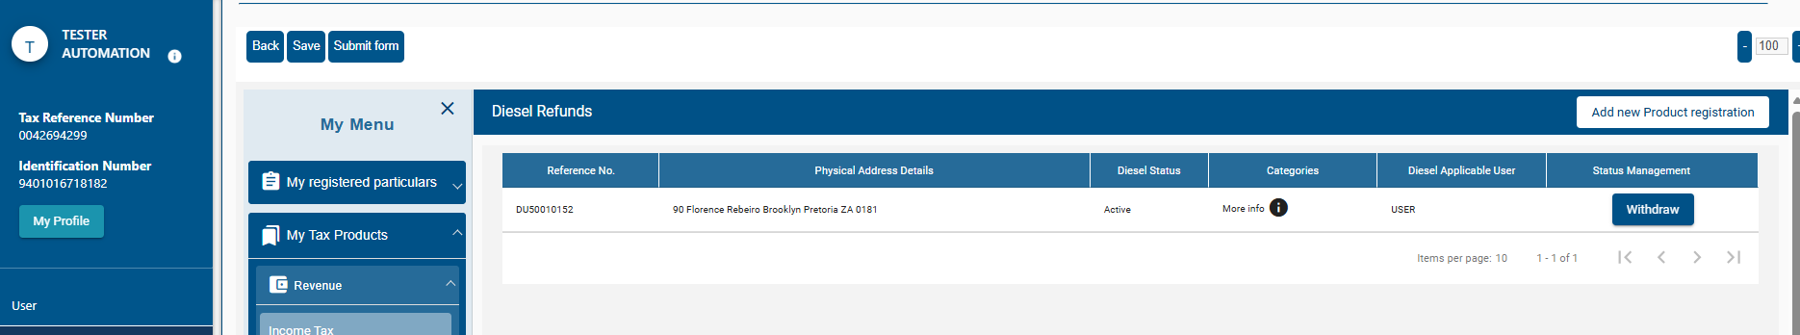
Application Outcome
Once the application is processed, your final outcome letter will be available on the Search Correspondence screen.
If necessary, you can amend your application to update any information by clicking on the application below. The form will open to view existing information as well as allow you to make any changes.
You may even withdraw (cancel) categories or your entire registration by clicking on the “Withdraw” button.
Notes:
Image source: Microsoft 365 content library
If annual turnover exceeds R2.3 million, VAT registration is compulsory. For turnovers between R120,000 and R2.3 million, voluntary VAT registration is available and can be beneficial depending on business circumstances. Below R120,000, VAT registration is generally not permitted, making it important to assess business needs before deciding.

Slide 22
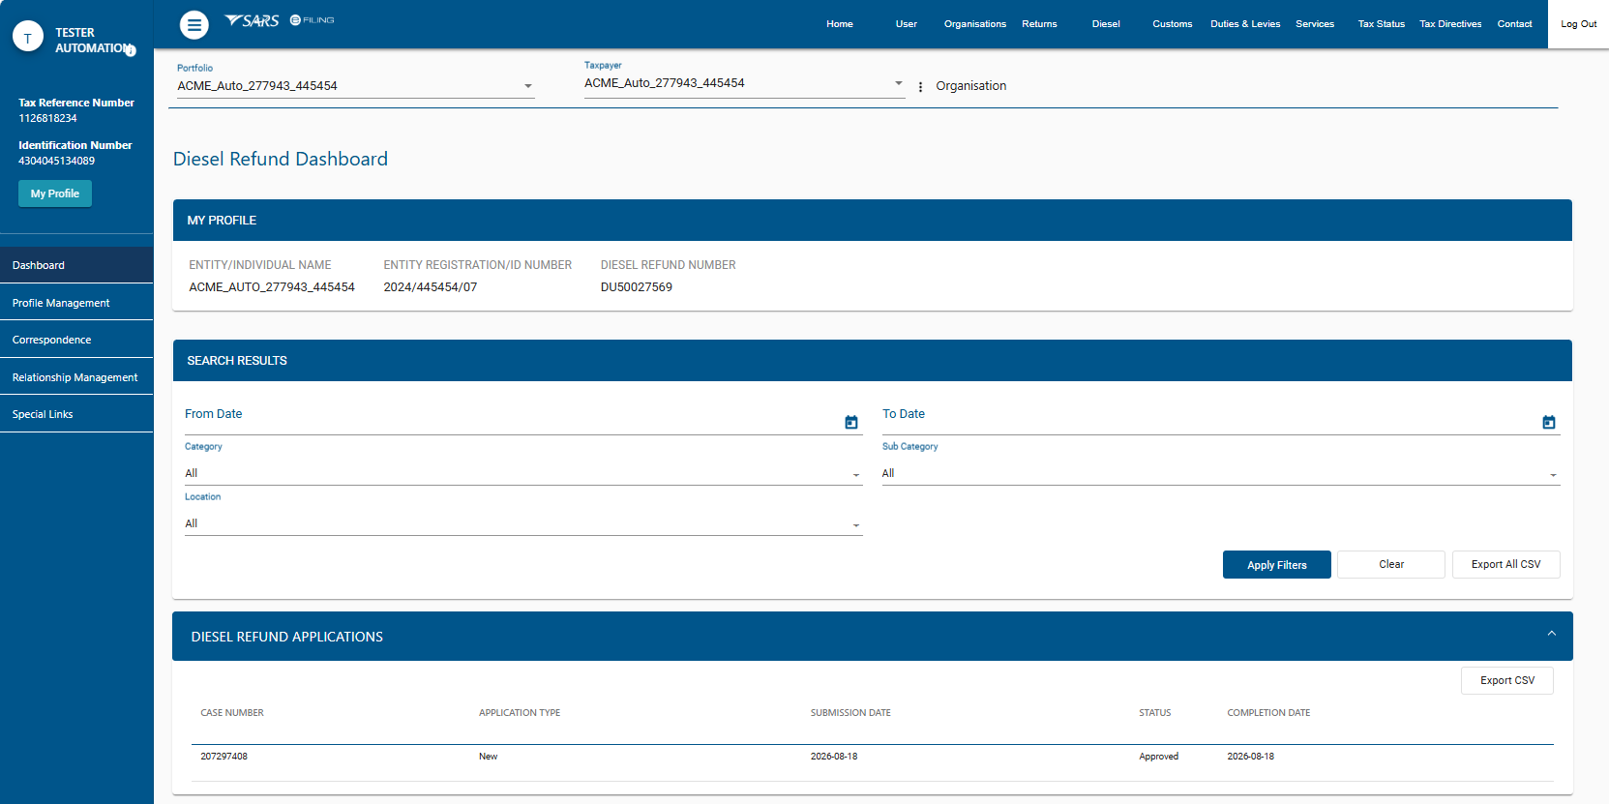
Diesel Refund Dashboard
Once the registration is approved, the client must activate the Diesel Refund tax type on eFiling
An eFiling User can then view their Diesel Refund Dashboard which includes details of the product registration, category details, relationships and profile.
Notes:
Image source: Microsoft 365 content library
If annual turnover exceeds R2.3 million, VAT registration is compulsory. For turnovers between R120,000 and R2.3 million, voluntary VAT registration is available and can be beneficial depending on business circumstances. Below R120,000, VAT registration is generally not permitted, making it important to assess business needs before deciding.

Slide 23
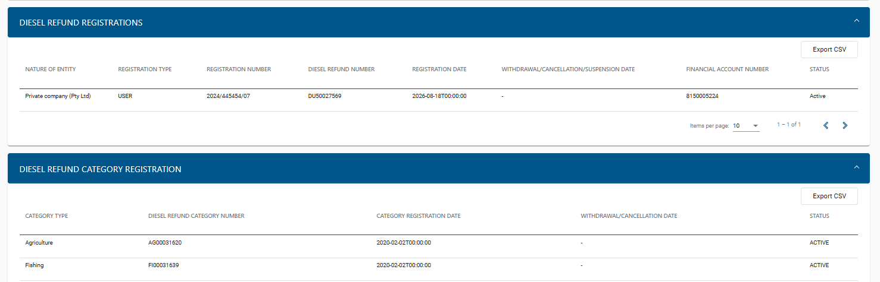
Diesel Refund Dashboard
An eFiling User can view their Diesel Refund Dashboard which includes details of the product registration, category details, relationships and profile.

Slide 24


Frequently Asked Questions
Your questions on Diesel Refund registration answered

Slide 25
Frequently Asked Questions
Q
Do existing Diesel Refund participants need to register again?
Q
Can one application be both a User and a Seller?
Yes. The new Diesel Refund system is separate from VAT and current VAT-system registrants must register in the new system. Clients must register in terms of the new legislative rules
No. Select either “Diesel Refund User” or “Diesel Seller”.
Q
Can a User select more than one category?
Q
Where will I find the documents SARS needs?
Yes. A Diesel Refund User may select one or more of the eight categories that apply to the activities.
Check the Request for Supporting Documents letter under “SARS Correspondence” on eFiling.
Q
How do I query or track my application?
Q
Can I change information after registration?
Retain the Case Reference Number and use it when querying the application. Review SARS Correspondence for letters and the final outcome.
Yes. After processing, the application may be opened to amend information. Categories or the entire registration may also be withdrawn.
Q
What happens after approval?
Q
What is the turnaround time?
Activate the Diesel Refund tax type on eFiling. The Diesel Refund Dashboard will then show registration, categories, relationships and profile details.
The approved TAT for merge takes up to 5 business days and registration 21 business days
Notes:
Image source: Microsoft 365 content library
If annual turnover exceeds R2.3 million, VAT registration is compulsory. For turnovers between R120,000 and R2.3 million, voluntary VAT registration is available and can be beneficial depending on business circumstances. Below R120,000, VAT registration is generally not permitted, making it important to assess business needs before deciding.

Slide 26
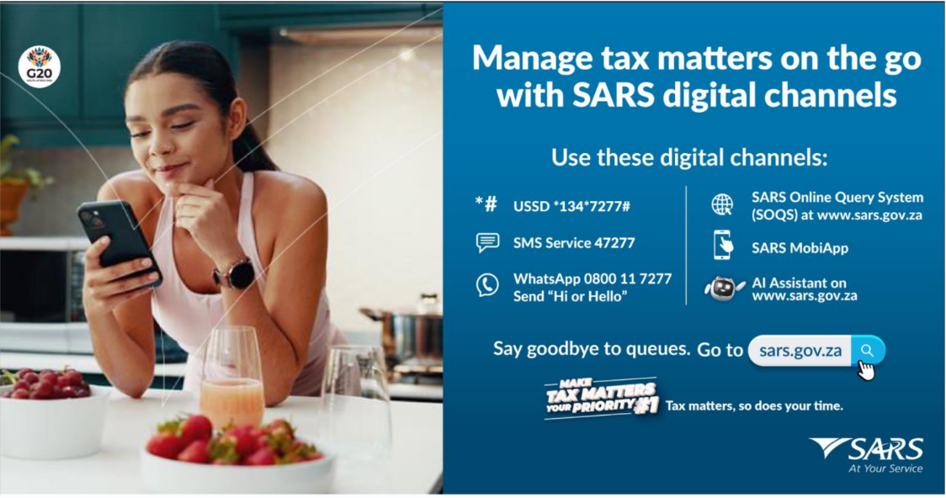

Slide 27
Thank you
Siyabulela
Siyabonga
Siyathokoza
Dankie
Re a leboga
Re a leboha
Ro livhuwa
Ha khensa

