Slide 1
Environmental Levy Products & Sugar Beverage Levy

Slide 2

Contents
Introduction
Environmental levy products
Registration and Licensing
Declaration of return
Compliance
Annual Revenue Collection
Sugar Beverage levy

Slide 3


Introduction
Environmental levy is levied on certain locally manufactured goods as well as on some of their imported equivalents in terms of Schedule No. 1 Part 3 of the Customs and Excise Act, 1964.
The levy aims to influence the public’s behaviour towards the environment.Environmental levies are imposed and paid to SARS.

Slide 4
Introduction
Goods subject to the Environmental Levy
Plastics
Tyres
Electricity Generation
Electric filament lamps
Motor vehicle C02 emissions
Carbon

Slide 5
Introduction
Environmental levy products
Process
Submission to be done on eFiling
Levies are calculated based on product type
Self assessed return completed together with supporting documents
Payment Calendar : Monthly, Quarterly or Yearly
Registration & Licensing done by manufactures via DA185

Slide 6
Annual Revenue Collections
Environmental levies: 2021 Financial Year

Slide 7
Environmental Levy on Tyres

Slide 8
Environmental Levy on Tyres
Why Environmental Levy on Tyres ?
Dept. of Environment, Forestry and Fisheries encourage better ways of:
Waste reduction
Reusing
Recycling
Disposal

Slide 9
Environmental Levy on Tyres
Implementation of tyre levy
Tyre levy is currently administered, governed and enforced by SARS on all manufactures in the tyre OR motor vehicle (MV) industries.
The levy is imposed on tyres manufactured in RSA in terms of item 152.00 in Schedule 1P3E and Sections 54A-54F read with the Rules
Effective from 1 February 2017.

Slide 10
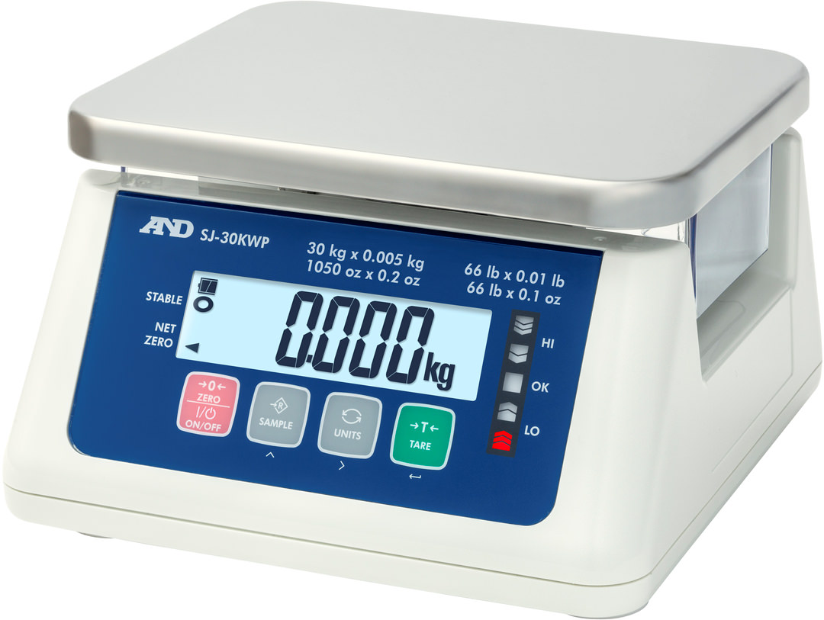
Environmental Levy on Tyres
Liability for levy
The tyre levy rate is a flat rate per Kilogram Net (KN) irrespective of the type or size of the tyre in terms of item 152.00 in Section E of Part 3 of Schedule 1
Current Rate of Levy is R2.30/kg net
If the nett mass is not available or cannot be determined, the rate of the environmental levy shall be calculated on the design mass of the tyres plus 10% of the design mass.

Slide 11
Environmental Levy on Tyres
Account Submissions and Payment dates
Accounting period | Submission date | Payment date
1 Jan 2021 – 31 Mar 2021 | 23-Apr-21 | 23-Apr-21
1 Apr 2021 – 30 June 2021 | 23-Jul-21 | 23-Jul-21
1 Jul 2021 – 30 Sept 2021 | 25-Oct-21 | 25-Oct-21
1 Oct 2021 – 31 Dec 2021 | 25-Jan-22 | 25-Jan-22

Slide 12
Environment Levy on Plastic Bags

Slide 13

Environment Levy on Plastic Bags
Why plastic bag levy ?
Risks of Plastic bags
Increases flooding
Clogs storm drains
Pollution in the ocean

Slide 14
Environment Levy on Plastic Bags
Implementation of the plastic levy
Disposal of Certain types of plastic carrier and flat bags has negative impact on the Environment.
The levy is payable by manufacturers in RSA.
The Customs and Excise Act 1964 Schedule 1 P3A and Sections 54A – 54F read with the rules give rise to the collection of this levy
Relevant entities in the RSA must license with SARS Excise before they start to manufacture.

Slide 15
Environment Levy on Plastic Bags
Liability for levy
  Plastic bags that are subject to levy are those manufactured to the specific legislative requirements with a thickness of 24 microns or more.
  The rate of environmental levy is currently 25c/bag in terms of Schedule 1 Part 3A.
  Manufactures are required to declare all stock, production and removals that took place in the accounting period.

Slide 16
Environment Levy on Plastic Bags
Account Submissions and Payment dates
Accounting period | Submission date | Payment date
1 Dec 2020 – 28 Feb 2021 | 30-Mar-21 | 30-Mar-21
1 March 2021 – 31 May 2021 | 29-Jun-21 | 29-Jun-21
1 June 2021- 31 Aug 2021 | 29-Sep-21 | 29-Sep-21
1 Sept 2021 – 30 Nov 2021 | 30-Dec-21 | 30-Dec-21

Slide 17
Electricity Generation Levy

Slide 18
Electricity Generation Levy
Why Electricity generation levy?
Greenhouse gases
Pollution & acid rain
Waste disposal

Slide 19
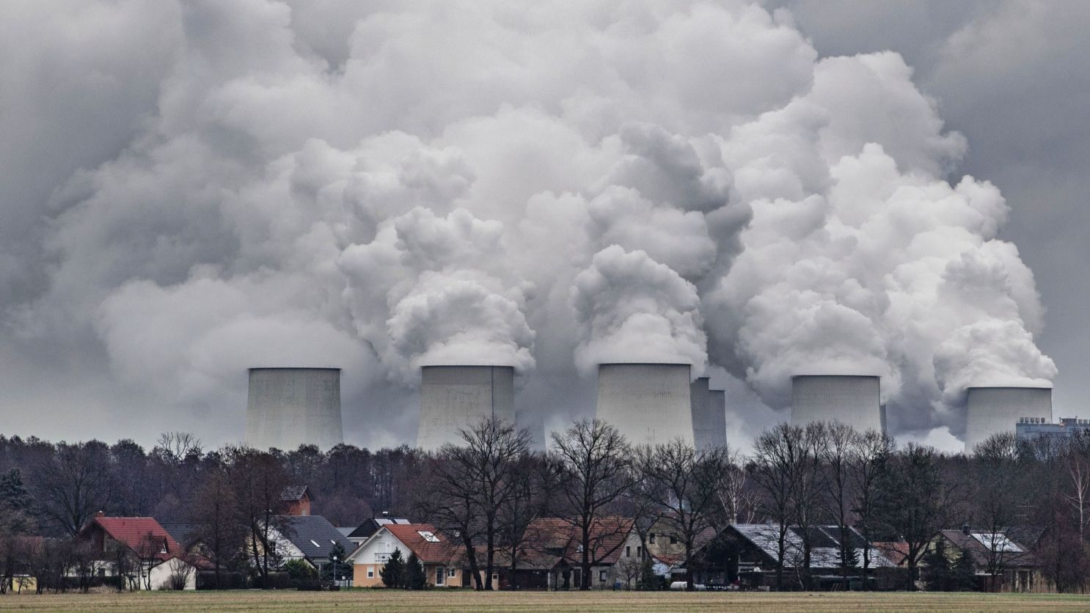
Electricity Generation Levy
Implementation of the Electricity generation levy
  The levy is imposed when non-renewable and environmental hazardous energy sources are used to generate electricity (e.g. Coal, Diesel, Nuclear).
  The threshold for licensing is when the installed capacity of the electricity generation plant exceeds 5 megawatts.
  The levy came into effect on 01 July 2009 with the promulgation of The Customs and Excise Act 1964 Schedule 1 Part 3B and Sections 54A – 54F read with the rules give rise to the collection of this levy
  An environmental levy is payable on locally generated electricity
  Relevant entities in South Africa must license with SARS Excise before they start to generate Electricity from non-renewable or environmentally hazardous sources

Slide 20
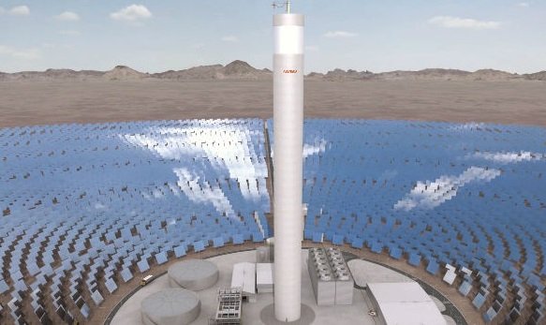
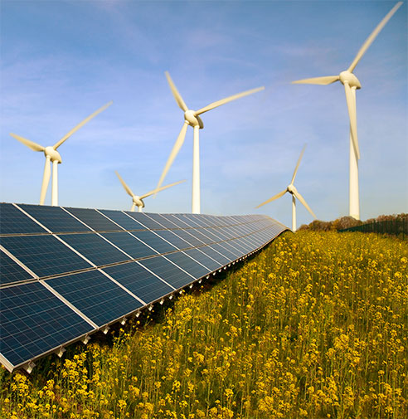
Electricity Generation Levy
Liability for levy & Submission of the tax return
The applicable Environmental Levy on Electricity Generation is self-assessed by licensed producers.
Current Rate of duty is 3.5c/kWh
Accounts submitted monthly

Slide 21
Motor Vehicle C02 Emissions Levy

Slide 22
Motor Vehicle C02 Emissions Levy
Why motor vehicle C02 emissions levy?
Air quality
Global warming
Atmospheric visibility

Slide 23
Motor Vehicle CO2 Emissions Levy
Implementation of motor vehicle C02 emissions levy
The levy came into effect on 01 September 2010.
The environmental levy is payable on new motor vehicles by manufacturers of these vehicles in South Africa.
The objective of the levy is to influence the composition of South Africa’s vehicle fleet to become more energy efficient and environmentally friendly.
Motor vehicle carbon dioxide (CO2) emissions above a specified threshold deemed harmful to the environment are subject to the payment of an Environmental Levy if used in the RSA.
Current rate of duty; R120 per g/km CO2 emissions exceeding 95g/km
Double cab rate of duty; R160 per g/km emissions exceeding 175g/km

Slide 24
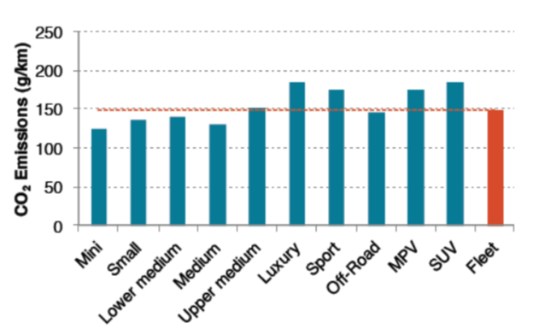
Typical Emissions in SA
Source: The International Council on Clean Transportation

Slide 25
Motor Vehicle CO2 Emissions Levy
Account Submissions and Payment dates
Accounting period | Submission date | Payment date
1 Jan 2021 – 31 Mar 2021 | 23-Apr-21 | 23-Apr-21
1 Apr 2021 – 30 June 2021 | 23-Jul-21 | 23-Jul-21
1 Jul 2021 – 30 Sept 2021 | 25-Oct-21 | 25-Oct-21
1 Oct 2021 – 31 Dec 2021 | 25-Jan-22 | 25-Jan-22

Slide 26
Electric Filament Lamps

Slide 27

Electric Filament Lamps
Implementation, Liability & Submission of Returns
Electric Filament Lamps manufactures are subject to the payment of an Environmental Levy if manufactured in SA.
The rate of the levy payable is R10/lamp.

Slide 28
Carbon Tax

Slide 29
Carbon Tax
Why Carbon Tax?
Climate Changes
Greenhouse gases
Air pollution
Global warming

Slide 30
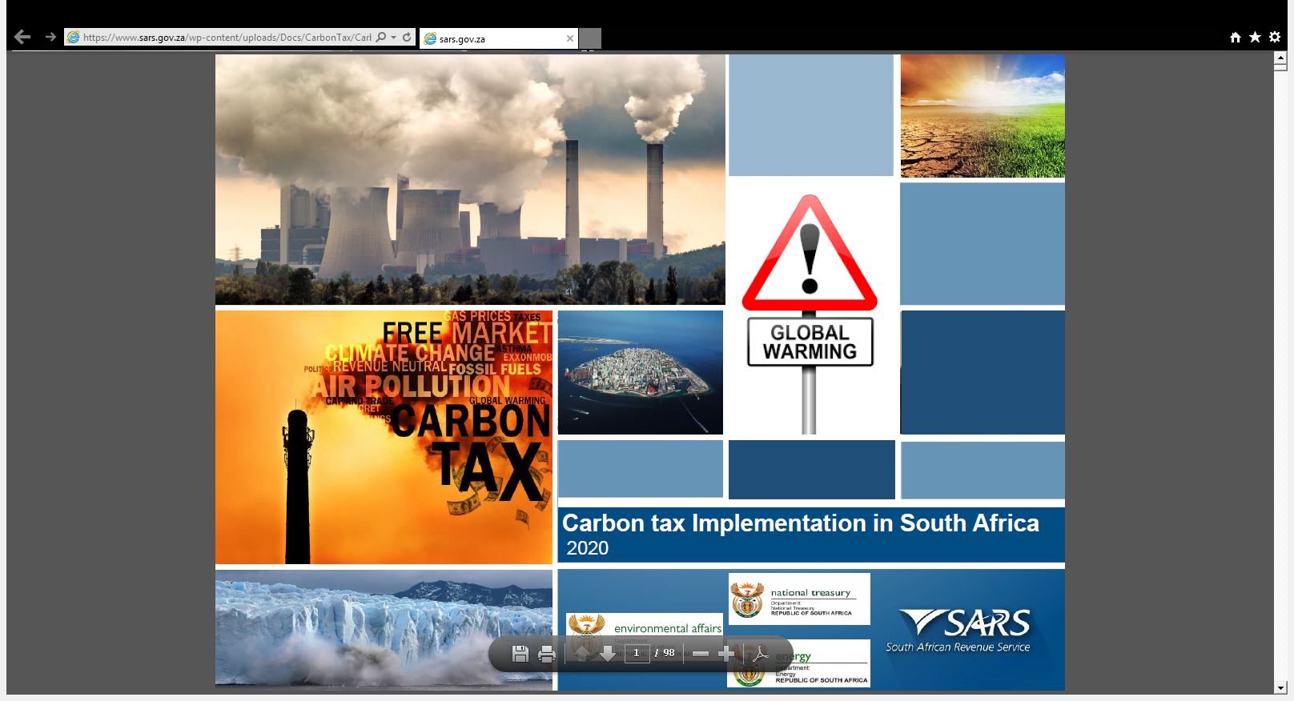

Carbon Tax
Why Carbon Tax?
A polluter pay principle is applied – the more you emit the more you will pay per CO2 ton equivalent emitted
To lower the rate at which greenhouse gas emission are increasing.
Introduce incentives efforts to make the production of goods and services less carbon intensive.

Slide 31
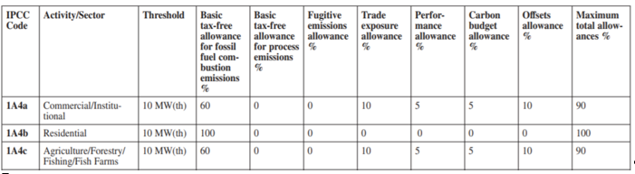
Allowances

Slide 32
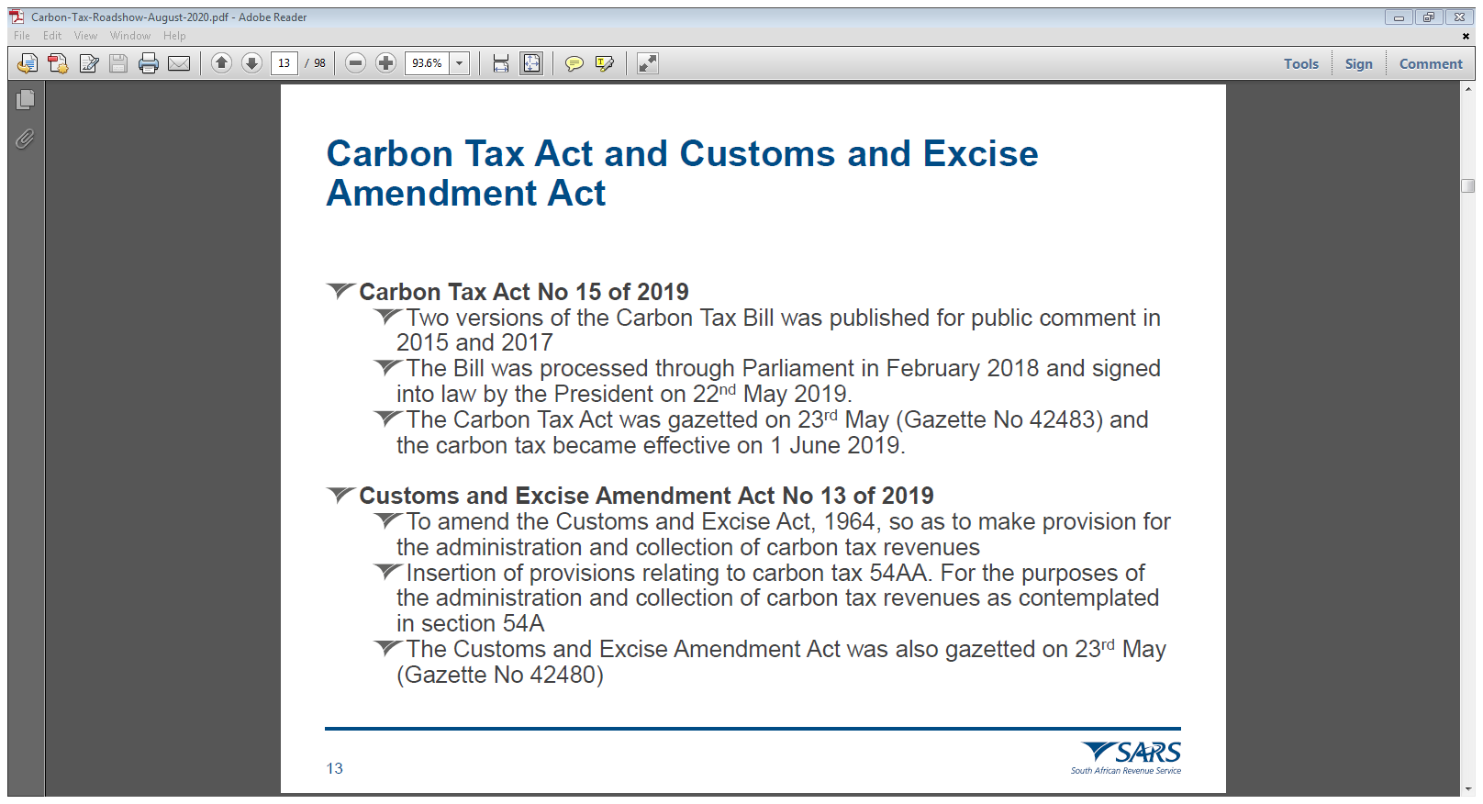
Carbon Tax
Implementation
Carbon Tax Act ,Customs and Excise Amendment Act
The carbon dioxide equivalent of greenhouse gas emissions of a taxpayer in respect of a tax period resulting from fuel combustion, industrial processes and fugitive emissions are taxed at a rate of R120/tCO2e for 2019 and R127/tCO2e for 2020.
The gradual implementation of the tax provides for the first phase from 1 June 2019 to 31 December 2022 and the second phase from 2023 to 2030. The carbon tax rate increases annually by inflation plus 2 per cent until 2022 and annually by inflation thereafter.

Slide 33
Carbon Tax
Implementation
The thresholds for licensing are prescribed per activity in schedule 2 of the Carbon Tax Act.
The levy came into effect on 01 July 2019 with the promulgation of The Customs and Excise Act 1964 Schedule 1 Part 3F (Chapter VB Item 191.00) and Sections 54A-F read with the rules
Returns are due penultimate day of July each year.

Slide 34
Health Promotion Levy on Sugary Beverages

Slide 35
Health Promotion Levy on Sugary Beverages
WHY HPL ?
Promote healthy habits as prescribed by the Department of Health
Reduce sugar content on beverages
Diabetes, Obesity, Heart disease etc

Slide 36
Levy on Sugary Beverages
Implementation
The levy came into effect on 01 April 2018 with the promulgation of The Customs and Excise Act 1964 Schedule 1 Part 7A
Relevant entities in the RSA must register or license with SARS Excise before they start to manufacture.
The threshold for licensing is when a manufacturer exceeds use of 500kg of sugar content per annum. If the manufacturer does not exceed this threshold they still need to register but they will be exempt in paying the levy.
The license is renewed annually.

Slide 37
Health Promotion Levy on Sugary Beverages
Liability for levy & Submission of the tax return
The applicable HPL on sugary beverages is self-assessed by licensed manufacturers
Submission of tax return and payment must be via E-Filing monthly
The SBL rate on 1 April 2018 is fixed at 2.21 cent per gram of the sugar content that exceeds 4 grams per 100ml

Slide 38
Examples of SBL products and non-SBL products
Beverage | SBL YES/NO | Notes
Soft Drinks (Coca Cola etc) | Yes | These are the common fizzy drinks in the market
Concentrates (Oros, Hall’s, powder drinks etc) | Yes | Sugar content should be provided for intended sugar concentration after adding particular amount of water to dilute. E.g. this 500ml bottle will produce 10 litres of cool drink with 12g sugar per 100ml
Fruit juices | Yes and No | 100% pure fruit juices exempt from SBL. 100% blended fruit juices are subject to SBL
Energy drinks | Yes | The sugar content of the energy drink will determine the leviability.

Slide 39
Registration & Licensing

Slide 40
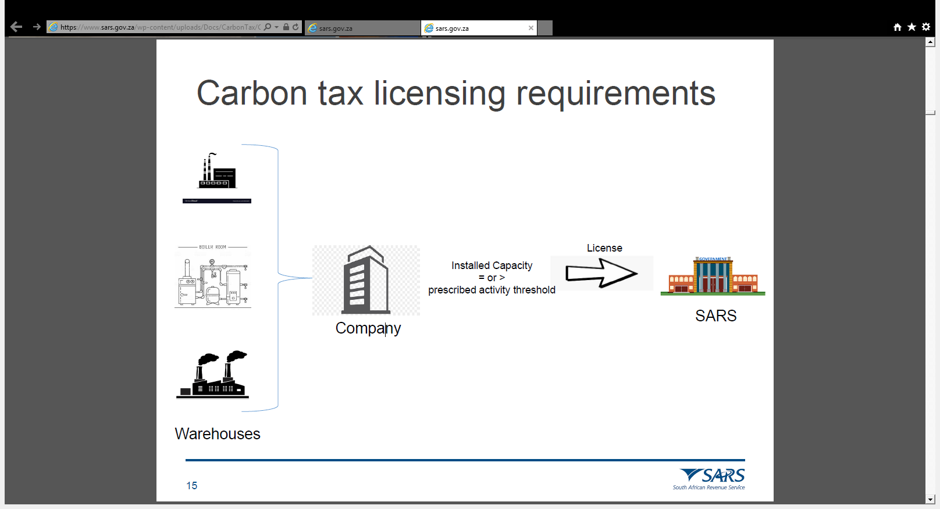
Registration and Licensing
Manufactures requirements

Slide 41
L&R Process Overview
Applicant
Submit Application (DA 185)
Submit Relevant Annexures and Supporting Documents
Security Management
Verify Financial status of applicant
Verify bond requirements where necessary
Premises Verification
Verify the existence of the warehouse
Verify the requirements of the warehouse as prescribed
Application Finalization
Approval or Refusal
Issue warehouse approval details

Slide 42
Registration and Licensing Process
Licensing Conditions
A license must be issued for the respective premises based on the type of application received and approved by Excise.
• The activities for which the license is required, the person and the conditions imposed be reflected on the specific license issued.
• Applicants for warehouses must apply for separate license for each individual warehouse, except for Carbon tax which licences at Entity Level
• No alterations may be made on such license by the applicant and the license must be available for inspection by Excise when requested.

Slide 43
Registration and Licensing Process
Licensing Conditions
No license may be transferred from one (1) person to another person; however a license may be endorsed by the Commissioner to allow a transfer from one (1) approved premise to another within the same area of control and subject to no alteration in legal ownership.
• Excise may at any reasonable time inspect the warehouse concerned to verify
whether it complies with the prescribed requirements.

Slide 44
Declaration on -eFiling

Slide 45

Declaration on eFiling
Capture and submit Excise return
Visit www.sarsefiling.co.za

Slide 46
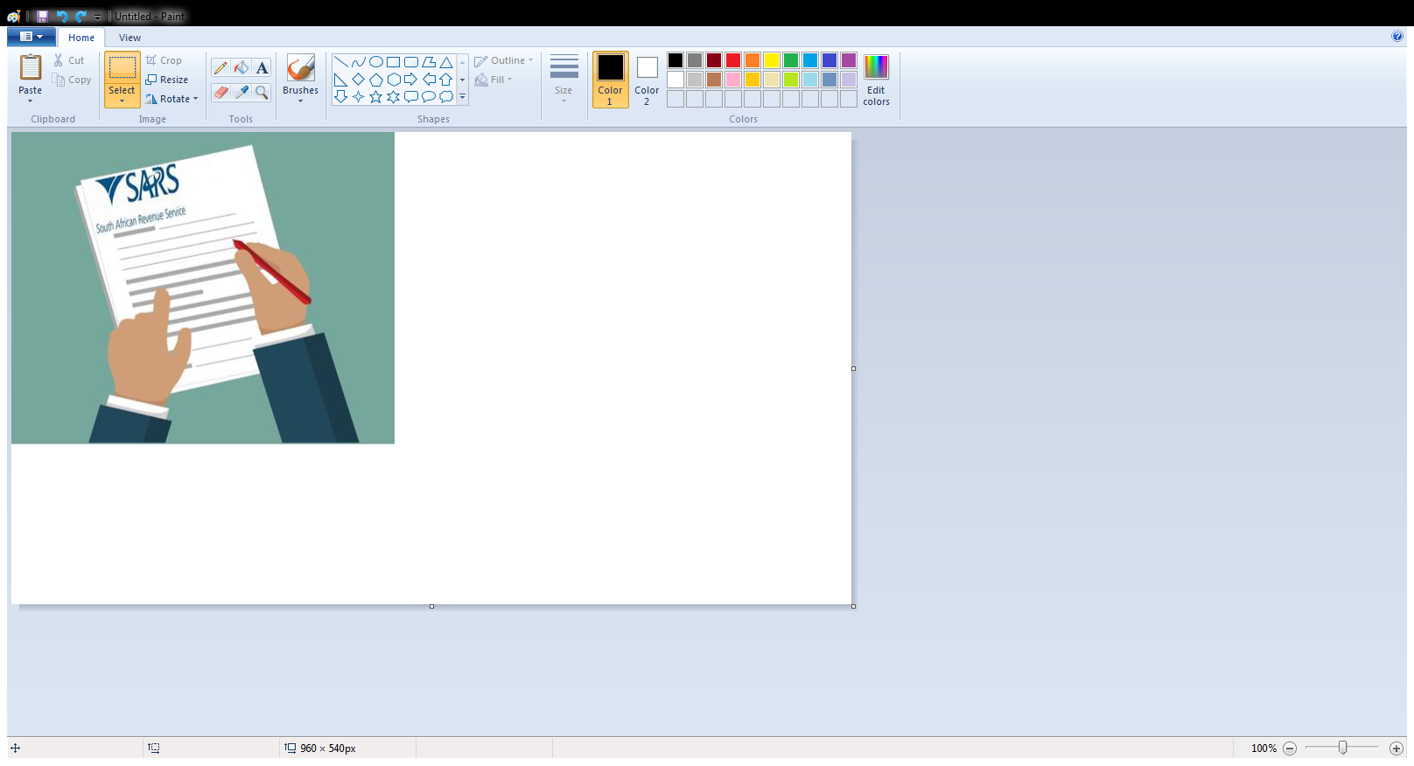
Declaration on eFiling
Supporting documents
Levy Product | Form | Supporting Doc(s)
Tyres (TLE) | EXD 178 | DA 178
Plastic Bags (ELG) | EXD 161 | DA 161A
Electricity (ELC) | EXD 176 | DA 176
Carbon Emissions for Motor Industry (CO2) | EXD 177 | DA 177
Carbon Tax (CBT) | EXD 180 | DA 180 and all annexures
Sugar (SBL) | EXD 179 | DA 179

Slide 47
Compliance

Slide 48
Compliance
Penal provisions
Penalties are imposed in accordance with the specific Sections 78 to 86A commonly termed “the penal provisions’
The Act distinguishes between less serious offences and serious offences and the severity of penalties increases with regard to the extent of the infringement

Slide 49
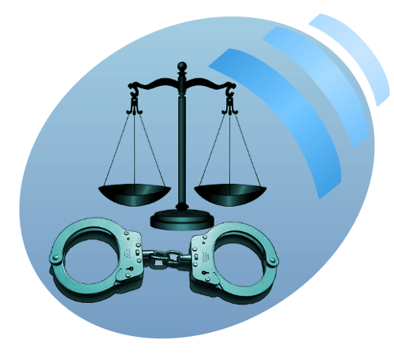
Compliance
Penalties
Failure to adhere to the provisions of the excise duty Act is considered an offence.
Offences may render the client liable to:
  Monetary penalties;
  Criminal prosecution; and/or
  Suspension and/or cancellation of their deferment account, registration, license, accreditation and/or designation.

Slide 50
Contact Us
For more information, visit the:
  SARS YouTube channel www.youtube.com/sarstax
  SARS website on www.sars.gov.za

Slide 51


