Slide 1
e@syFile Re-platform

Slide 2
Presenter
Welile Nhlapo
Assisted By
Nokuthula Mbatha
Options
Ai Assistant Icon
2

Slide 3


e@syFile TC
e@syFile Replatform Version 8 Released as an upgrade to the e@syFile Flex Version:
Updated technology
Enhanced Security Features

Slide 4
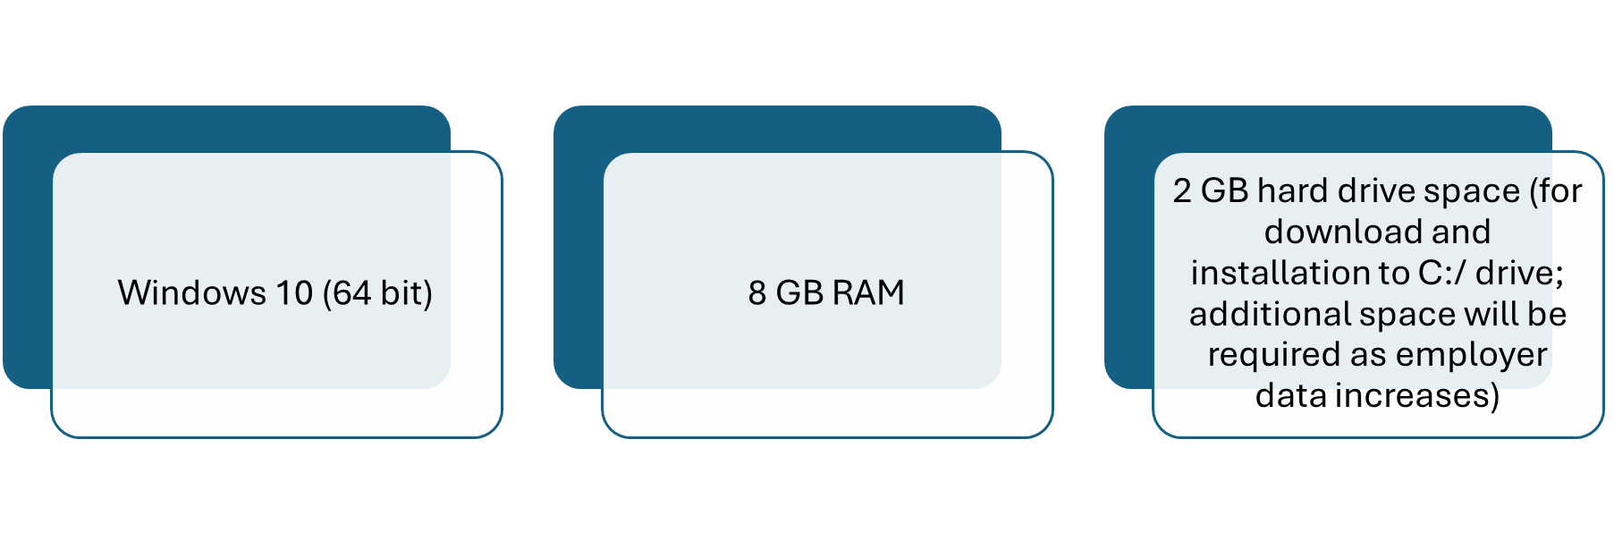
Minimum System requirements

Slide 5
Overview
•Installation of e@syFile Thin Client
•e@syFile functionality overview
•Dos and Don’ts
•e@syFile & eFiling interconnectivity
•Bi-Annual enhancements

Slide 6
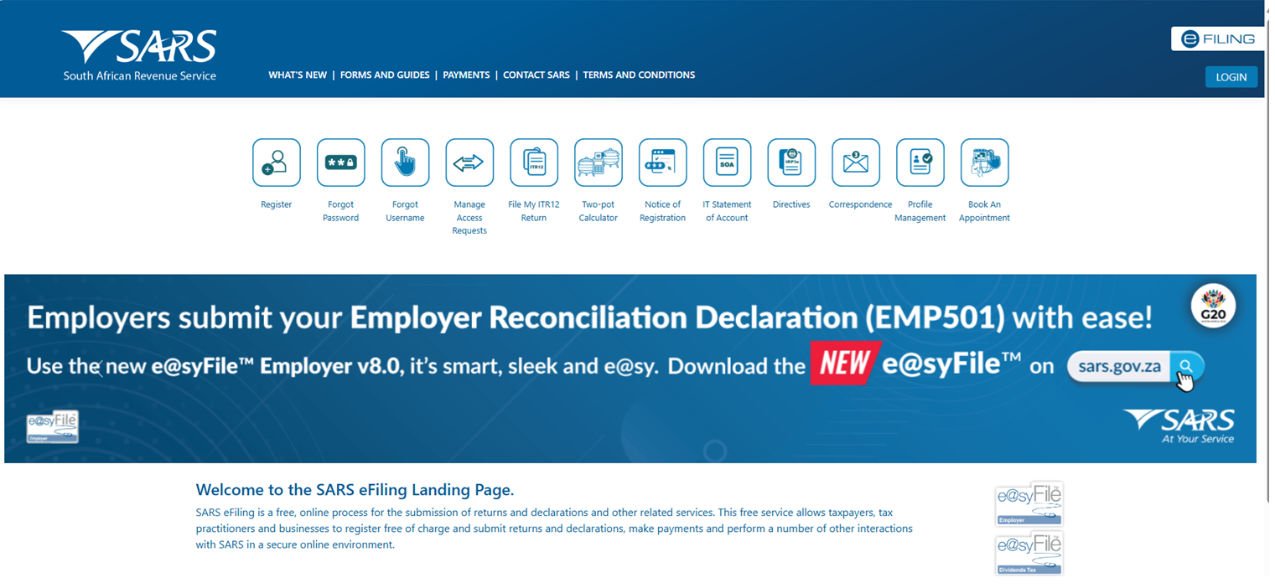
e@syFile Download Page

Slide 7
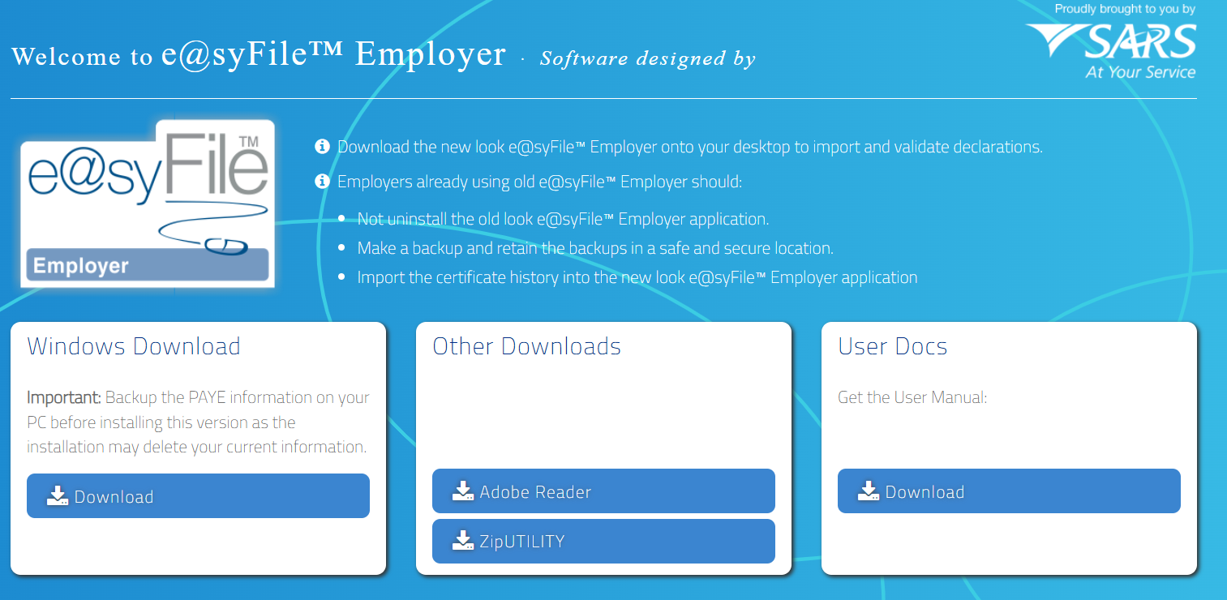
e@syFile Download Page

Slide 8
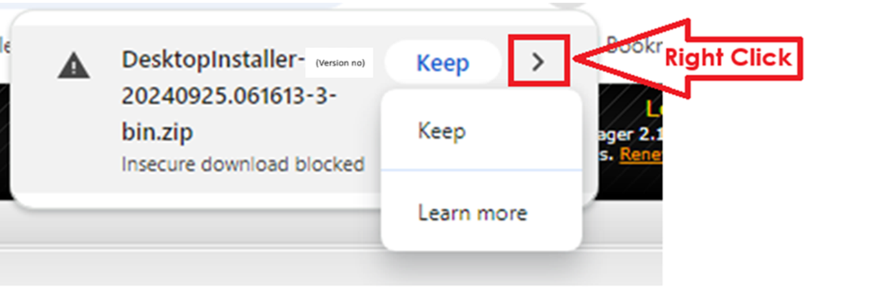
Should you encounter an error for insecure file download please follow instruction below

Slide 9
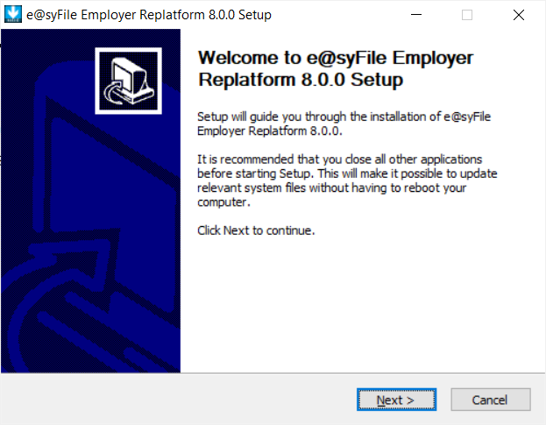
e@syFile TC

Slide 10
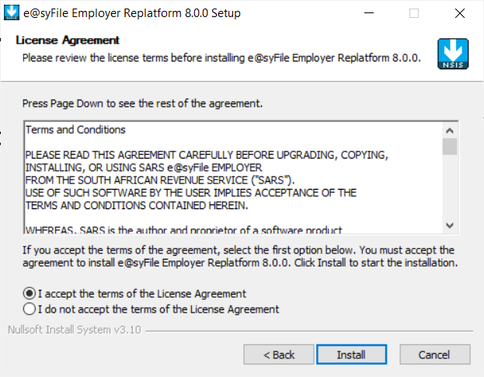
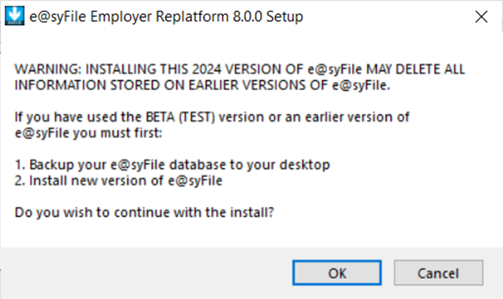
Installation Process

Slide 11

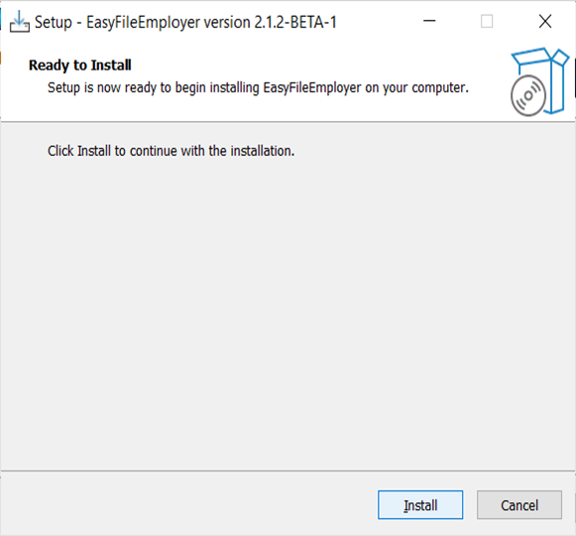
Installation Process

Slide 12
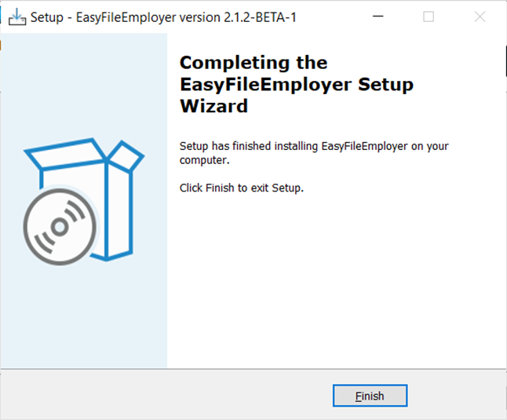
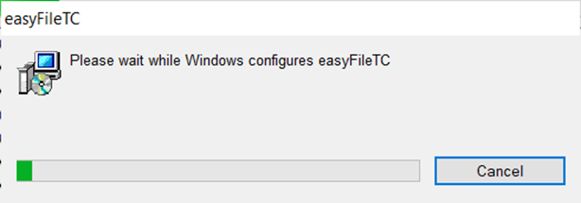
Installation Process

Slide 13
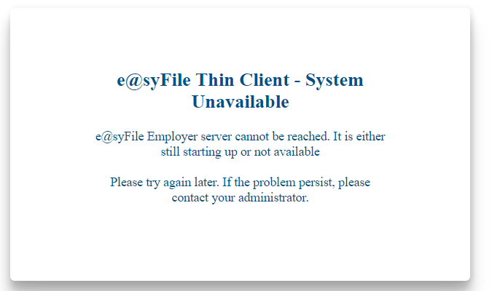
Installation Process
Should this error be experienced, please wait a couple of minutes for the services to start and relaunch the application.
If the problem persist, please check that the e@syFile server is running in the Task Manager.
Open the Task Manager > Click on “Services” (or the jigsaw puzzle icon) > search for “EasyFileServer”, and check that it is running.

Slide 14
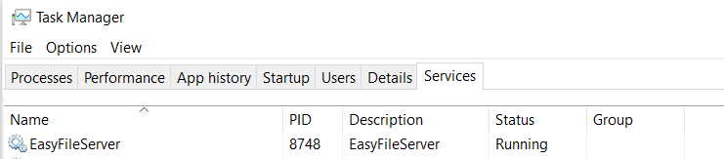
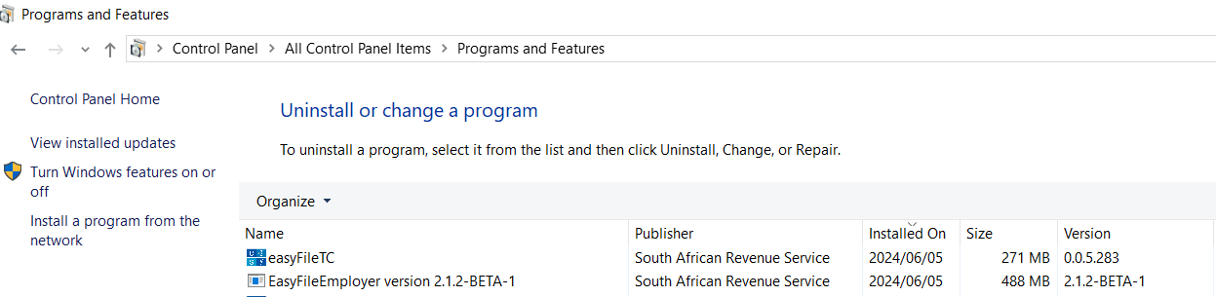
Installation Process
E@syFile Service
e@syFile Installations

Slide 15


Installation Process
Desktop Icon
Taskbar Icon
e@syFile can be launched from Desktop Icon and will display the Taskbar Icon once opened.

Slide 16
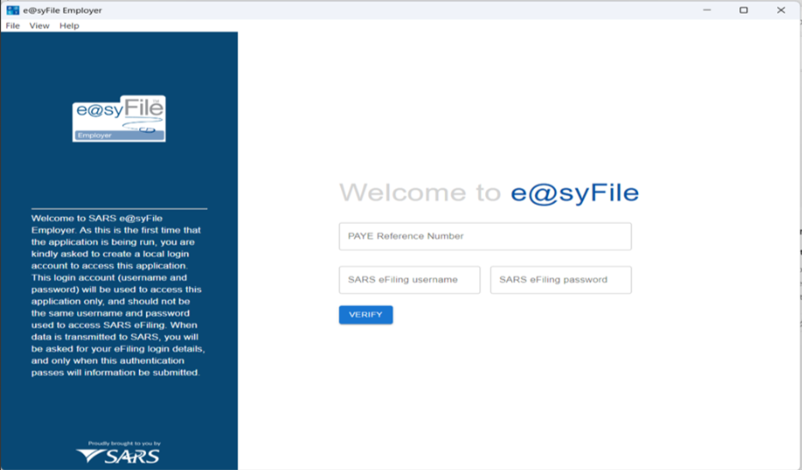
Database Registration

Slide 17
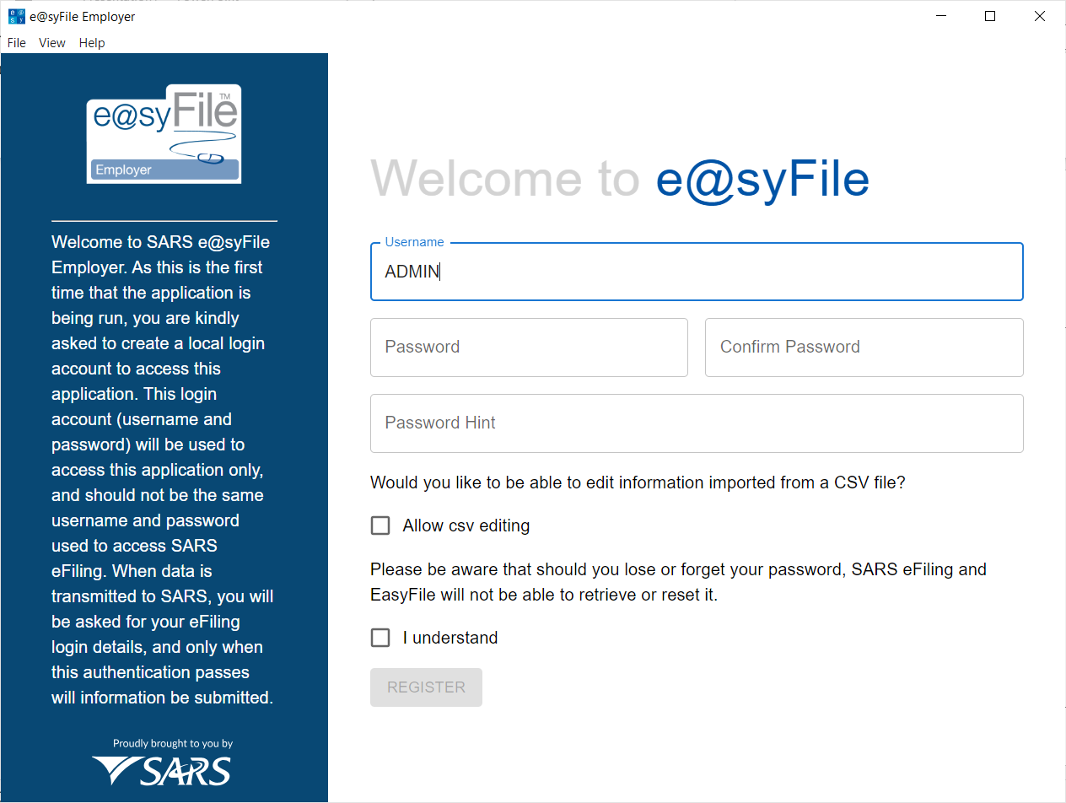

e@syFile login details
Upon initial startup, an administrator
password must be setup. This login details will be
used to access the e@syFile database.
Note: e@syFile will require eFiling login details in addition to the e@syFile login details, which is linked to the database for added security.

Slide 18
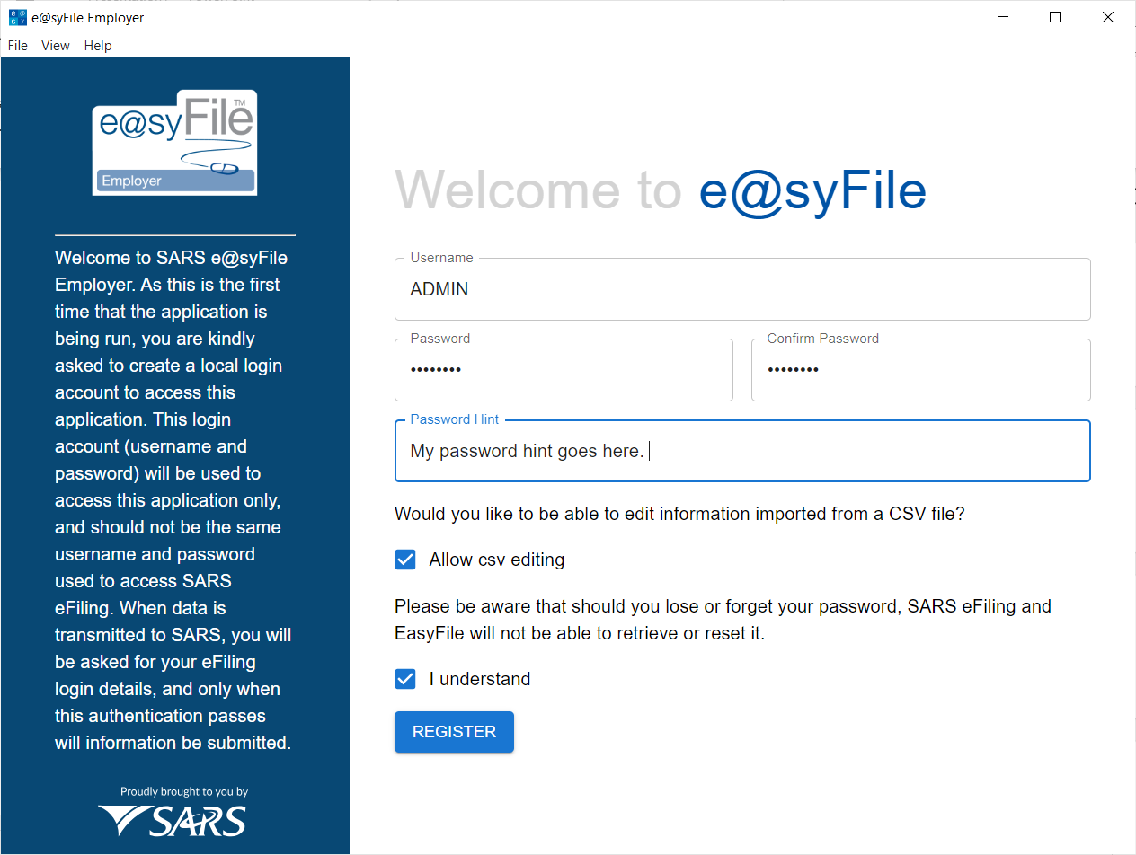
e@syFile login details
Create a password that contains a
A capital letter
A small letter
A number
A special character
And must be 6 long
Ensure “Password” and “Confirm Password”
is the same
Once “I understand” is ticked the “Register”
button opens and can be selected.

Slide 19
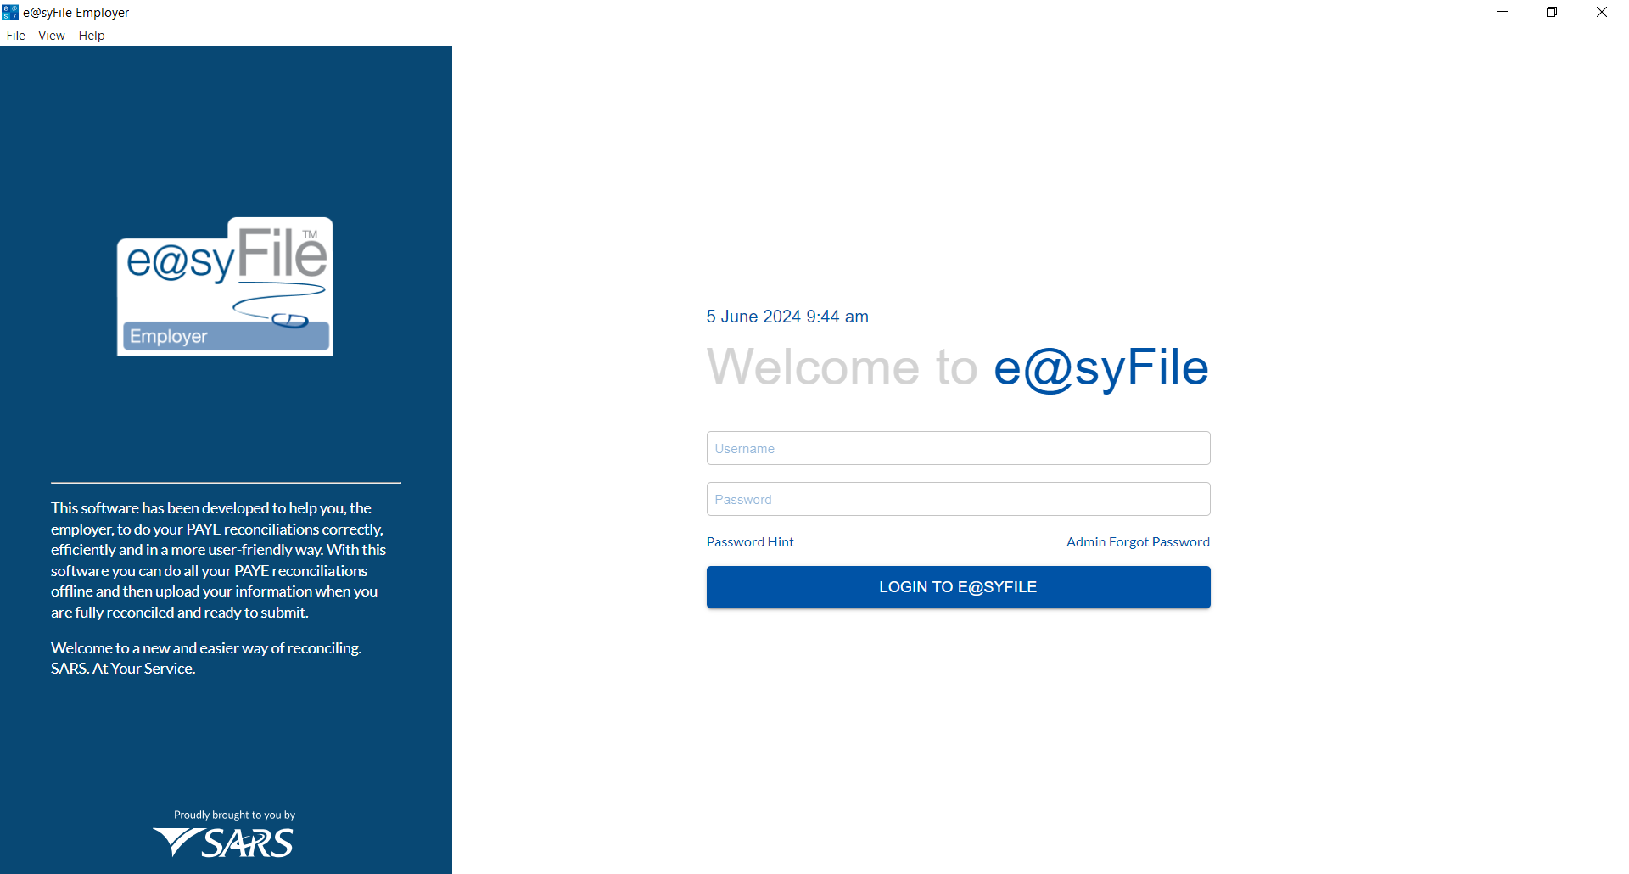
e@syFile login details
Enter the Username and Password
Password Hint & ADMIN forgot Password is available

Slide 20
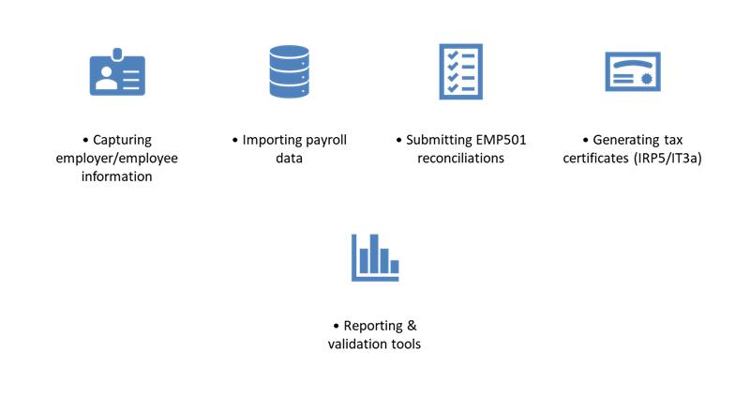
e@syFile Functionality

Slide 21
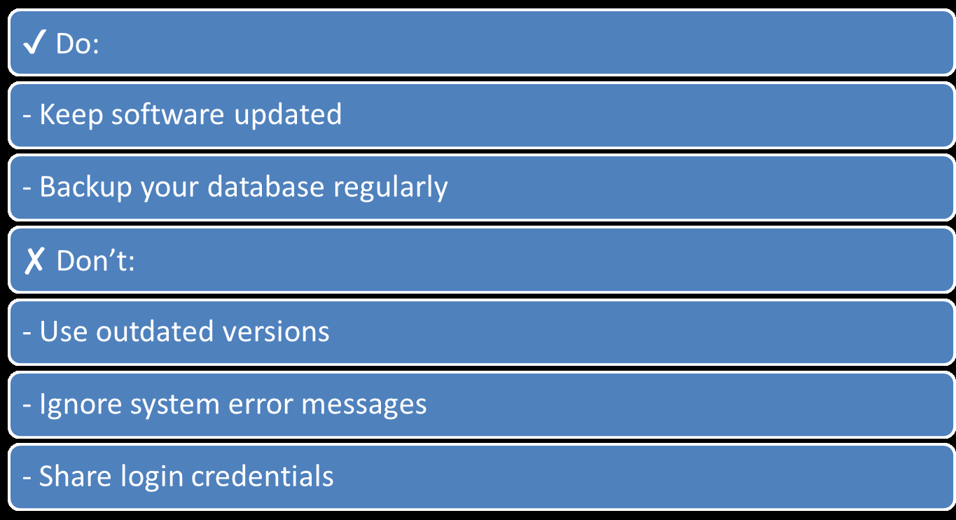

Slide 22
Live Demonstration

Slide 23

Options
Ai Assistant Icon

