Slide 1
South African Revenue Service
Income Tax For Resident Artists

Slide 2

Welcome to the
SARS
SMME Tax Workshop
Purpose:
This presentation is merely to provide information in an easily understandable format and is intended to make the provisions of the legislation more accessible
Disclaimer:
The information therefore has no binding legal effect and the relevant legislation must be consulted in the event of any doubt as to the meaning or application of any provision.

Slide 3
To build a smart modern SARS with unquestionable integrity, trusted and admired by Government, the public, as well as our international peers.
For the purpose of this presentation, we focus on the following strategic objectives:
SARS Vision 2024
MAKE IT EASY & SIMPLE TO COMPLY
MODERNIZE SYSTEMS TO PROVIDE SEAMLESS ONLINE DIGITAL SERVICES
MAKE IT HARD TO NOT COMPLY
CREATE AWARENESS, CLARITY & CERTAINTY
USE DATA FOR INSIGHTS, RISKS & IMPROVED OUTCOMES

Slide 4
Points of Discussion
Why do we Pay Taxes?
Administrative penalties
Remuneration
Do you need to submit a tax return?
Completing an Income Tax Return ITR12
Royalties received
Record Keeping
Tax threshold, rebates, tax credits and Tax Rates
Reduction Process
Provisional Tax

Slide 5
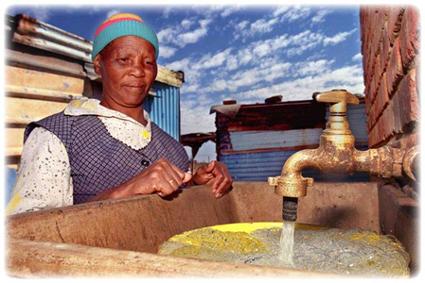

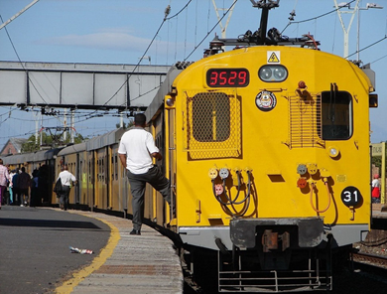
Why do we pay taxes?
Every government is mandated to provide basic services to
citizens
Basic services include:
  Education
  Health
  Welfare (Child Grants/Old Age Pensions)
  Policing
Every citizen enjoys the benefits of one or other government
basic services
4

Slide 6
Remuneration
Definition
Remuneration is an amount of income that is paid or becomes payable for services rendered or for some other reason. It does not matter whether the amount is in cash or otherwise (in kind).
Date of Receipt
Amount actually received
For the benefit of that person
Date of Accrual
Became entitled to
Not necessarily received

Slide 7

In Cash or Otherwise
Remuneration
Two basic principles apply:
In Cash
Or Otherwise
  Monetary amount received
  Receipts or Accruals can be in any form other than money
  Amount determined, for example at market value

Slide 8
Resident
Remuneration
Taxed on worldwide income if:
Ordinarily Resident of RSA
Is it his/her permanent home?
Where will he/she return to if job is done?
Is it his/her intention to return to his/her permanent home?

Slide 9
Remuneration
Remuneration Example 1
The table below gives an example of how the combined taxable income is calculated in the case of a taxpayer who is over the age of 65 years and receives an income of R240 000 from agent A and R160 000 from agent B during the 2022 tax year.
​ | ​Agent A | ​Agent B | ​Assessment
Taxable income​ | ​240 000 | ​160 000 | 400 000
​Normal tax payable | 18 895 | ​3 375 | ​62 840
​Less: Tax paid in the form of PAYE withheld by Agent A and Agent B | ​18 895 | ​3 375 | ​22 270
​Amount due by taxpayer on assessment | ​ | ​ | ​40 570

Slide 10
Remuneration
Remuneration Example 2
The table below gives an example of how the combined taxable income is calculated in the case of a taxpayer who is over the age of 65 years and receives an income of R240 000 from agent A and R80 000 from agent B during the 2022 tax year.
​ | ​Agent A | ​Agent B | ​Assessment
Taxable income​ | ​240 000 | ​80 000 | 320 000
​Normal tax payable | 18 895 | ​0 | ​39 695
​Less: Tax paid in the form of PAYE withheld by Agent A and Agent B | ​18 895 | ​0 | ​18 895
​Amount due by taxpayer on assessment | ​ | ​ | ​20 800

Slide 11
Income From More Than One Source
Remuneration
Scenarios below are not exhaustive
A taxpayer that is employed and is receiving an income from a deceased spouse pension.
A retired taxpayer that is earning his monthly pension and getting income from a retirement annuity fund.
An employed taxpayer that has other trading activities that will earn him extra income besides his salary.
A pensioner/employed taxpayer that is receiving investment income(interest) that is above the exempted amount.

Slide 12
Reduction Process
Gross Income
Gross Income is all the employees/taxpayers income except capital receipts or accruals (e.g. payments received for the sale of your home or any assets, etc.)

Slide 13
Reduction Process
Exemptions
Interest from a South African source, earned by any natural person are exempt from income tax.
under 65 years of age, up to R23 800 per annum
persons 65 and older, up to R34 500 per annum,

Slide 14
Reduction Process
Deductions
The act prescribes that a taxpayer/ employee may deduct certain expenses/contributions that they have paid from their income. Expenses such as retirement annuity fund contributions, pension fund contributions, etc. may be allowed.
Taxable income is the portion of your gross income used to calculate how much tax you owe in a given tax year. In order to determine the amount of tax to pay on assessment, it is important to first determine what the “taxable income” is. The determination of taxable income is thus the first step in the calculation for normal tax.
In order to determine your taxable income, there is a step-by-step process which must be followed. This process is called the reduction process. An example below:

Slide 15
Reduction Process
GROSS INCOME TABLE
 | R
Gross Income | xxxxxxxxx
Less: Exemptions (tax-free amounts, local interest) | (xxxxxxxx)
Income | xxxxxxxxx
Less: Deductions (travel, subsistence / RAF) | xxxxxxxxx
 | xxxxxxxxx
Add: Taxable capital gain | xxxxxxxxx
TAXABLE INCOME | XXXXXXXX

Slide 16
Tax threshold, rebates and Tax Rates
Tax rates from 1 March 2022 to 28 February 2023:
Income Tax: Individuals
Taxable Income (R) | Rate of Tax (R)
1 – 226 000 | 18% of taxable income
226 001 – 353 100 | 40 680 + 26% of taxable income above 226 000
353 101 – 488 700 | 73 726 + 31% of taxable income above 353 100
448 701 – 641 400 | 115 762 + 36% of taxable income above 488 700
641 401 – 817 600 | 170 734 + 39% of taxable income above 641 400
817 601 – 1 731 600 | 239 452 + 41% of taxable income above 817 600
1 731 601 and above | 614 192 + 45% of taxable income above 1 731 600
15

Slide 17
Individual tax thresholds and rebates
Tax Threshold
Rebates
Age | 2023 | 2022 | 2021
Primary (Under 65 years) | R91 250 | R87 300 | R83 100
Secondary ( Age 65 to 74) | R141 250 | R135 150 | R128 650
Tertiary (Age 75 & above) | R157 900 | R151 100 | R143 850
Tax Rebate | 2023 | 2022 | 2021
Primary (Under 65 years) | R16 425 | R15 714 | R14 958
Secondary ( Age 65 to 74) | R9 000 | R8 613 | R8 199
Tertiary (Age 75 & above) | R2 997 | R2 871 | R2 736

Slide 18
Royalties Received
Entertainers who receive Royalties may become liable to pay tax on those royalties received in the country of the payer of the royalty, and the payer may become liable to withhold tax on royalty payments.
In RSA, withholding tax on royalties and the rights to tax royalties are dealt with in most, if not at all of the double taxation agreements concluded by RSA.
Royalties received will be included in Gross Income if they are RSA sources. It is necessary to establish where the true source of the royalty. If the source is entirely RSA, the royalty must be included in the resident’s gross income.

Slide 19
Royalties Received
If the true source of the royalty is outside the Republic, but it results from the use of a royalty-producing asset in RSA, then gross royalty is subject to the withholding tax on royalties. Section 35 subjects the gross royalty to a final tax of 12%. Therefore no deductions are made against the amount of this royalty.
It is only when the true source of a royalty (other than copyright royalty)is in the Republic that a non- resident will be subject to normal tax in the Republic on the royalty.

Slide 20
Provisional Tax
What is provisional Tax?
Provisional tax is not a separate tax from Income Tax.
It is a method of paying tax due, to ensure the taxpayer does not pay large amounts on assessment, as the tax liability is spread over the relevant year of assessment.
It requires the taxpayers to pay at least two amounts in advance, during the year of assessment, which are based on estimated taxable income.
A third payment is optional after the end of the tax year, but before the issuing of the assessment Final liability, however, is worked out upon assessment and the payments will be off-set against the liability for normal tax for the applicable year of assessment.

Slide 21
Provisional Tax
What is provisional Tax?
Provisional tax is not a separate tax from Income Tax.
It is a method of paying tax due, to ensure the taxpayer does not pay large amounts on assessment, as the tax liability is spread over the relevant year of assessment.
It requires the taxpayers to pay at least two amounts in advance, during the year of assessment, which are based on estimated taxable income.
A third payment is optional after the end of the tax year, but before the issuing of the assessment Final liability, however, is worked out upon assessment and the payments will be off-set against the liability for normal tax for the applicable year of assessment.

Slide 22
When must Provisional Tax be paid?
First period:
This payment must be made within six months from the commencement of the year of assessment in question.
This means that for the year of assessment that starts on the 1 March and end on the 28/29 February, the first period for which provisional tax becomes due will be the period ending 31 August.
Second period:
This payment must be made not later than the last day of the year of assessment in question.
This means that for the year of assessment that starts on the 1 March and end on the 28/29 February, the second period for which Provisional Tax becomes due will be the period ending on the 28/29 February.

Slide 23
When must Provisional Tax be paid?
Third period:
This payment also known as “additional” or “topping-up” provisional payment must be paid not later than the ‘effective’ date’ The effective’ date’ is:
Where the year of assessment ends on 28/29 February the effective date is seven months after the financial year-end, which is 30 September.
For an approved financial year-end which ends on a date other than 28/29 February, the effective date will be six months after the financial year end e.g. financial year end is 30 April 2015, the effective date will therefore be 31 October 2016.
The payment in the third period is a voluntary payment which any provisional taxpayer can make.
However, taxpayers (other than companies) with a taxable income more than R50 000 or companies with a taxable income of R20 000 or more, may make a third voluntary payment to avoid interest in terms of section 89quat(2) being levied on any underpayment of tax on assessment.

Slide 24
Completing an Income Tax Return ITR12
Taxpayers need to submit a tax return to SARS so that the final tax liability can be calculated based on the income the taxpayers declare and the tax-deductible expenses incurred for a year of assessment. In some cases it may result in a refund.
The annual Filing Season is when taxpayers will be required to submit a return. For individuals, it is announced year by the SARS Commissioner.

Slide 25
Completing an Income Tax Return ITR12
An Income Tax Return may be requested, completed and file through the following submission channels:
SARS MobiApp
SARS eFiling
SARS Branch (through an appointment)

Slide 26
Administrative penalties and Payments
What is an Administrative Penalty?
An Administrative Penalty (Admin Penalty) is a penalty levied under Section 210 of the Tax Administration Act (TAA). The Act prescribes the various types of non-compliance which are subject to fixed administrative penalties.
For individuals the penalty will be imposed where the taxpayer has failed to submit a return as and when required under the Income Tax Act for years of assessment commencing on or after 1 March 2006 where that person has two or more outstanding income tax returns for such years of assessment.

Slide 27
Administrative Penalties and Payments
Taxpayers who do not submit their tax returns will be charged an admin penalty which must be paid over to SARS.
Regardless of whether you agree or disagree with the admin penalty it is advisable to submit the outstanding return to stop further admin penalties. The penalty will reoccur for every month the return(s) remains outstanding for a maximum of 35 months.
The administrative non-compliance penalty for the failure to submit a return comprises fixed amount penalties based on a taxpayer’s taxable income and can range from R250 up to R16 000 a month for each month that the non-compliance continues.

Slide 28
Administrative Penalties and Payments
What if I do not agree with the penalty?
A Request for Remission (RFR) can be submitted when a taxpayer disputes any penalty levied due to non-compliance. The taxpayer must provide reasons for the non-compliance for the request to be considered.
If the Request for Remission is disallowed or only a portion was selectively allowed, you may still object to the decision made by SARS and even appeal the decision if you disagree with the outcome of the objection process.

Slide 29
Record Keeping
There are many different ways to keep records
Choose a way of keeping records in a way that suits your business
• Keep your invoices, till slips and other information together
• Have separate bank account, so that your personal and business expenses doesn’t get mixed up
Business records must include all of the following:
• Assets
• Liabilities
• Undrawn profits
• Revaluation of fixed assets
• Loans

Slide 30
Record Keeping
To enable you to complete your tax returns accurately
Documentary proof are essential to enable you to claim actual expenses incurred
Expenses may be overlooked, unless you record them at the time they are incurred
All documents must be kept for a period of 5 years from date of submission of the return

Slide 31
Turnover Tax
What is Turnover Tax?

Slide 32

Decision making factors
Record keeping too much of a burden or too expensive
Current tax system is technically too difficult to comply with
Costly to hire a tax practitioner to meet the requirements of the current tax system
If business is in a “assessed loss” situation it may be better to stay in the current tax system

Slide 33
Turnover Tax Rates
These rates have not changed for the last 6 years
Taxable Turnover ( R ) | Rate of Tax ( R )
0 – 335 000 | 0% of taxable turnover
335 001 – 500 000 | 1% of taxable turnover
500 001 – 750 000 | 1 650 + 2% of taxable turnover
750 001 and above | 6 650+ 3% of taxable turnover
32

Slide 34

Tax Comparison
Example: Company A: Sales = R600 000
Expenses = R180 000
Taxable Income = R420 000
 | Taxable Income PIT | Taxable Income Company | Taxable Income Company SBC | Turnover Tax | Amount Due
Sole Proprietor | 70 532 + 31% of taxable income above R 337 800 |  |  |  | R 96 014
Company |  | 420 000 X 28% |  |  | R 117 600
Company SBC |  |  | 19 439 + 21% of taxable income above R 365 000 |  | R 30 989
Turnover Tax |  |  |  | R1650 + 2% of taxable turnover above R500 000 | R 3650

Slide 35
Tax Obligations
Whether as a self-employed individual or business, you are required to register your business with SARS, file your tax returns and pay the required taxes on time.
Tax Return submission periods per tax type
Tax type | Submission frequency | Tax Form | Notes
Company Income Tax (CIT) | Once a year as per company’s financial year end | ITR14 | The company has 12 months to submit the ITR14 after the financial year-end. The financial year end is indicated on the company registration certificate from CIPC
Personal Income Tax (for self-employed individuals) | Once a year as announced by SARS during filing season | ITR12 | Sole traders, self-employed and individuals in a partnership should declare their business income on their ITR12

Slide 36
Tax Obligations
Tax type | Submission frequency | Tax Form | Notes
VAT | Every two (2) months before the 25th | VAT201 | The period will be allocated at registration and some companies may be required to submit every month
PAYE | Monthly on or before the 7th | EMP201 | The submission is due within seven (7) days after the month the tax was deducted from the employee.
Provisional Tax | Twice a year | IRP6 | For companies: The first submission is due six (6) months from the start of the financial year. The second submission is due at the end of your financial year. For individuals: the first submission is due on 30 August and second submission is due 28/9 February of each year.

Slide 37
Tax Obligations
Tax type | Submission frequency | Tax Form | Notes
Turnover Tax | Once a year | TT03 | The submission of turnover tax returns is done once a year in line with the company’s financial year-end or submission of the annual income tax returns, between 1 July and 31 January of the following year for individuals.
Employer reconciliation | End of October and end of May | EMP501 | First interim submission is due at end of October and final submission end of May

Slide 38

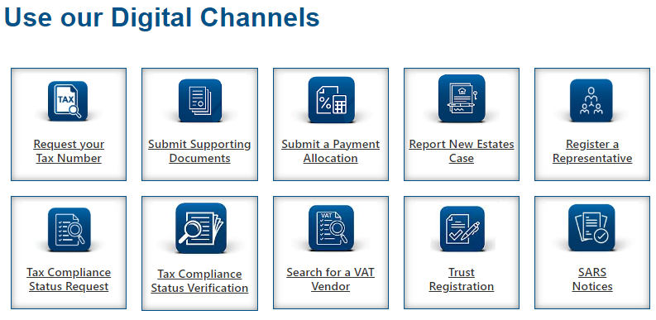
SARS Online Query System(SOQS)
For any related queries or submission of the supporting documents use the following channel:

Slide 39

Go digital
Remember to use our Digital Channels
We’ve made it easier for you
Go Digital!
  Register for eFiling via sars.efiling.co.za
  SARS Online Query System via sars.gov.za
Visit and follow us on our Social Media platforms
  Linked In Facebook Twitter
          Twitter
For more information, visit the:
  SMME webpage on the SARS website: www.sars.gov.za . This can be accessed on landing page
  SARS YouTube channel: www.youtube.com/sarstv

