Slide 2
Module 3: How to Register as a Tax Practitioner

Slide 3
Learning Objectives
At the end of this module, you are expected to:
  Understand how to register as a tax practitioner
  Understand how to configure your tax practitioner registration
  Understand how to add your tax practitioner portfolio to your eFiling profile

Slide 4
Tax Practitioner Registration Process via eFiling
The registration is a three-step process:
  First, register with a RCB as a tax practitioner. The RCB will then submit your details to SARS via eFiling platform for the RCB.
  Second, log onto eFiling using your log in details, and update your registered particulars indicating that you are a tax practitioner. This is done on the RAV01 (Registration, Amendments and Verification form).
  Third, once the information has been updated, you would need to select the RCB you belong to. If you are registered with more than one RCB, you need to select one of your choice. This RCB will be your RCB on the SARS system.

Slide 5
Tax Practitioner Registration Process via eFiling
Steps to Follow:
Log into your e-filing profile using your Primary user log in credentials.
Once logged in, navigate to the screen as shown on the next slide, in order to finalise the process of the registration.
Click on Home tab (Top left)
Maintain SARS registered details (left hand side tab)
The RAV01 will be generated.
Scroll down to “My Tax Practitioner details”

Slide 6
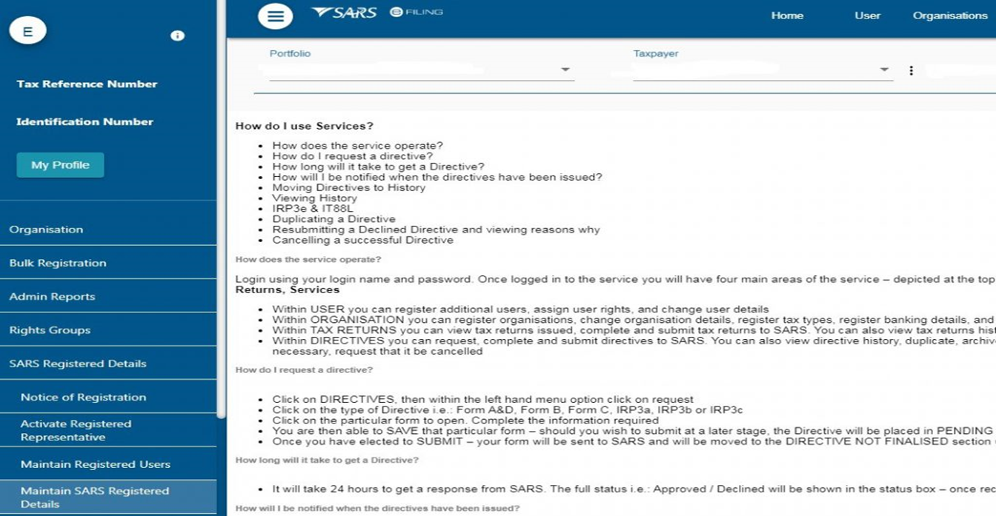
Tax Practitioner Registration Process via eFiling
Maintain SARS registered details tab (left hand side tab)

Slide 7
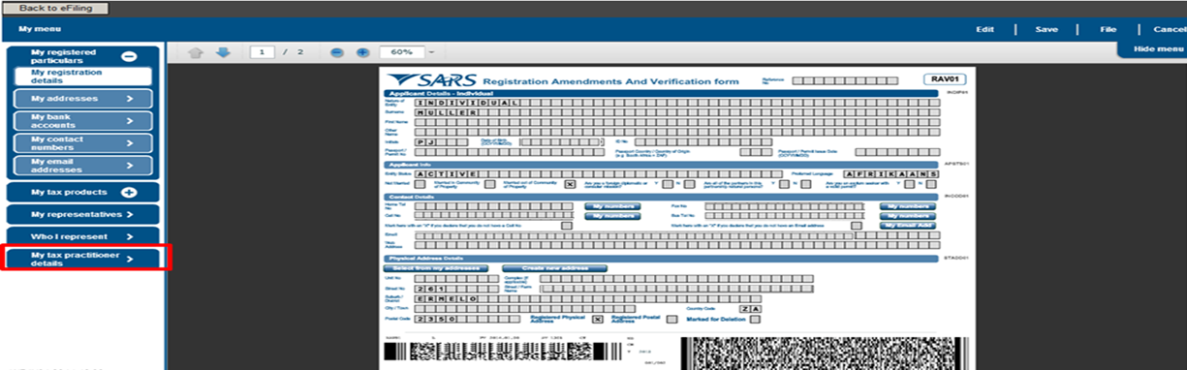
Tax Practitioner Registration Process via eFiling
The RAV01 form will generate with the fields that need to be completed
Registration Status – Registered or Unregistered
Registration Number
Appointment Date (CCYYMMDD) – indicates the date the tax practitioner was officially registered as a tax practitioner.
Controlling Body
Deactivate Registration

Slide 8
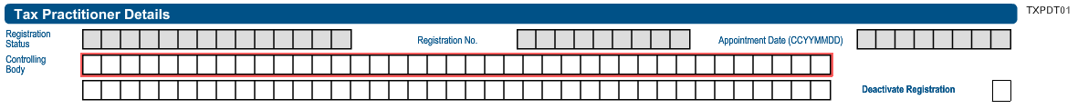
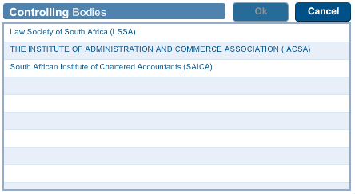
Tax Practitioner Registration Process via eFiling
If you are registered with an Recognised Controlling Body (RCB) and the RCB has submitted your information to SARS successfully, you need to select your RCB from the list of the RCBs in the Controlling Bodies' field. However, if you are not registered with an RCB or the RCB has not submitted your information to SARS, you will not be able to select an RCB, hence not able to complete the tax practitioner registration process.
Top tip: The tax practitioner’s status will only reflect as “Registered” on SARS systems once the RCB and the practitioner have successfully submitted information to SARS and the details match.

Slide 9

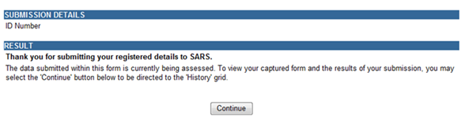
Tax Practitioner Registration Process via eFiling
After you have selected the Controlling Body, select the “Done” button on the RAV01 page to proceed.
After you have submitted the RAV01 form, you will receive the following message, select “Continue”:

Slide 10
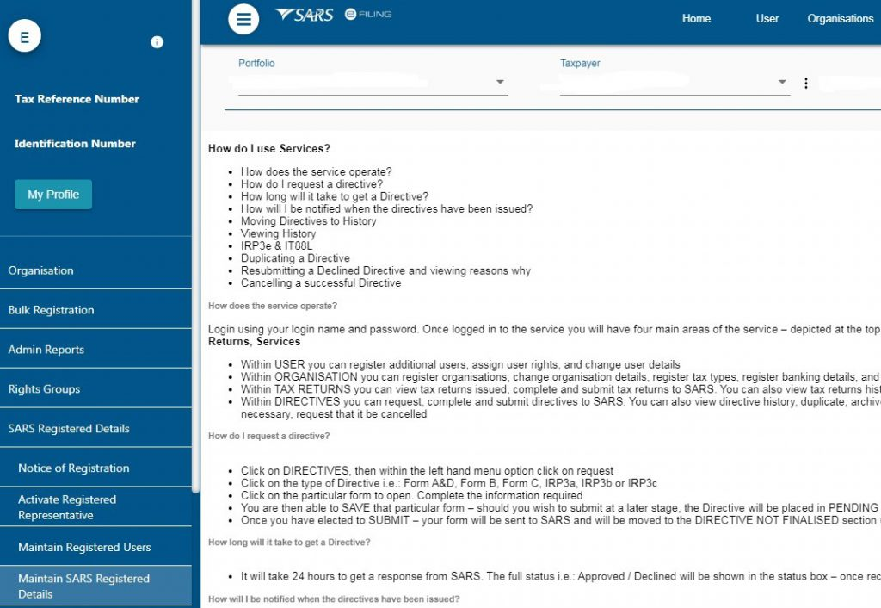
Tax Practitioner Registration Process via eFiling
You need to repeat this step, click on Maintain SARS Registered Details

Slide 11

Tax Practitioner Registration Process via eFiling
Click on my Tax practitioner details:
The PR number will be prepopulated.
The tax practitioner can now copy the PR number in order to configure it.

Slide 12
Tax Practitioner Registration Process via eFiling
Adding a tax practitioner portfolio to an existing Profile
A tax practitioner may register a new tax practitioner portfolio by clicking on
‘My Profile’ >>> ‘Portfolio Management’ >>>> ‘Add Portfolio’

Slide 13
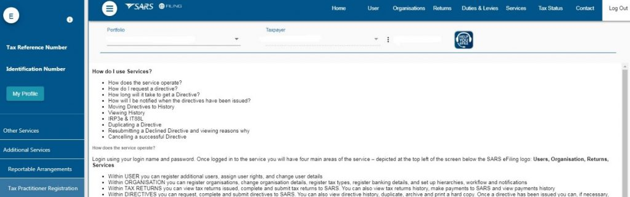
Tax Practitioner Registration Process via eFiling
Tax practitioner registration configuration
  This functionality enables tax practitioners to confirm their tax practitioner status at SARS and allow tax practitioners to link practitioner users to other activated practitioner user profiles.
  On the Organisation profile, ensure that the correct taxpayer is selected from the taxpayer list in the event of registering an individual as a tax practitioner.
  Select the “Services” menu tab and “Additional Services”. Click on “Tax Practitioner Registration

Slide 14
Tax Practitioner Registration Process via eFiling
Select: Activate Tax Practitioner

Slide 15

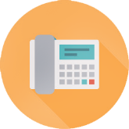



Thank you
www.sars.gov.za
SARS Contact Centre 0800 00 SARS (7277)
Visit your nearest SARS branch (to locate a branch visit www.sars.gov.za)
Open: Monday, Tuesday, Thursday & Friday 08:00 to 16:00; Wednesday 09:00 to 16:00
Find us on Facebook

