Slide 2
Module 6: eFiling

Slide 3
Learning Objectives
At the end of this module, you are expected to:
Understand how to add a new portfolio on eFiling,
Understand how to add a new client to a portfolio,
Understand how to add a tax type for the new client,
Understand how to invite a new user to a portfolio.

Slide 4
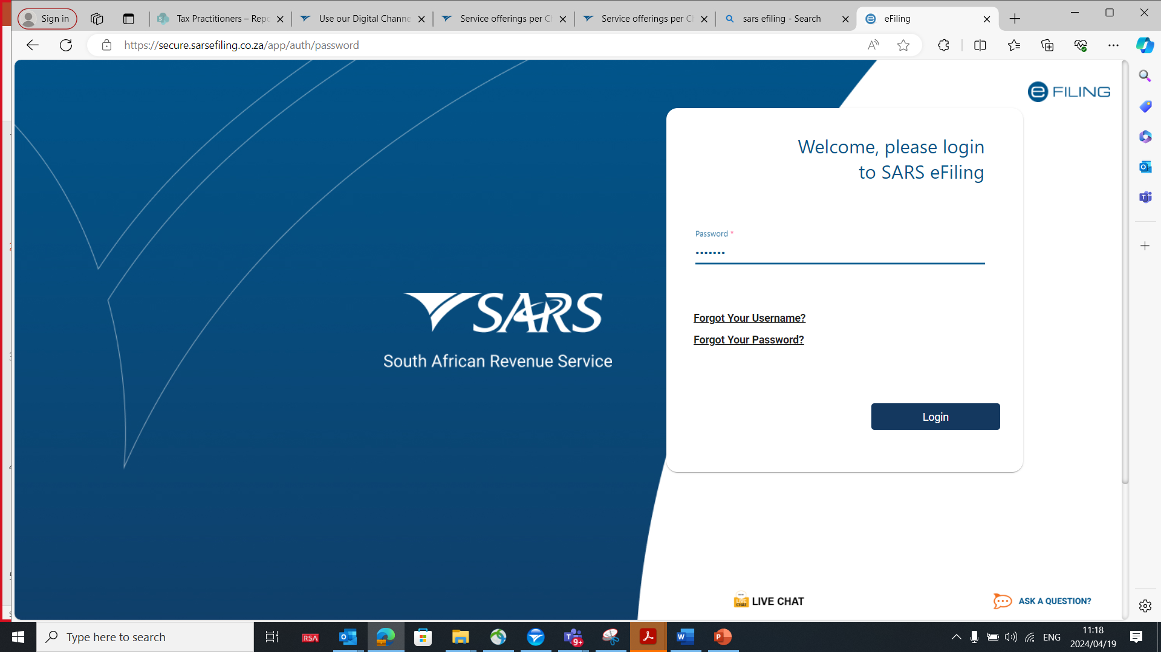
Login to SARS eFiling

Slide 5
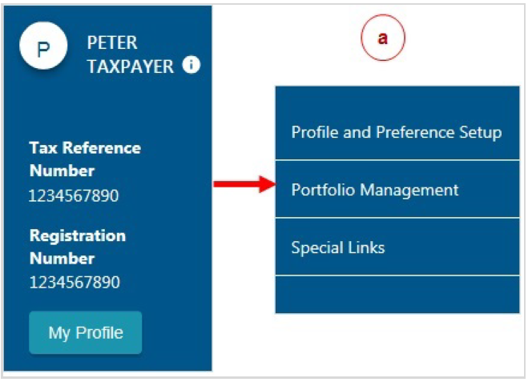
Portfolio Management
Click on “My Profile”, then click on “Portfolio Management”.

Slide 6
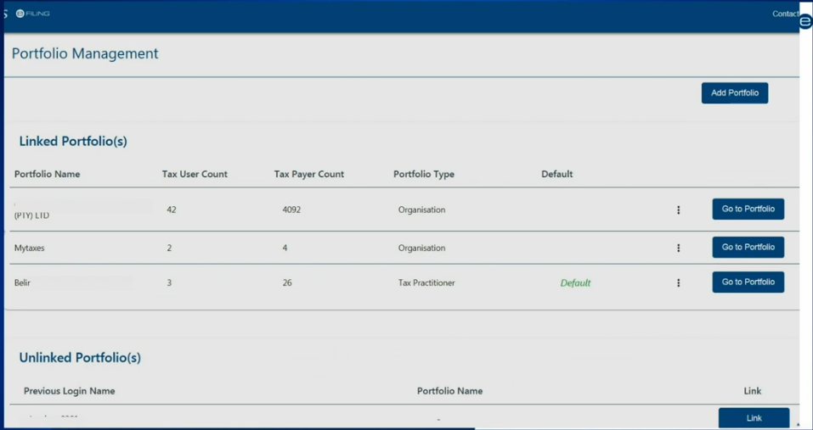
Portfolio Management
The Portfolio Management Screen will display for you to add a new portfolio.

Slide 7
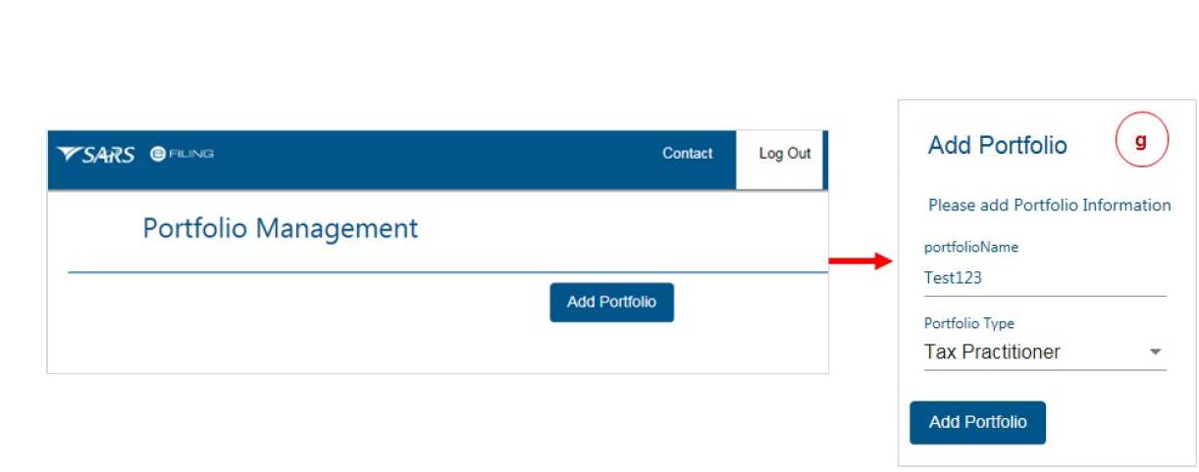
Portfolio Management
Click on “Add Portfolio”.
Enter the portfolio name and select the portfolio type from
the drop-down menu, click on “Add Portfolio”

Slide 8
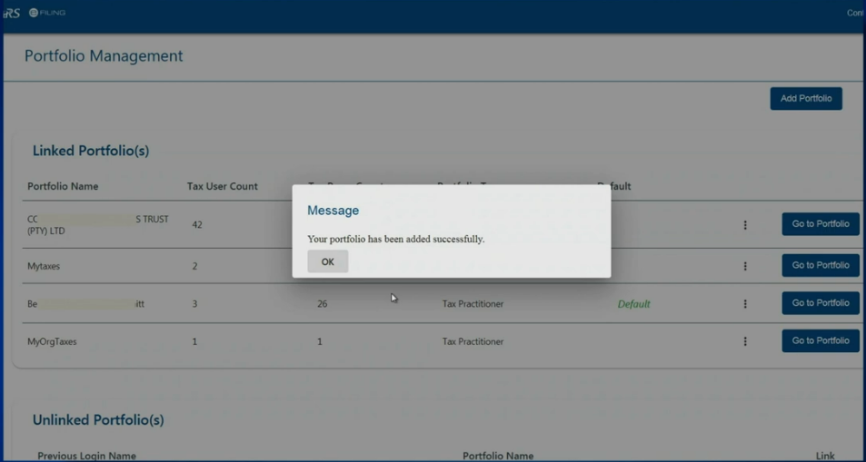
Portfolio Management
The new portfolio will be successfully added.

Slide 9
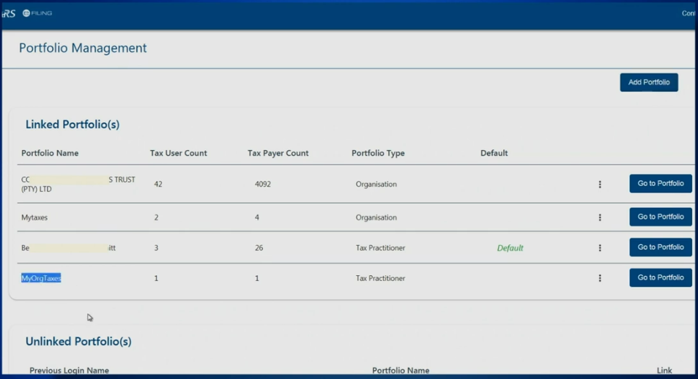
Portfolio Management
The added portfolio will be displayed under linked portfolios.

Slide 10
Adding New Client to a Portfolio
How to add clients to a portfolio? Click “Go To Portfolio” on the portfolio where you wish to add the client.

Slide 11
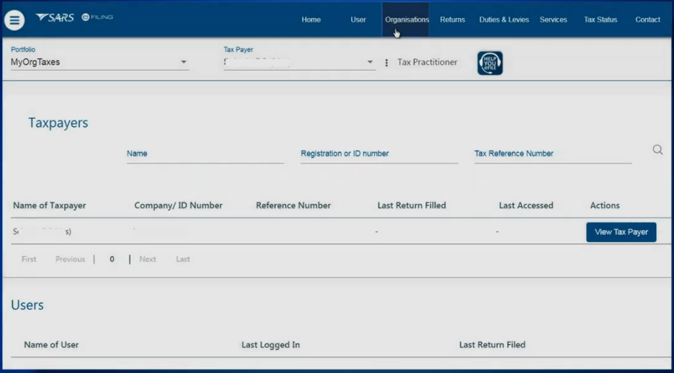
Adding New Client to a Portfolio
Click “Organisations” on the top of the screen

Slide 12
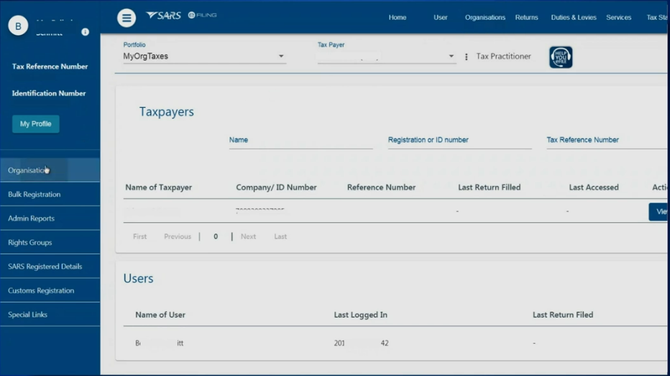
Adding New Client to a Portfolio
Then click “Organisations” on the left hand side of the screen

Slide 13
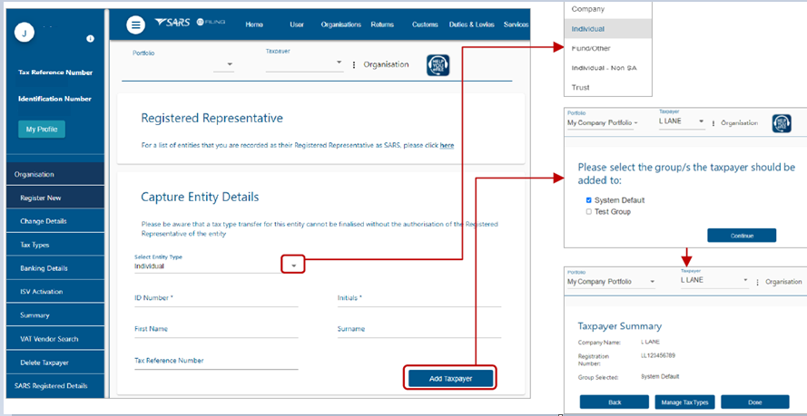
Adding New Client to a Portfolio
Select the submenu “Register New” to register a new client.
Select the Entity Type on the drop-down menu, then complete all the field and click “Add Taxpayer”

Slide 14
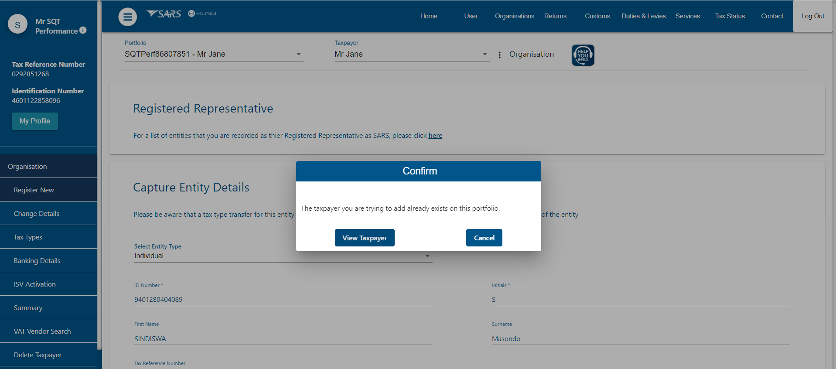
Adding New Client to a Portfolio
If the taxpayer you are adding already exists on your portfolio, you will get a message “The taxpayer you are trying to add already exist on this portfolio” Then click on “View Taxpayer”

Slide 15
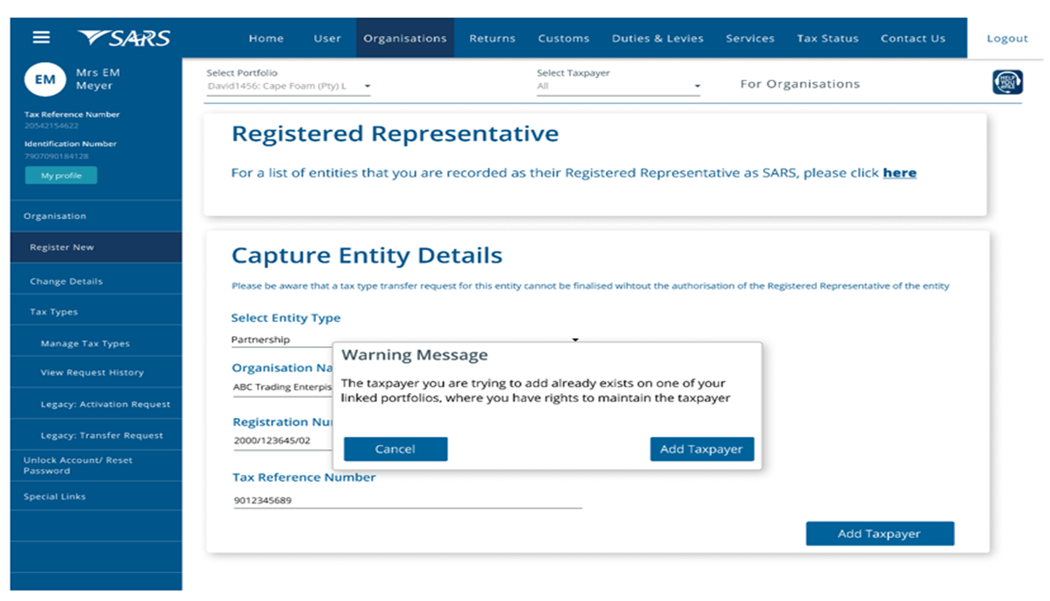
Adding New Client to a Portfolio
If the taxpayer you are adding already exist on a different portfolio, you will get the warning message. Click “Add Taxpayer” if you wish to register the taxpayer on this portfolio.

Slide 16
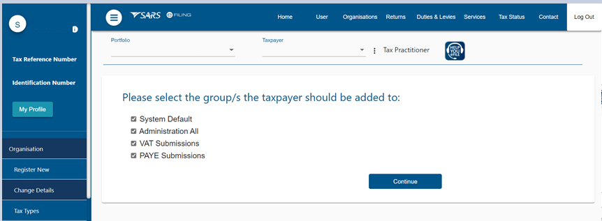
Adding New Client to a Portfolio
After adding the taxpayer, you must add the taxpayer to the group by selecting the group name and click “Continue”

Slide 17
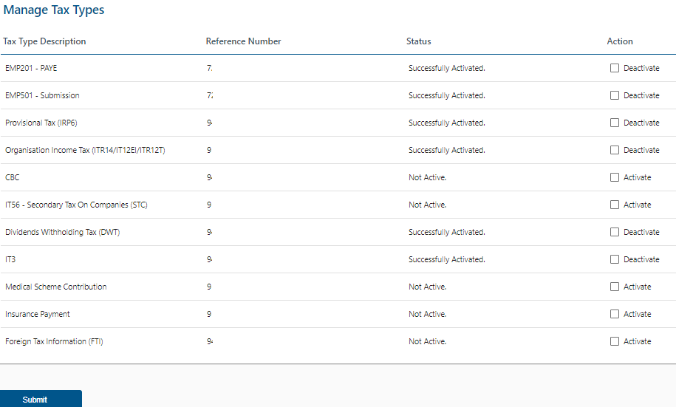
Adding a Tax type for the New Client
The list of tax types linked to the selected taxpayer
Reference numbers
Activation Status
Action that can be selected for that number (e.g. request activation, request tax type transfer, deactivate)
To activate or request transfer of tax types, tick the box under “Action” and click on “Submit” at the bottom.

Slide 18
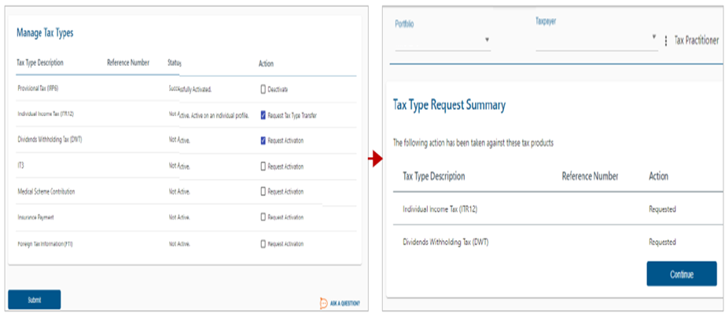
Adding a Tax type for the New Client
Select the tick-boxes for the applicable actions required (example): “Request Activation” or “Request Tax Type Transfer” and click on “Submit” the status will change to “Requested”, then click “Continue”.

Slide 19
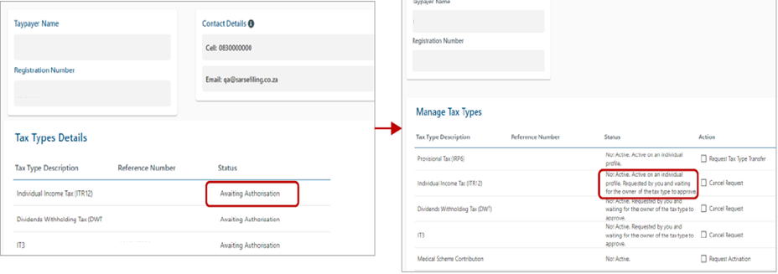
Adding a Tax type for the New Client
The status of the request will change to awaiting authorisation and will require the current Taxpayer/Representative of the tax number to authorise the request via the SARS website to complete the process.

Slide 20
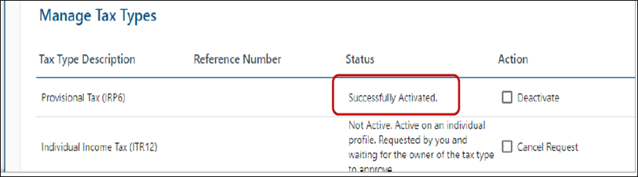
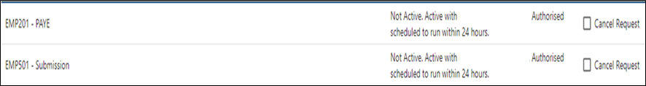
Adding a Tax type for the New Client
If the Taxpayer/Representative authorises the request to “Activate”, the status will change to “Successfully Activated”. If the taxpayer/representative authorises the request to transfer and there are previously submitted returns, the Status will change to “Authorised schedule to run within 24 hours” to allow the transfer of historical submissions.

Slide 21
Invite User
To Invite a new user to a portfolio, select the correct portfolio.
Click on “My Profile” on the left screen.
Then select “Portfolio Management”

Slide 22
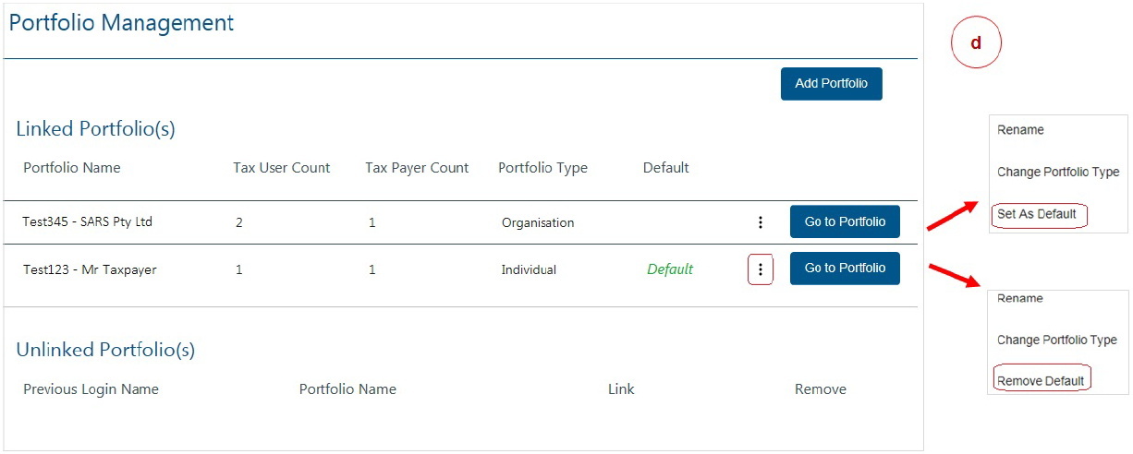
Invite User
Chose the portfolio by clicking on “Go to Portfolio”

Slide 23
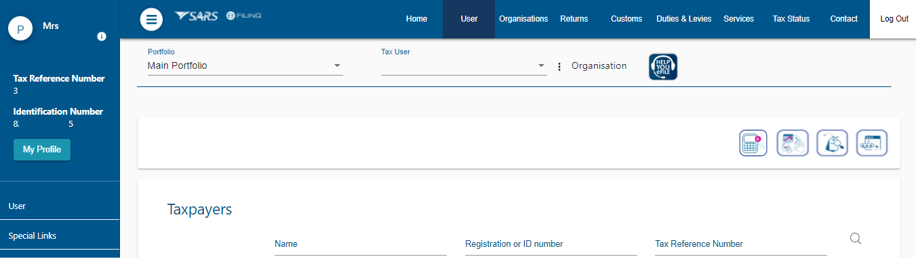
Invite User
Click on “User” from the top menu, then click on “User” on the left menu.

Slide 24
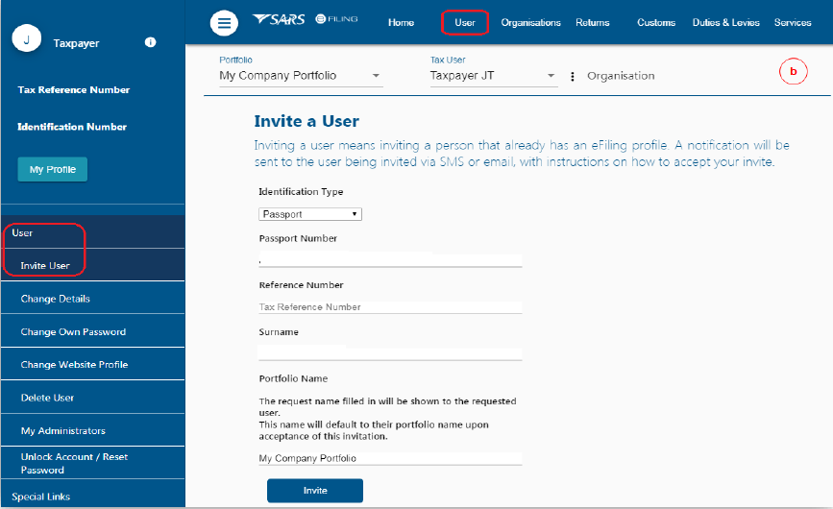
Invite User
Select “Identification Type”, Enter “ID number”, Enter “Surname”, Click on “Invite”

Slide 25
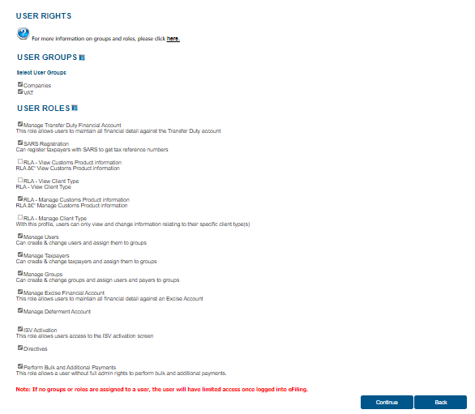
Invite User
Give the new user “Access Rights” on the next screen

Slide 26
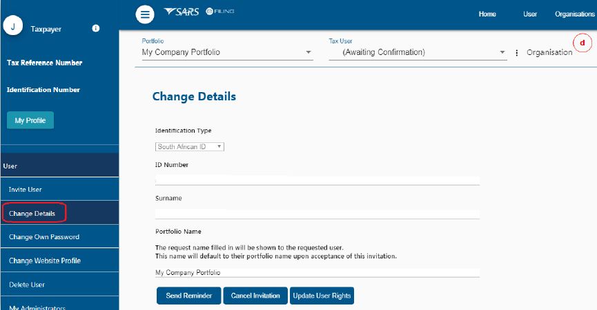
Invite User
The status will show “Awaiting Confirmation”. Invitation can be “cancelled” by clicking “Cancel Invitation” and the user can send a reminder by clicking the “Send Reminder”

Slide 27
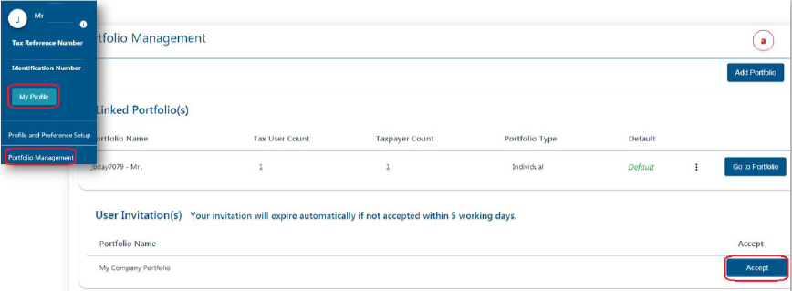
Invite User
Accepting the Invitation
SMS and an email notification will be sent to the person who has been invited to be a user on an organisation or tax practitioner’s portfolio.
Log on to your eFiling profile.
Select “My Profile”
Select “Portfolio Management”
The User Invitation will display. Click on “Accept”.

Slide 28
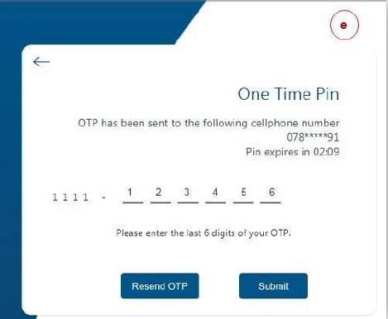
Invite User
Accepting the Invitation
The new user will be sent an OTP (One Time Pin) via the preferred means of contact (cell phone or email)

Slide 29
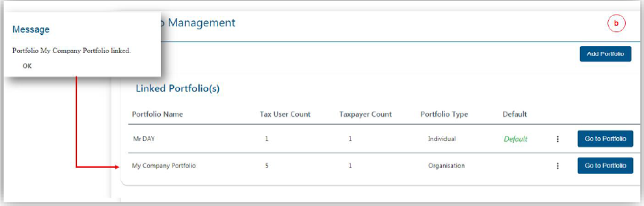
Invite User
Accepting the Invitation
The message will come up confirming that the Portfolio has been linked. The linked portfolio will move to “Linked Portfolio”

