Slide 2
Module 8 Part 4: Registered Representative

Slide 3
Learning Objective
At the end of this module, you are expected to understand:
Definition of Registered Representative,
Legislation pertaining to Representative Taxpayer,
Who may be the Registered Representative,
How to update the Registered Representative on eFiling, and
How to register or update a Registered Representative on the SARS Online Query System (SOQS).

Slide 4
Definition of Registered Representative
A Registered Representative is a person who is appointed with full rights to act on behalf of another legal entity (e.g. Companies, Trusts). If a legal entity has more than one Registered Representative, then one must be nominated as the official “representative person” and be registered with SARS.
Note:
  Registered Representative (RR) registration does not require an eBooking Appointment.
  Registration or updating of a Registered Representative can be done on eFiling or the SARS Online Query System (SOQS).

Slide 5
Legislation pertaining to Representative Taxpayer
The following sections of the Tax Administration Act No.28 of 2011 pertain to Representative Taxpayer:
Section 23. Communication of changes in particulars.—A person who has been registered under section 22 must communicate to SARS within 21 business days any change that relates to.​
postal address;
physical address;
representative taxpayer;
banking particulars used for transactions with SARS;
electronic address used for communication with SARS; or
such other details as the Commissioner may require by public notice.
Section 73. Disclosure to taxpayer of own record —(1) A taxpayer or the taxpayer’s duly authorised representative is entitled to obtain—
a copy, certified by SARS, of the recorded particulars of an assessment or decision referred to in section 104 (2) relating to the taxpayer;
access to information submitted to SARS by the taxpayer or by a person on the taxpayer’s behalf;
information, other than SARS confidential information, on which the taxpayer’s assessment is based; and
other information relating to the tax affairs of the taxpayer.

Slide 6
Legislation pertaining to Representative Taxpayer
Section 153. Representative taxpayer.—(1) In this Act, a representative taxpayer means a person who is responsible for paying the tax liability of another person as an agent, other than as a withholding agent, and includes a person who—
  is a representative taxpayer in terms of the Income Tax Act;
  is a representative employer in terms of the Fourth Schedule to the Income Tax Act; or
  is a representative vendor in terms of section 46 of the Value-Added Tax Act.
  Every person who becomes or ceases to be a representative taxpayer (except a public officer of a company) under a tax Act, must notify SARS accordingly in such form as the Commissioner may prescribe, within 21 business days after becoming or ceasing to be a representative taxpayer, as the case may be.
  A taxpayer is not relieved from any liability, responsibility or duty imposed under a tax Act by reason of the fact that the taxpayer’s representative—
    failed to perform such responsibilities or duties; or
    is liable for the tax payable by the taxpayer.

Slide 7
Legislation Pertaining to Representative Taxpayer
Section 154. Liability of representative taxpayer.—(1) A representative taxpayer is, as regards—
the income to which the representative taxpayer is entitled;
moneys to which the representative taxpayer is entitled or has the management or control;
anything else done by the representative taxpayer,
transactions concluded by the representative taxpayer; and
  in such capacity—
  subject to the duties, responsibilities and liabilities of the taxpayer represented;
  entitled to any abatement, deduction, exemption, right to setoff a loss, and other items that could be claimed by the person represented; and
  liable for the amount of tax specified by a tax Act.
  A representative taxpayer may be assessed in respect of any tax under subsection (1), but such assessment is regarded as made upon the representative taxpayer in such capacity only.

Slide 8
Legislation Pertaining to Representative Taxpayer
Section 246. Public officers of companies.—(1) Every company carrying on business or having an office in the Republic must at all times be represented by an individual residing in the Republic. 2) The individual representative under subsection 1) must be—
  approved by SARS and—
    must be a person who is a senior official of the company; or
    if no senior official resides in the Republic, may be another suitable person;
  appointed by the company or by an agent or legal practitioner who has authority to appoint such a representative for the purposes of a tax Act;
  called the public officer of the company; and
  appointed within one month after the company begins to carry on business or acquires an office in the Republic.
If a public officer is not appointed as required under this section, the public officer is the director, company secretary or other officer of the company that SARS designates for that purpose.

Slide 9
Legislation Pertaining to Representative Taxpayer
  If a public officer is not appointed as required under this section, the public officer is the director, company secretary or other officer of the company that SARS designates for that purpose.
  A company that has not appointed a public officer is subject to a tax Act as if a tax Act did not require the public officer to be appointed.
  A public officer is responsible for all acts, matters, or things that the public officer’s company must do under a tax Act, and in case of default, the public officer is subject to penalties for the company’s defaults.
  A public officer’s company is regarded as having done everything done by the public officer in the officer’s representative capacity.
  If SARS is of the opinion that a person is no longer suitable to represent the company as public officer SARS may withdraw its approval under subsection (2) (a).
  A person who is disqualified in terms of section 6 of the Trust Property Control Act, 1988 (Act No. 57 of 1988), section 25A of the Nonprofit Organisations Act, 1997 (Act No. 71 of 1997), or section 69 of the Companies Act, 2008 (Act No. 71 of 2008), may not be appointed as a public officer under this section.

Slide 10
Who may be the Registered Representative?
Examples of Registered Representatives are as follows:
Treasurer,
Curator,
Liquidator/ Executor/ Administrator (Estates)​,
Main Partner,
Main Trustee,
Public Officer,
Member of a Close Corporation,
Parent/Guardian (Guardian includes an appointed administrator acting on behalf of a legally incapacitated individual or appointed administrator acting on behalf of an individual in extended absence (Imprisoned or Overseas)) or
Accounting Officer.

Slide 11
How to Update the Registered Representative on eFiling
If you are the appointed Registered Representative for an entity and approved by SARS, you must activate the status on eFiling in order to transact on behalf of your client.
Select <Organisations > from the menu on the top.
Select <SARS Registered Details> from the menu on the left
Select <Activate Registered Representative>
Select the applicable option (i.e. Tax Practitioner or Registered Representative)
Agree to the declaration confirming that you are the authorised representative for the taxpayer and click on <Continue>
Complete the applicable fields and select the representative capacity (e.g. accounting officer, curator, public officer, parent guardian, etc.)
Click the on the activate button at the bottom of the screen

Slide 12
How to update the Registered Representative on eFiling
The steps on how to update the Registered Representative on eFiling can be found on the guide
D

Slide 13
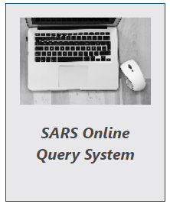
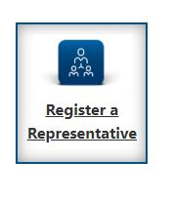
How to Register or Update a Registered Representative on the SARS Online Query System (SOQS)
Click on the <SARS Online Query System> option on the SARS website.
2. Once on the <SARS Online Query System> page, select the option <Register a Representative>

Slide 14
How to Register or Update a Registered Representative on the SARS Online Query System (SOQS)
3. Select the Capacity of the Registered Representative in the drop-down list.
Treasurer,
Curator,
Liquidator/ Executor/ Administrator (Estates),
Main Partner,
Main Trustee,
Public Officer,
Main Member,
Parent/Guardian,
Accounting Officer.
.

Slide 15
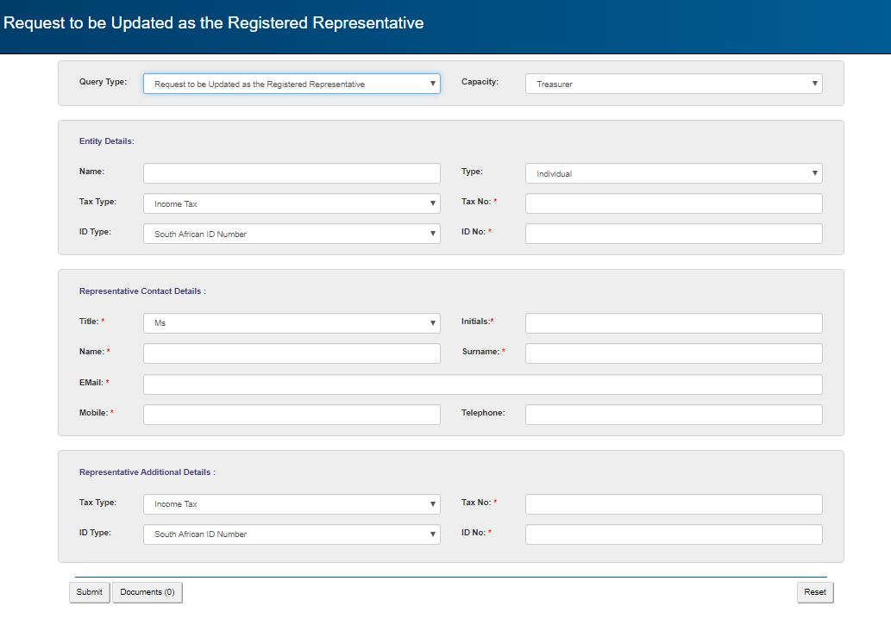
How to Register or Update a Registered Representative on the SARS Online Query System (SOQS)
To confirm who may be a Registered Representative, please click here.This will explain what type of representative capacity is linked to an entity.

Slide 16
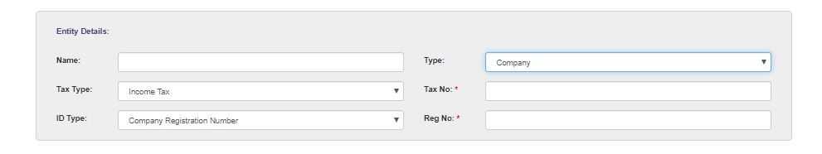
How to Register or Update a Registered Representative on the SARS Online Query System (SOQS)
4. Select the Type of Entity to be linked to the Registered Representative and complete the required fields.
If a Company is selected as the Entity Type, the details of the Company should be captured. If a Parent/Guardian is selected as the Capacity and the Entity Type is Individual, the details of the Minor should be captured as the “Entity Details”.

Slide 17
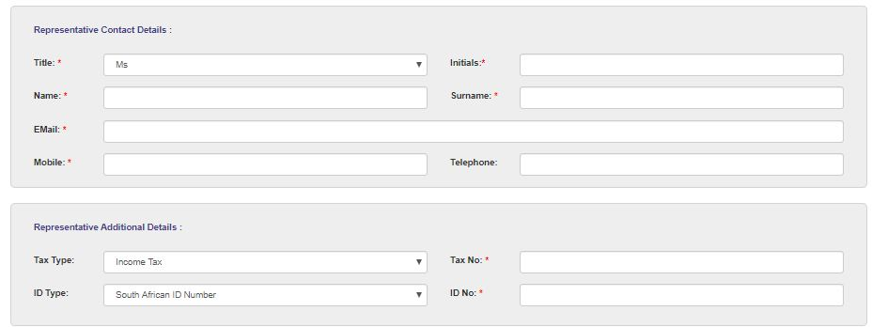
How to Register or Update a Registered Representative on the SARS Online Query System (SOQS)
5. Capture the Representative Contact details (these are the details of the person that must be recorded as the Registered Representative of the taxpayer in the selected Capacity).
If the Public Officer is selected, the details of the Public Officer should be captured. In the case of a Minor, the Parent/Guardian details should be completed.

Slide 18

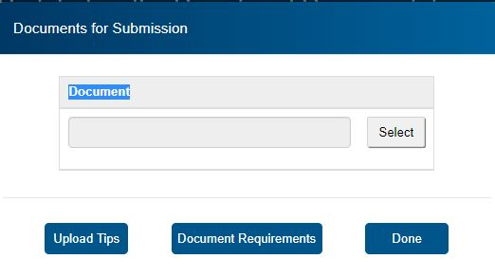
How to Register or Update a Registered Representative on the SARS Online Query System (SOQS)
6. Click on the <Add Documents> button to add the supporting documents. It is important to upload all relevant documents to process the request successfully.
7. Click on <Select> to search for the documents to be uploaded. Click on the <Upload Tips> button to view the criteria to upload documents.

Slide 19
How to Register or Update a Registered Representative on the SARS Online Query System (SOQS)
8. Click on <Document Requirements> button to view the list of supporting documents required.
The following documents must be attached to the case:
Representative Appointment letter/Power of Attorney(POA)
  This letter specifies the rights of the Representative to act on behalf of the Represented Entity and is available on the SARS website. No appointment letter is required where founding documents indicates there is only one director of company;
b) Enterprise Notice of Incorporation
  Copy of Registration Certificate or Notice of Incorporation in the case of a Company, or
  Trust Deed with minutes of a meeting specifying who is authorised to act on behalf of Trust, or
  Partnership / Joint Venture Agreement in the case of a Partnership or Joint Venture, or
  Copy of Identity Document of taxpayer (e.g. minor) in case of an individual.
c) Identity document /Passport document
  A copy of ID/Passport document of the Representative;
  An image taken on the day that the request is submitted, clearly showing the individual in question holding up a copy of Identity Document and a note that reads ‘Update my details’, and Proof of residential address.
A list of documents that will be accepted by SARS to update Registered Representative details can be found on the SARS website on the following link. Relevant Material or Supporting Documents – South African Revenue Service (sars.gov.za).

Slide 20
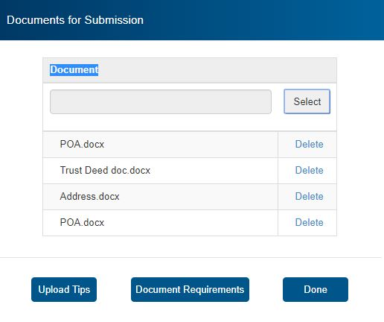
How to Register or Update a Registered Representative on the SARS Online Query System (SOQS)
9. View the list of attached documents and the number of items attached. Where an incorrect document has been attached, click on the “Delete” button.

Slide 21

How to Register or Update a Registered Representative on the SARS Online Query System (SOQS)
10. Once all documents have been uploaded, select the <Done> tab on the “Documents for Submission” screen.
Then click the <Submit> button to send the captured details and attached documents to SARS.
SARS will send an email with a message to notify the requestor that the request to be updated as the Registered Representative has been received successfully with the allocated case number.
A SARS official will verify the information submitted and complete the case within 21 business days. The outcome of the case will be emailed to the requestor. It is important to make sure all relevant supporting documents are uploaded to process the request successfully.
To access the comprehensive guide pertaining to the SARS Online Query Systems, click here.

