Slide 2
Module 8 Part 5: Deceased Estate

Slide 3
Learning Objectives
At the end of this module, you are expected to understand:
What is a Deceased Estate?
Parties Involved in a Deceased Estate.
Step by Step Deceased Estates Process.
Required Steps to Transfer the Deceased Person’s Efiling Profile.
Update of Banking Details.
Available Online Channels.

Slide 4
Deceased Estates
Assets at death = Deceased Estates
What is a deceased estate?
When a natural person (taxpayer) dies, that person is called a ‘deceased person’ and all his or her assets on the date of death will be placed in an estate, called a deceased estate. Assets in a deceased estate can among other things include immovable property and movable property, cash in the bank, etc. The person who administers a deceased estate is called an ‘Executor’/‘Administrator’ (for section 18(3) estates where the gross value is below R250 000). The Executor receives a letter of executorship, and an Administrator receives a letter of appointment. This module will refer to the role of the Executor as the basis.
Once the Executor has finalised all the administration in the deceased estate, the remaining assets (after paying all the debts) will be distributed to the beneficiaries. For more information on deceased estates and the impact of income tax and estate duty thereon, refer to the Estate Duty webpage.

Slide 5
Deceased Estates
Who are the parties involved?
The following parties are generally involved in the administration of a deceased estate.
The Master of the High Court (the Master)
The Executor / Administrator/ agent
The Conveyancer
The Registrar of Deeds
The South African Revenue Service
The family, surviving spouse, heirs and legatees

Slide 6
Deceased Estates
Sections 13 and 14 of the Administration of Estates Act
Process flow to finalise a deceased estate at SARS:
A deceased estate compliance letter is issued as confirmation that all tax affairs are completed at SARS. The Master then approves the distribution.
The executor receives a letter of executorship and must inform any SARS office about the death of the deceased. SARS will code the taxpayer accordingly.
The executor’s details as the representative taxpayer must be updated and linked with the deceased taxpayer to act on the deceased’s behalf.
All outstanding tax returns must be submitted up to the date of death for all tax types: Income Tax, VAT, PAYE, SDL, UIF and estate duty. Any taxable income arising after the date of death will be dealt with in the deceased estate (with a separate income tax reference number).
Assessments must be issued; outstanding liabilities must be paid, and refunds must be paid out (for pre- and post- death).
Section 21 of the Act
Public notice and tax act
Section 17 of the Estate Duty Act

Slide 7
Reporting a death at SARS

Slide 8
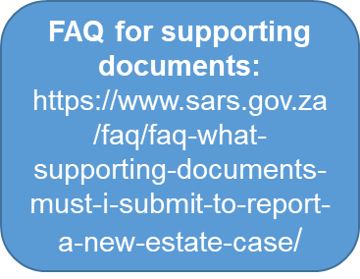
How to report a death at SARS
Reporting Channels
For Tax Practitioners: pcc@sars.gov.za
For Taxpayers: contactus@sars.gov.za
On the SARS website - Online Service link - Request New Estate Case
21 business days turnaround time

Slide 9
How to report a death at SARS
List of reporting documents also available on the updated FAQ (Issue 3) question 48 : (Estates | South African Revenue Service (sars.gov.za))

Slide 10
How to report a death at SARS
It is important to know that if the deceased person had a tax number, SARS must be informed. After reporting the case via one of the available channels, SARS will proceed to code the case and update the representative’s details.
SARS transfers the income tax number to the SARS office nearest to the Masters Office where the death was reported.
Part of the coding process of a deceased estate is to verify the representative’s details. Therefore, it is important for the details of the representative to be updated on their personal e-Filing profile. If this process was not done at coding, a request to update the details can be done via the digital channel provided (a video of this process is already available on SARS TV on the YouTube channel).

Slide 11
Updating the executor’s details at SARS
Part of the coding process of a deceased estates is to verify the Representative Taxpayer (the Executor).
When?
How?
Open link: Registered Representatives | South African Revenue Service (sars.gov.za)
Select <SARS Registered Details> from the menu on the left
Select <Activate Registered Representative>
The appointed registered representative must activate the status on eFiling in order to transact on behalf of the deceased.

Slide 12
Representative taxpayer
Section 1 of the Income Tax Act – Definitions, Fourth Schedule, VAT Act
Who is the representative taxpayer?
The official appointed by the Master to attend to the administration of the affairs of the estate.
The executor/administrator is the representative taxpayer of the deceased person and his or her estate (including the representative employer if the deceased was an employer, or the representative employer if the deceased was a vendor).
Should the executor not fulfil the required obligations or do so in a negligent manner by disbursing funds without settling tax liabilities, this may result in the executor being held personally liable.
Section 13 and 14 of the Administration of Estates Act, 1965
Section 155 of the Tax Administration, 2011

Slide 13
Representative taxpayer
What must happen at SARS?
When the estate is reported, the details of the executor as the representative taxpayer must be updated and linked to the deceased taxpayer as part of the coding step.
Benefit: The sooner the executor’s details are updated, the quicker the administrative function can be initiated to finalise the estate and tax affairs.
Risk: If the details are not updated, the necessary tax obligations cannot be performed and finalisation of the deceased estate will be delayed.
Who must inform SARS?
The executor/administrator

Slide 14
Communication with SARS
When a case is reported, the executor will receive a case number.
This case number must be provided when the executor does a follow-up enquiry or submits any further outstanding documents relating to the estate.
This ensures all communication is linked to the same estate case.
When documents are submitted, the file descriptions (each file must have a name) must be clear to prevent delays in verifying the documents.

Slide 15
Importance of coding a deceased person
Notification (engagement letter) to executor
The executor must finalise all the deceased person’s tax affairs for SARS to raise the necessary assessments and submit the claims before the Master approves the distribution of the estate by the executor to the beneficiaries. Should any taxable income arise after the date of death, the executor must submit the necessary returns and ensure that all liabilities are paid. SARS must ensure that assessments are issued, and refunds are paid out.
Delays in the above processes may affect the finalisation of the estate and the distribution thereof to the beneficiaries.

Slide 16
Compliance

Slide 17
Returns and assessments
Public Notice under section 25 of the TA Act and section 67 of the TA Act
As soon as the executor is appointed, all outstanding returns must be submitted.
For deceased person: All required outstanding returns up to the date of death.
For deceased estates: If taxable income was earned after the date of death (interest, rental income, etc.) and a second registration was required, all returns of the deceased estate must be submitted until the deceased estate is finalised and deregistered.
When?
Who must submit?
The executor/agent (Power Of Attorney - POA)

Slide 18
Returns and assessments
The returns must be submitted so that the assessments can be issued by SARS (except for VAT and PAYE that are self-assessed taxes). All assessments (IT, VAT, PAYE and Estate Duty) serve as the claim that must be submitted to the executor to be accounted for in the Liquidation and Distribution (L&D) account.
It is important to note that IT, VAT and PAYE must first be assessed before the estate duty assessments can be done which will have to take into account the relevant debt (liabilities) or refund (asset) for estate duty purposes.
Benefit: The sooner the returns are submitted, the sooner the assessments can be issued so that the correct claim can be accounted for in the L&D account.
Risk: If there is a delay in the submission of returns and issuing of assessments, the correct SARS claim is omitted from the L&D account, which may result in objections by SARS to the L&D account resulting in further delays in finalising the estate.
Why?

Slide 19
Deceased Estate
When?
The executor or the authorised agent (for example, a tax practitioner) must register the deceased estate (referred to as the second tax reference number) once the first tax reference number (Deceased person) has been coded as “Deceased” and there is taxable income received by or accrued to the deceased estate after the date of death.
Tax returns for the deceased estate must be submitted for the period after death until the L&D account is approved.
Sections 1 and 25 of the IT Act and section 22 of the TA Act.
Public Notice under section 25 of the TA Act and section 67 of the TA Act

Slide 20
eFiling Profiles
When?
A registered eFiler can act in different “roles” on eFiling (e.g., tax administrator). These “roles” are referred to as Portfolio Types. For example:
Individual – a person acting as himself/herself to administer his/her own individual taxes.
Organisation – a representative of a tax paying entity acting either as the representative taxpayer (e.g., Public Officer, Executor of an estate, etc.) or an appointed representative with a signed Power of Attorney in place.
Tax Practitioner – a person registered with SARS and a Recognised Controlling Body (RCB) and has a signed power of attorney to act on behalf of another taxpayer.
Note: Single Login, One username and password

Slide 21
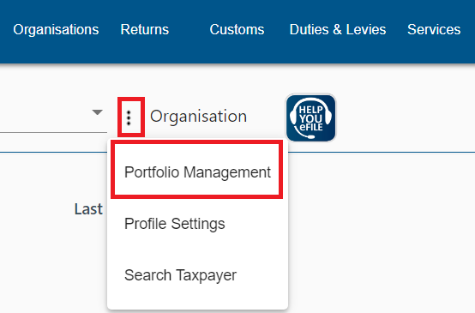
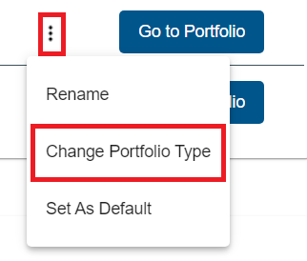
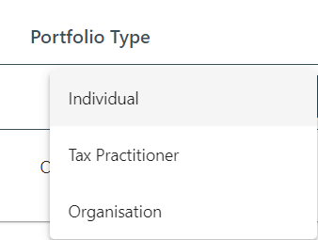
Efiling Portfolio Types
Individual portfolio can be converted to Organisation portfolio for existing eFiling users.
Step 1: Select “Portfolio Management”
Step 2: Click on the ellipsis and select “Change Portfolio”
Step 3: Select the portfolio type required.

Slide 22
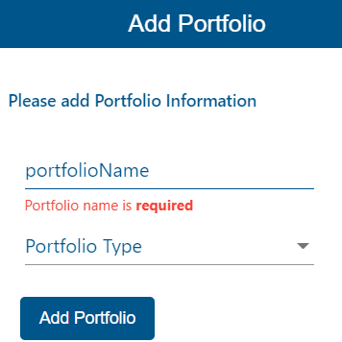
eFiling “ Add Portfolio”
From the eFiling landing page, go to ‘Portfolio Management’ page by selecting ‘My Profile’ on the Portfolio Management sub menu.
Step 1: Select “Add Portfolio”
Step 2: Enter the “Portfolio Name”, select a Portfolio type from a dropdown menu and select “Add Portfolio”

Slide 23
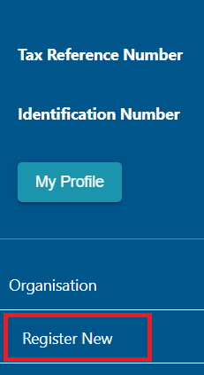
Steps for adding a taxpayer on your profile
After successful login to eFiling, ensure that you are in the correct portfolio, proceed as follows:
Select the "Organisations" Tab on the top
Click on "Organisation" on the left menu.
Click on "Register New“ and complete all applicable fields.
Once all applicable fields have been completed:
Select - Add Taxpayer
On the pop screen select the group to which the taxpayer
should be added.
A summary of the taxpayer’s details will display
Select Done.

Slide 24
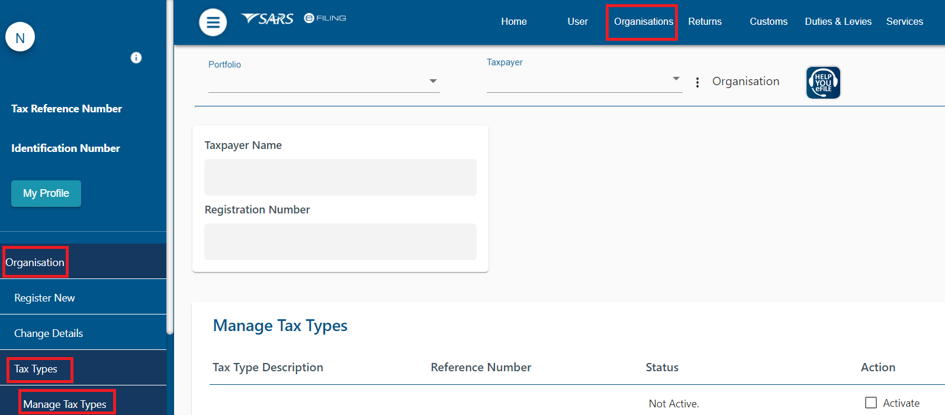
Steps to activate Tax Types

Slide 25
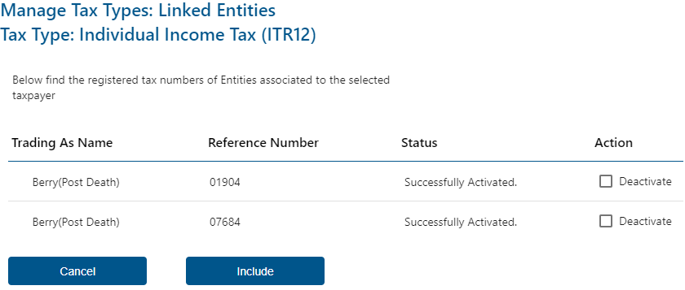
Steps to activate Tax Types

Slide 26
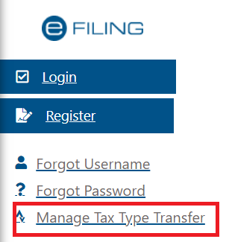
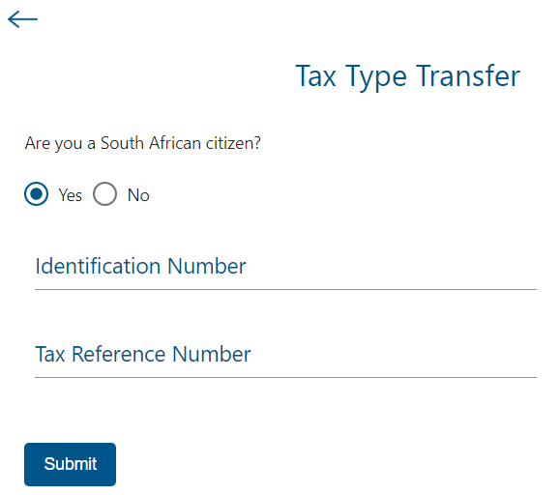
Steps to activate Tax Types
The status of the request will display “Awaiting Authorisation” and will require the representative to approve the request.
The Registered Representative will access the SARS website and select on “Manage Tax Type Transfer” to complete the process.
In the case of an Estate
The Identification Number of the Registered Representative
The Tax Reference Number of the Estate
The Registered Representative must update his or her personal contact details at SARS (Not the Entity details). Example: Update the Executor’s details and not the deceased estate details.

Slide 27
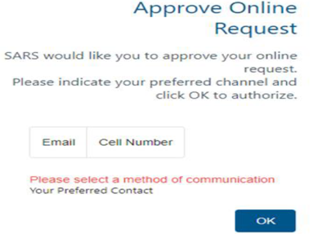
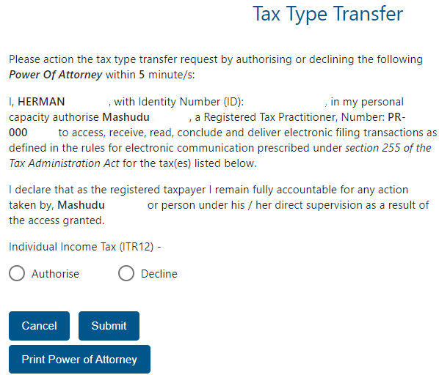
Steps to activate Tax Types
The Registered Representative will receive an OTP which will display the POA for their approval.
More information is available on the SARS website: Tax Types

Slide 28
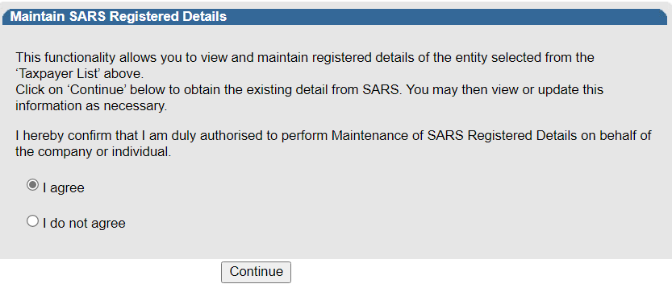
Second Registration – Deceased Estate
After successful login to eFiling, ensure that you are in the correct portfolio, proceed as follows:
Select the "Organisations" Tab on the top
Click on “SARS Registered Details" on the left menu.
Click on “Maintain SARS Registered Details“ the page below will display, select on “I agree” and click on “Continue” to proceed.

Slide 29
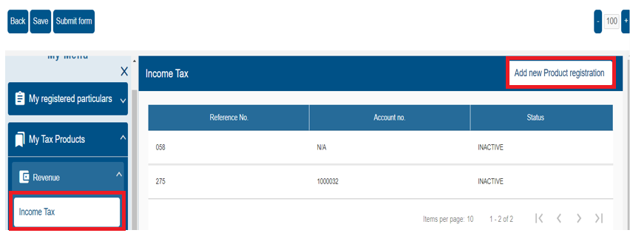
Second Registration – Deceased Estate
On the form that opens, under “My Tax Products” select “Income Tax”. Thereafter select “Add new Product Registration” .

Slide 30
Second Registration – Deceased Estate
Scroll to the section “Income Tax Liability Details” complete the required fields. Once the fields have been completed, you will be able to submit the changes.
Note: Reference is made to Insolvent estate on the above screen shot, you are therefore advised to ensure that when doing the second registration for deceased estates you should select deceased estate option on the drop down menu and not Insolvent estate.

Slide 31
Useful Information
Second Registration – Deceased Estate
eFiling System | South African Revenue Service (sars.gov.za)
Tax Types Transfer Process | South African Revenue Service (sars.gov.za)
Registered Representatives | South African Revenue Service (sars.gov.za)
https://www.sars.gov.za/gen-elec-18-g01-how-to-register-for-efiling-and-manage-your-user-profile-external-guide/

Slide 32
Payments
Sections 9C and 10 of the Estate Duty Act
Chapter 10 of the TA Act and relevant tax Acts
Payment of all outstanding tax liabilities must be made as soon as possible after the assessments are issued, taking into account the approval by the Master to release funds from the estate bank account.
Estate duty liabilities must be paid within 12 months after the date of death unless an assessment is issued within the 12 months then it is payable on the payment date prescribed in the assessment.
If it becomes clear that all estate duty payable within the first 12 months after the date of death (if no assessment was issued) or within the prescribed period within the assessment, an interest free extension can be requested under section 10(2) of the Estate Duty Act to obtain an extended period in which the estate duty can be paid.
This application must be made within the timeframes set out in section 10(2) of the Estate Duty Act, it must be in writing and accompanied by a reasonable deposit payment.
Who must pay?
The executor/agent (POA)/beneficiary

Slide 33
Refunds
All refunds due to the estate must be paid into the estate bank account before the case can be finalised and deregistered.
Refunds in respect of all tax types (excluding estate duty) is refunded through the normal process, however, it will only be paid out if the estate bank account details are verified.
Estate duty refunds have its own process. The REV16 must be completed and submitted to the estate duty team.
If there is outstanding tax on income tax, the amount can be deducted from the estate duty refund before the difference will be refunded to the estate, subjected to written requests.
Chapter 13 of the TA Act and relevant tax Acts
Why?
How?

Slide 34
Refunds/Update of Banking Details
The bank details of the deceased person must be updated with the bank details of the Estate Late account which will be subject to an account verification process. The same banking details will be relevant if a second registration in respect of the deceased estate for the period after the date of death is applicable.
Change of banking details for a deceased taxpayer can only be made once classified as a “deceased estate” by SARS. Executors are advised to wait for a letter from SARS confirming the status change before trying to change the banking details.
A refund will only be paid out if there is a valid Estate Late bank account.
Where more than one executor has been appointed by the Master and one executor has been nominated by the co-executor/s to represent the taxpayer, a completed and signed SARS Power of Attorney (POA) form is acceptable. The executor must submit SARS POA form together with the listed documents before the update can be made.
The banking details can also be amended by completing the RAV01 on eFiling.
Who must request the update of the bank details?
The executor

Slide 35
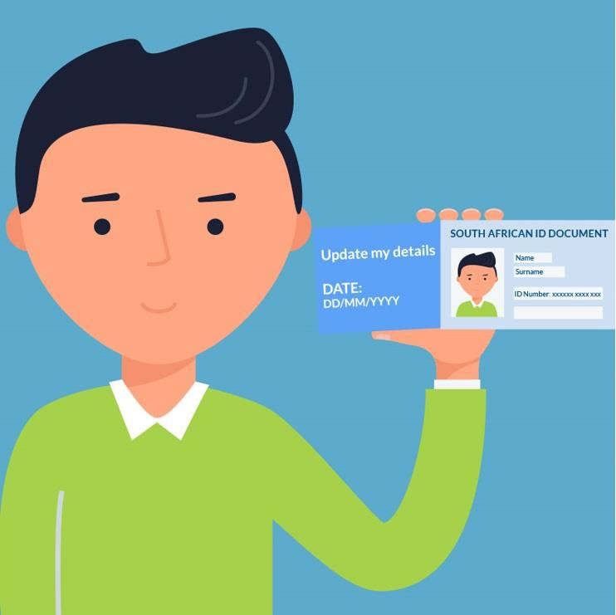
Refunds/Update of Banking Details
If a letter is received from SARS to verify the banking details:
The requestor submitting the supporting documents electronically, must provide an image of himself/herself holding their proof of identity, as well as a written note containing the case number and the date on which the documents are uploaded to SARS. It is important that the requestor’s face, proof of identity and the note are clearly visible in the same picture.

Slide 36
Finalising deceased estate

Slide 37
Deceased Estate Compliance Letters
Once all tax returns are submitted, assessments are issued, liabilities are paid and refunds are refunded, the Deceased Estate Compliance letter (DEC letter) can be issued. This is the last step in the process that takes place when the case is finalised.
Currently, the DEC letter is requested via one of the SARS email addresses (see slide 36 below).
The DEC letter cannot be requested when a case is reported.
Once the DEC is issued, the Master can approve the estate for distribution.
Section 17 of the Estate Duty Act
When?
How?
NB

Slide 38
Deceased Estate Compliance Letters
Channels to request DEC letters:
For Tax Practitioners: pcc@sars.gov.za
For Taxpayers: contactus@sars.gov.za
Estate Duty Mailbox: estateduty@sars.gov.za
21 business days turnaround time
Who can request the DEC letter form SARS?
The executor/agent (POA)
Delays in issuing the DEC letter cause delays in the finalisation and distribution of the estate.

Slide 39
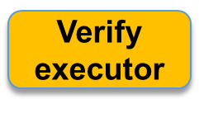
Master’s timeline with SARS process combined
Report to SARS
Death
Report estate to Master
Appoint executor
14 days
2 months
Submission of returns and issue of assessments
2 weeks
6 months
Advertise estate
Prepare L&D account
Submit L&D account
1-3 months
1-3 months
21 days
Advertise L&D account
Final approval for distribution
Payments and refunds
21 days
Deceased estate
compliance letter

Slide 40
Available online channels
The following channels can be used to code an estate/ submit supporting documents/ submit a queries/ DEC letters:
For Tax Practitioners: pcc@sars.gov.za
For Taxpayers: contactus@sars.gov.za
SARS Online Query System on the SARS website.
For requests on Estate duty/ refunds of estate duty/ DEC letters:
For Tax Practitioners: pcc@sars.gov.za
For Taxpayers: contactus@sars.gov.za
Estate Duty Mailbox: estateduty@sars.gov.za

Slide 41
Available information
Estate webpage:
https://www.sars.gov.za/businesses-and-employers/estates/
Estate Duty webpage:
https://www.sars.gov.za/types-of-tax/estate-duty/
FAQ on Deceased Estates:
https://www.sars.gov.za/lapd-it-g31-faqs-on-deceased-estates/
Administration of Deceased Estates leaflet (in collaboration with the Master):
https://www.sars.gov.za/administration-of-deceased-estates-sars-2022/+

