Slide 1
NON- COMPULSORY BRIEFING SESSION
RFP23/2025 : PROVISION OF A TRANSFER PRICING BENCHMARKING TOOL
NON- COMPULSORY BRIEFING SESSION:
CLOSING DATE:
02 OCTOBER 2025
24 OCTOBER 2025 AT 11:00 AM

Slide 2
TABLE OF CONTENTS
Welcome and Introduction
Governance, Rules and Procedures
RFP Timelines
Background and Requirements
Bid Evaluation Process
Price &Specific goals
Financial Analysis
Service Agreement
RFP submission and contact details
Q&A

Slide 3
WELCOME AND INTRODUCTION
  SOUTH AFRICAN REVENUE SERVICE TEAM
  POTENTIAL SERVICE PROVIDERS

Slide 4
Options
Ai Assistant I
Governance Rules and Procedures

Slide 5
2. PURPOSE
Non-Compulsory Briefing Session
Purpose
  explain selected concepts, procedures and other aspects of the RFP
  confirm formal registration of Bidders for notices and other communications
It may contain
  additional information
  additional rules that must be adhered to
It does not
  cover every item in the RFP
  replace any of the issued RFP material
  Change any of the RFP rules unless explicitly communicated in writing
The briefing session slide
  The briefing session slides will be uploaded to the SARS website and e-Tender platform.
The RFP pack remains the primary source of information for the Bidder to respond

Slide 6
2.1 PROCEDURES DURING THE BRIEFING SESSION
Questions during the session
SARS will take questions submitted at the end of the session
SARS will review and focus on most pertinent themes arising from the questions and provide answers where possible
Bidders are requested to submit written questions during the open Q&A period to Tender Office email published; tenderoffice@sars.gov.za
All questions and answers will be published as part of the wider Q & A process
The published answers will take precedence over any verbal response given in the briefing session
The session is being recorded

Slide 7
2.2 GOVERNANCE REQUIREMENTS
Strict communication channels
  Bidders will be disqualified for non-compliance
  No solicitation of information will be allowed other than by prescribed channels
Deadlines must be strictly met
Adhere to prescribed submission format to ensure queries are properly dealt with

Slide 8
RFP TIMELINES

Slide 9
3. RFP TIMELINES
RFP issued date:
Deadline for respondents to submit queries:
SARS to post answers to Respondent’s questions on the SARS website :
Proposals due date:
23 September 2025
23 September 2025 – 10 October 2025
25 September 2025 – 14 October 2025
24 October 2025 @11h00
Any enquiries must be referred, in writing via email: tenderoffice@sars.gov.za

Slide 10
BACKGROUND AND BUSINESS REQUIREMENTS

Slide 11
4. BACKGROUND AND BUSINESS REQUIREMENTS
Since South Africa’s re-emergence in the international market, there has been a marked expansion of international trade and commerce, with wide-ranging changes in volume and complexity. An increasing proportion of this international activity is carried on between members of MNEs. As the globalisation of business activity continues to accelerate, protecting the South African tax base is vital to South Africa’s wealth and development.
Exchange controls historically provided some protection against the more significant manipulation of transfer prices to transfer profits to lower tax jurisdictions. In anticipation of the relaxation of exchange controls and the envisaged adverse effect on the South African tax base, section 31 was introduced into the Act in 1995.
Refer to SARS RFP 23-2025 2-1 Business Requirement Specification

Slide 12
BID EVALUATION PROCESS

Slide 13
5. BID EVALUATION PROCESS
REFER TO SECTION 7 OF SARS RFP 23-2025 1-1 MAIN DOCUMENT
Gate 0 – Prequalification Evaluation
Gate 1 – Mandatory Evaluations
Gate 2 – Technical Evaluation
Gate 3 – Price & Specific Goals (80/20)
Refer to SARS RFP 23-2025 1-1 Main Document

Slide 14

5.1 PREQUALIFICATION EVALUATION STAGE
SBD 1: Invitation to Bid
SBD 4: Bidder’s Declaration
SBD 6.1: Preference points claim form
Proof of registration on the Central Supplier Database (CSD)
General Conditions of Contract (GCC)
A complete set of three (3) most recent years annual financial statements
Gate 0
Pre-Qualification Evaluation

Slide 15
5.2 MANDATORY EVALUATION STAGE
If a bidder does not meet any of the mandatory evaluation criteria, the bidder will be disqualified, and the bidder’s proposal will not be evaluated further
Gate 1
Mandatory Evaluation
NB: All bidders are required to complete, sign, and return the issued SARS RFP 23-2025 5-1 Mandatory Response Template
for the purpose of mandatory evaluation criteria.

Slide 16
5.3 TECHNICAL EVALUATION STAGE
The technical evaluation will be scored out of a total of 100 points, and bidders are required to score a minimum threshold of 66.67 out of 100 points to proceed to the next stage of evaluation.
If a bidder does not meet the technical evaluation minimum threshold, the bidder will be disqualified, and the bidder’s proposal will not be evaluated further
Gate 2
Technical Evaluations

Slide 17
PRICE AND B-BBEE EVALUATIONS

Slide 18
6. GATE 3: PRICE AND B-BBEE EVALUATION
The Price and Specific goals points will be added together to determine each bidder’s overall score out of 100 points.
EVALUATION | POINTS
PRICE | 80
SPECIFIC GOALS | 20
TOTAL POINTS FOR PRICE AND SPECIFIC GOALS | 100

Slide 19
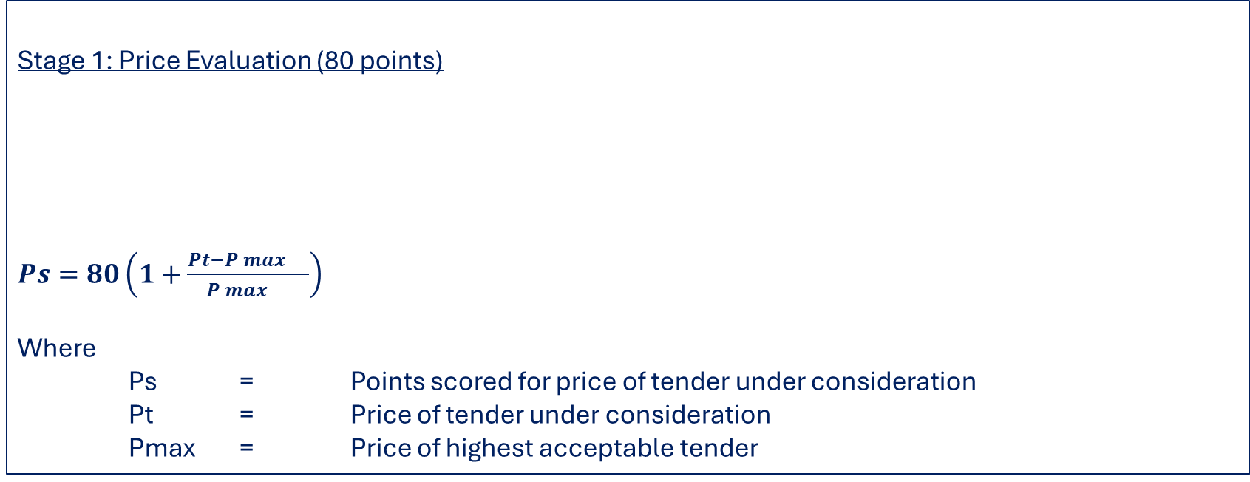
6.1 PRICE EVALUATION
Stage 1: Price Evaluation (80 points)
$Ps=80\left(1+\frac{Pt−P\max{}}{P\max{}}\right)$
Where
Ps = Points scored for price of tender under consideration
Pt = Price of tender under consideration
Pmax = Price of highest acceptable tender
Evaluation Criteria | Points
Price Evaluation | 80
Refer to SARS RFP 23-2025 6-1 Price Template

Slide 20
6.2 B-BBEE/SPECIFIC GOALS EVALUATION
Stage 2: Specific Evaluation (20 points)
Evaluation Criteria | Points
Specific Goals Evaluations | 20
Refer to SARS RFP 23-2025 3-3 SBD 6.1

Slide 21
6.2.2 B-BBEE/SPECIFIC GOALS EVALUATION
Specific goals points may be allocated to Bidders on submission of documentation or evidence as follows:
The specific goals allocated points in terms of this tender | Number of points allocated (80/20 system) (To be completed by the organ of state) | Number of points claimed (80/20 system) (To be completed by the tenderer)
An entity that is an Exempted Micro Enterprise (EME)/Qualifying Small Enterprise (QSE) | 2
An entity that has at least 51% Black Ownership | 5
An entity that has at least 30% Black Women Ownership | 5
An entity that has at least 51% Black Youth Ownership | 4
An entity that has at least 51% Black ownership by Persons with Disabilities. | 4
Bidders MUST complete and sign the SBD 6.1 form to claim the points for Specific goals, failing which, the Bidder will be scored zero.

Slide 22
FINANCIAL ANALYSIS

Slide 23
7. FINANCIAL ANALYSIS
Bidders are required to submit complete sets of annual financial statements, for the three (3) most recent financial periods in the name of the bidding entity. The annual financial statements must either be audited or independently reviewed.
The annual financial statements must contain:
  A statement of profit and loss and other comprehensive income;
  A statement of financial position;
  A statement of cash flows;
  A statement of changes in equity / net assets; and
  Accompanying notes.
  An incorporated joint venture is required to submit annual financial statements of the joint venture.
An unincorporated joint venture / consortium is required to submit annual financial statements of each of the parties to the arrangement.

Slide 24
7.1 FINANCIAL ANALYSIS
SARS reserves the right to request further information regarding the annual financial statements of a bidder at a later stage to demonstrate the potential bidder’s financial capability.
These will include, but are not limited to:
  Holding company’s / Parent company’s accounts;
  Management accounts;
  Signed letter from a recognised financial institution confirming capital availability and bank statements; and/or
  Credit rating reports (confirming capital availability or access to capital).

Slide 25
SERVICE AGREEMENT

Slide 26
8. SERVICE AGREEMENT
Bidders should note that, SARS issued a General Condition of Contract (GCC) and that Bidders would be expected to sign off and submitted the GCC.
Bidders should however note that, the appointed Bidder would then be given a draft Contract where they would then be expected to:
Comment on the terms and conditions set out in the Services Agreement and where necessary, make proposals to the terms and conditions;
Each comment and/or amendment must be explained; and
All changes and/or amendments to the Services Agreement must be in an easily identifiable
colour font and tracked for ease of reference.
SARS reserves the right to accept or reject any or all amendments or additions proposed by the successful bidder if such amendments or additions are unacceptable to SARS or pose a risk to the organisation.

Slide 27
RFP SUBMISSION AND CONTACT DETAILS

Slide 28
9. RFP SUBMISSION AND CONTACT DETAILS
Bidders must submit one (1) hard copy file and a USB with content of each
file. Refer to paragraph 6.5 of the Main RFP document
Hard Copy File + 1 Electric Submission
TENDER BOX
Tender Office SARS Procurement, Lehae La SARS
Head Office,299 Bronkhorst Street Niew
Mucleneuk,
Physical submission

Slide 29
9.1 RFP SUBMISSION AND CONTACT DETAILS
Section 1
  Prequalification documents (SBD and other documents)
Section 2
  Response to mandatory requirements
  Supporting documents for mandatory requirements
Section 3
  Response to technical requirements
  Supporting documents for technical requirements
Section 4
  Company profile
  Supplementary information
Section 5
  General Conditions of Contract
Folder 1

Slide 30
9.2 RFP SUBMISSION AND CONTACT DETAILS
Section 1
  B-BBEE certificate or sworn affidavit
  SBD 6.1 Preference point claim form
Section 2
  Pricing response template
Section 3
  A complete set of three (3) most recent years annual financial statements as detailed in this RFP
Folder 2
Any enquiries must be referred, in writing via email:
tenderoffice@sars.gov.za

Slide 31

QUESTIONS AND ANSWERS

