Slide 1
RFP 02/2023:
THE PROVISION OF CLEANING CONSUMABLES, CHEMICALS, AND INDUSTRIAL CLEANING EQUIPMENT TO THE SOUTH AFRICAN REVENUE SERVICE (SARS) OFFICES NATIONWIDE.
Briefing Session: 21 August 2023
RFP No : RFP 02/2023
Closing Date: 31 August 2023 at 11h00

Slide 2
TABLE OF CONTENT
1. Welcome and Introduction
2. RFP Timelines
3. Governance Requirements
4. Technical Requirements
5. Bid Evaluation Process
6. Price & Specific goals
7. Financial Analysis
8. RFP submission and contact details
9. Q&A

Slide 3
BID EVALUATION COMMITTEE
Procurement
Sourcing Specialist
Governance, Compliance & Risk Specialist
Pricing Specialist
B-BBEE Specialist
Financial Analysis Specialist
SARS Business Unit
Technical Specialists

Slide 4
RFP TIMELINES
ACTIVITY | DUE DATE
RFP Advertisement Date & Availability of Bid Documents on SARS and NT website | 8 August 2023
Non-compulsory Briefing Session | 21 August 2023 at 10h00
Bidder's questions | 8 August 2023 – 22 August 2023
Response to Bidder’s questions | 23 August 2023
RFP Closing Date | 31 August 2023 at 11h00

Slide 5
GOVERNANCE REQUIREMENTS

Slide 6
INTRODUCTION
NON- COMPULSORY BRIEFING SESSION
Purpose:
Explain selected concepts, procedures and other aspects of the RFP
Confirm formal registration of Bidders for notices and other communications
It may contain:
Additional information
Additional rules that must be adhered to
It does not:
Cover every item in the RFP
Replace any of the issued RFP material
Change any of the RFP rules unless explicitly communicated in writing
The briefing session slides will be uploaded on the SARS website.
The RFP pack remains the primary source of information for the Bidder to respond.

Slide 7
PROCEDURE DURING THE BRIEFING SESSION
Questions during the session.
SARS will take written questions submitted during the session
SARS will review and focus on most pertinent themes arising from the questions and provide answers where possible
All questions and answers will be published on SARS website to all the bidders as part of the wider
Q & A process
The emailed answers will take precedence over any verbal response given in the briefing session
The session is being recorded

Slide 8
GOVERNANCE REQUIREMENTS
Strict communication channels
Bidders will be disqualified for non-compliance
No solicitation of information will be allowed other than by prescribed channels
Deadlines to be strictly met
Adhere to prescribed submission format to ensure queries are properly dealt with

Slide 9
TECHNICAL REQUIREMENTS

Slide 10
SARS REQUIREMENTS
The Provision of Cleaning Consumables, Chemicals, and Industrial Cleaning Equipment to the South African Revenue Service (SARS) Offices Nationwide for a period of 3 years.
Bid requirements and specifications:

Slide 11
MANDATORY REQUIREMENT
No. | Mandatory evaluation criteria | Non-submission will result in disqualification?
1. | Bidders must provide copies of Material Safety Data Sheets (MSDS) for all surface specific cleaning detergents. | Yes

Slide 12
TECHNICAL EVALUATION CRITERIA
No. | Technical evaluation criteria | Weights
1. | Bidder’s Schedule of Experience - Reference Letters | 15
2. | Ordering Procedures and Billing Plan | 15
3. | Supply Contracts | 15
4. | Delivery Infrastructure | 15
5. | Training Program | 10
6. | Cluster/Footprint Presence | 15
7. | ISO Certification (45001/ 9001) | 15
Total | Total | 100

Slide 13
Bid Evaluation Process: Gate 2 (Price & Specific Goals)
PRICING

Slide 14
NATIONAL TREASURY PREFERENTIAL PROCUREMENT REGULATION
Preference Point System
In line with the requirements of the Preferential Procurement Policy Framework Act, 2000, and its Preferential Procurement Regulations 2022, only bidders that have met or exceeded the minimum threshold of 70 points for functionality in the technical evaluation, will be evaluated further in terms of the following preference point system
The value of this bid is estimated to not exceed R50 000 000 (all applicable taxes included) and therefore the 80/20 preference point system shall be applicable

Slide 15
PRICE EVALUATION
Only Bidders that have achieved the minimum technical threshold of 70 points will be considered for price evaluation
Evaluation criteria:
Where
Ps = Points scored for price of bid under consideration
Pt = Rand value of bid under consideration
Pmin = Rand value of lowest acceptable bid
Adjudication Criteria | Points
 | 80

Slide 16
PRICING TEMPLATES

Slide 17
Bid Evaluation Process Gate 2 (Price & Specific goals)
SPECIFIC GOALS

Slide 18
SPECIFIC GOALS = 10 POINTS
Specific goals points may be allocated to Bidders on submission of valid B-BBEE certificate or sworn affidavit together with the SBD 6.1 Preference points claim form:
The specific goals allocated points in terms of this tender is to EMEs, QSEs and WO entities only.
A bidder who does not claim preference points will be scored zero for Specific goals
The B-BBEE certificate or sworn affidavit should be submitted in the name of the bidding entity. Entities who are in a holding and subsidiary relationships must submit a list / annexure of the B-BBEE certificate indicating the subsidiaries to the holding company
Incorporated JVs or Consortiums must submit the B-BBEE certificate or affidavit of the entity. Unincorporated JVs must submit a consolidated B-BBEE certificate as if they were a group structure for every separate bid.
JVs or Consortiums are also required to submit signed JV or Consortium agreements
ADJUDICATION CRITERIA | POINTS
A duly completed Preference Point Claim Form: SBD 6.1 and a B-BBEE Certificate/Affidavit. | 20

Slide 19
Valid Affidavits
Valid Affidavits
Affidavits must be sworn or affirmed before a person authorized to administer the oath or take the affirmation.
The deponent must then sign the affidavit in the presence of Commissioner of Oaths
It is not permissible to backdate or postdate an affidavit. The backdating or postdating makes the affidavit misleading and irregular.
The date on the affidavit is the date on which the deponent is saying that the information stated in the affidavit is true.
The signature of the deponent and the Commissioner of Oaths must be on the same day.
The Commissioner must give their details on the affidavit.(Usually the commissioner stamp and signature)
SARS reserves the right to request that bidders submit their Black ownership and turnover information in support of their Affidavits.

Slide 20
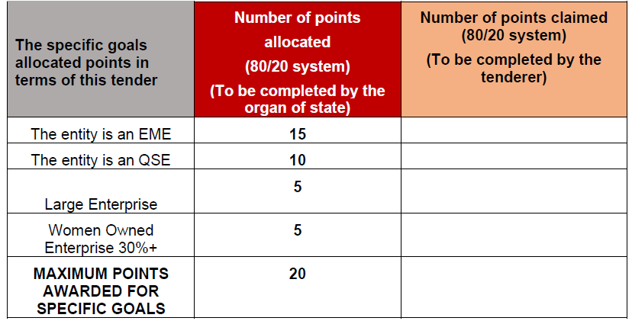
POINTS AWARDED FOR SPECIFIC GOALS
4.1. In terms of Regulation 4(2); 5(2); 6(2) and 7(2) of the Preferential Procurement Regulations, preference points must be awarded for specific goals stated in the tender. For the purposes of this tender the tenderer will be allocated points based on the goals stated in table 1 below as may be supported by proof/ documentation stated in the conditions of this tender:
Page 4 of SBD6.1

Slide 21
B-BBEE CERTIFICATE/AFFIDAVIT
The table below indicates the specific B-BBEE certification documents that must be submitted for this tender.
No. | Classification | Turnover | Submission requirement
1. | Exempted Micro Enterprise (EME) | Below R10 million p.a. | A sworn affidavit or certificate from CIPC.
2. | Qualifying Small Enterprise (QSE) | Between R10 million and R50 million p.a. | A sworn affidavit only 51% Black Ownership and above; or A copy of B-BBEE Rating Certificate from a SANAS accredited rating agency.
3. | Large Enterprise (LE) | Above R50 million p.a. | A copy of B-BBEE Rating Certificate from a SANAS accredited rating. agency.

Slide 22
USE AND ACCEPTANCE OF AFFIDAVITS
Section 1.6 SBD 6.1 states.. 1.6 The organ of state reserves the right to require of a tenderer, either before a tender is adjudicated or at any time subsequently, to substantiate any claim with regards to preferences, in any manner required by the organ of state.
SARS reserves the right to request that bidders submit proof of their Black ownership and turnover information in support of their Affidavits.

Slide 23
FINANCIAL ANALYSIS

Slide 24
PURPOSE
Part of overall risk management strategy of SARS
One of multiple governance steps to assess financial fitness of bidders
Assess financially stability
Identify financial risks that SARS as an organisation is exposed too
Recommend appropriate mitigating strategies
Notes:
Fa

Slide 25
FINANCIAL REQUIREMENTS
Three recent complete sets of Audited/Reviewed Annual Financial Statements comprising of:
Statement Of Comprehensive Income (Income Statement)
Statement of Financial Position (Balance Sheet)
Statement of Cash Flows (Cash Flow Statement)
Accompanying Unabridged Notes for ALL of the above documents
Any supplementary information
Less than three years Financial Periods
Explanatory Letter – Providing reasons why the entity has been trading for less than three years signed by the Financial Director

Slide 26
FINANCIAL REQUIREMENTS
Joint Arrangements (JA)
Annual financial statements of the JA and legal agreement detailing the percentage of ownership of each entity.
Unincorporated JAs must submit separate F/S for each party to the JA.
Signed JA legal agreement.
Financial statements in Bidding Companies Name
Financial statements must be in name of the bidding entity.
Subsidiary submitting holding company’s AFS must also furnish a Performance Guarantee from holding company.

Slide 27
BID SUBMISSION
Bidders must submit copies of each file (Original and Duplicate) and a USB with content of each file by 31 August 2023 at 11H00
1
2
Original
+
Duplicate
+
Content of File 1 and 2
TENDER BOX
Lehae La SARS, 299 Bronkhorst Street, Nieuw Muckleneuk, Brooklyn, Pretoria
Any enquiries must be referred, in writing via email:
tenderoffice@sars.gov.za 8 August 2023 – 22 August 2023

Slide 28
Q & A Session

