Slide 1
THE APPOINTMENT OF A SERVICE PROVIDER FOR THE PROVISION OF DRUG TEST KITS FOR THE PERIOD OF FIVE (5) YEARS
Virtual Briefing Session: 15 July 2022 at 11H30
RFP No.: RFP 11/2022
Closing Date: 05 August 2022, 11h00

Slide 2
Table of Content
1. Welcome and Introduction
2. RFP Timelines
3. Governance, Rules and Procedures
4. Background and Scope of Work
5. Bid Evaluation Process
6. Price and B-BBEE
7. Financial Analysis
8. Services Agreements
9. RFP submission and contact details
10. Q&A

Slide 3
Bid Evaluation Committee
Procurement
Sourcing Lead: Corporate Real Estate – Project Oversight
Governance, Compliance & Risk Specialist – Audit
Tender Office – Bid Opening
Value Delivery Planning – Price Evaluations
B-BBEE Section – BEE Evaluations
SARS Business Unit
Bid Specification Committee
Technical Evaluators
Corporate Legal Services
Legal Specialist

Slide 4
Table of Content
1. Welcome and Introduction
2. RFP Timelines
3. Governance, Rules and Procedures
4. Background and Scope of Work
5. Bid Evaluation Process
6. Price and B-BBEE
7. Financial Analysis
8. Services Agreements
9. RFP submission and contact details
10. Q&A

Slide 5
RFP TIMELINES
ACTIVITY | DATE DUE
Advertisement of Bid in the: National Treasury Tender Portal. | 06 July 2022
Tender documents on SARS website | 06 July 2022
Non-compulsory virtual briefing session | 15 July 2022
Last date for questions relating to RFP | 27 July 2022
Bid Closing Date | 05 August 2022
Notice to bidders | October 2022

Slide 6
Table of Content
1. Welcome and Introduction
2. RFP Timelines
3. Governance, Rules and Procedures
4. Background and Scope of Service
5. Bid Evaluation Process
6. Price and B-BBEE
7. Financial Analysis
8. Services Agreements
9. RFP submission and contact details
10. Q&A

Slide 7
Purpose
Non-Compulsory Briefing Session
Purpose
– explain selected concepts, procedures and other aspects of the RFP
It may contain
– additional information
– additional rules that must be adhered to
It does not
– cover every item in the RFP
– replace any of the issued RFP material
– change any of the RFP rules unless explicitly communicated in writing
The briefing session slides will be posted on the SARS website
The RFP pack remains the primary source of information for the Bidder to respond.

Slide 8
Procedures during conference
Questions during the session.
SARS will take written questions submitted during the session
SARS will review and focus on most pertinent themes arising from the questions and provide answers where possible
All questions and answers will be published as part of the wider Q & A process
The published answers will take precedence over any verbal response given in the briefing session
The session is being recorded

Slide 9
Table of Content
1. Welcome and Introduction
2. RFP Timelines
3. Governance, Rules and Procedures
4. Background and Scope of Service
5. Bid Evaluation Process
6. Price and B-BBEE
7. Financial Analysis
8. Services Agreements
9. RFP submission and contact details
10. Q&A

Slide 10
BACKGROUND & SCOPE OF WORK
  Refer to Annexure A – Specifications Document

Slide 11
Table of Content
1. Welcome and Introduction
2. RFP Timelines
3. Governance, Rules and Procedures
4. Background and Scope of Work
5. Bid Evaluation Process
6. Price and B-BBEE
7. Financial Analysis
8. Services Agreements
9. RFP submission and contact details
10. Q&A

Slide 12
BID EVALUATION PROCESS
Invitation to Bid SBD 1
Tax Compliance status pin
Central Registration Report (Central Database System) from NT
SARS Oath / Affirmation of Secrecy
Declaration of interest SBD 4
Supplier cost and risk assessment questionnaire
Bid Document - SBD 6.1
General Conditions of Contract (GCC)
Gate 0
Pre-Qualification
Gate 1
BBBEE – BBBEE Level 1 to 3
Mandatory Requirements

Slide 13
BID EVALUATION PROCESS
Gate 2
Technical Evaluation
100 points
Refer to:
Technical Evaluation Criteria as per Paragraph 8.4 of the Main RFP Document
Achieve overall score of 70 out of 100 points to be considered for Price and BBBEE Evaluations
Gate 3
Annexure B – Pricing Schedule
B-BBEE Certificate/ Sworn Affidavit
Bid Document - SBD 6.1
Price and BBBEE

Slide 14
Table of Content
1. Welcome and Introduction
2. RFP Timelines
3. Governance, Rules and Procedures
4. Background and Scope of Work
5. Bid Evaluation Process
6. Price and B-BBEE
7. Financial Analysis
8. Services Agreements
9. RFP submission and contact details
10. Q&A

Slide 15
Bid Evaluation Process Gate 2 - Price
Stage 1: Price Evaluation (80 points)
Bidders are required to submit a fully completed and signed pricing schedule (Annexure B).

Slide 16
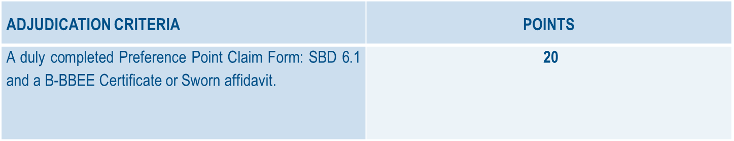
Bid Evaluation Process Gate 2 – B-BBEE
B-BBEE points may be allocated to Bidders on submission of documentation or evidence as follows:
Bidders MUST complete and sign the Bid Document - SBD 6.1 to claim the Bidder’s B-BBEE preference points.

Slide 17
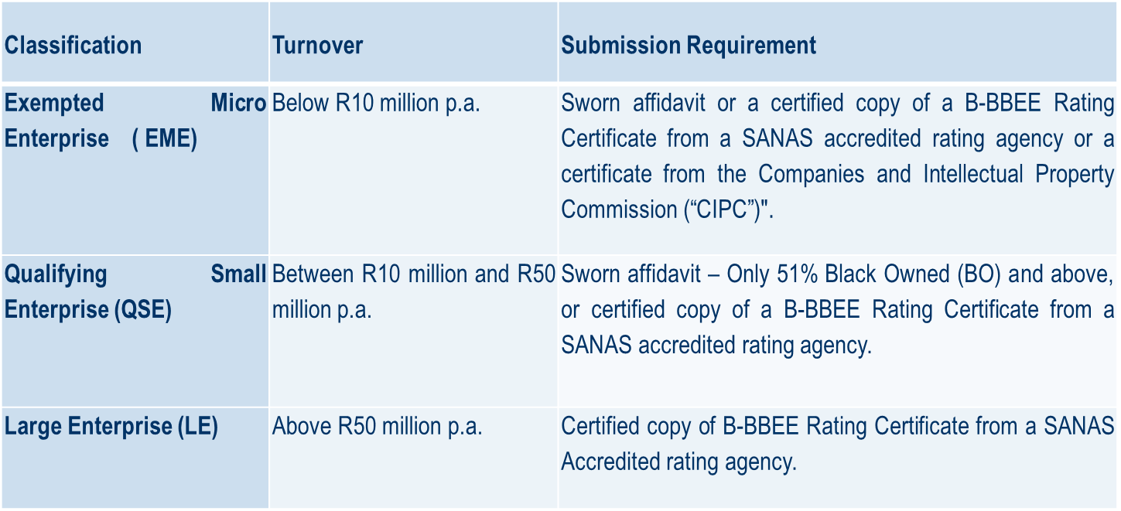
Bid Evaluation Process Gate 2 – B-BBEE
The table below indicates the specific B-BBEE certification documents that must be submitted for this tender:
JOINT VENTURES
Incorporated JVs must submit the B-BBEE status of the entity. Unincorporated JVs must submit a consolidated B-BBEE certificate as if they were a group structure for every separate Bid.

Slide 18
Bid Evaluation Process Gate 2 – B-BBEE
SARS reserves the right to request that bidders submit their Black ownership and turnover information in support of their Affidavits.
Affidavits must be sworn or affirmed before a person authorized to administer the oath or take the affirmation.
The deponent must then sign the affidavit in the presence of Commissioner of Oaths
It is not permissible to backdate or postdate an affidavit. The backdating or postdating makes the affidavit misleading and irregular.
The date on the affidavit is the date on which the deponent is saying that the information stated in the affidavit is true.
The signature of the deponent and the Commissioner of Oaths must be on the same day.
The Commissioner must give their details on the affidavit.(Usually the commissioner stamp and signature)

Slide 19
JOINT VENTURES AND SUB -CONTRACTING
Joint Ventures and Consortiums
A trust, consortium or joint venture (including unincorporated consortia and joint ventures), will qualify for points for their B-BBEE status level as a legal entity, provided that the entity submits their consolidated B-BBEE status level
Verification Certificate scorecard and that such a consolidated BBBEE scorecard is prepared for every separate bid.
Proof of Existence: Joint Ventures
Bidders must submit proof of the existence of joint ventures arrangements. SARS will accept signed agreements as acceptable proof of the existence of a joint venture arrangement.
The above-mentioned joint venture agreement must clearly set out the roles and responsibilities of the Lead Partner and the joint venture party. The agreement must also clearly identify the Lead Partner, who shall be given the power of attorney to bind the other party/parties in respect of matters pertaining to the joint venture arrangement.

Slide 20
JOINT VENTURES AND SUB -CONTRACTING
SUB-CONTRACTING
Bidders who want to claim preference points will have to comply fully with regulations 11(8) and 11(9) of the Preferential Procurement Regulations, 2011 with regard to sub–contracting:
A person must not be awarded points for B-BBEE status level if it is indicated in the tender documents that such a tenderer intends sub-contracting more than 25% of the value of the contract to any other enterprise that does not qualify for at least the points that such a tenderer qualifies for, unless the intended sub-contractor is an Exempted Micro Enterprise that has the capability and ability to execute the sub-contract.

Slide 21
Bid Document - SBD 6.1

Slide 22
Table of Content
1. Welcome and Introduction
2. RFP Timelines
3. Governance, Rules and Procedures
4. Background and Scope of Work
5. Bid Evaluation Process
6. Price and B-BBEE
7. Financial Analysis
8. Services Agreements
9. RFP submission and contact details
10. Q&A

Slide 23
FINANCIAL ANALYSIS
SARS is responsible for an appropriate procurement system as per Public Finance Management Act (PFMA)
which is:
Fair
Equitable
Transparent
Competitive
Cost Effective

Slide 24
FINANCIAL ANALYSIS
Complete Sets of Audited/ Independently Reviewed Annual Financial Statements
        Signed Auditors / Accounting Officers Opinions
        Statement of Comprehensive Income (Income Statement)
        Statement of Financial Position (Balance Sheet)
        Statement of Cash Flows (Cash Flow Statement)
        Accompanying Unabridged Notes for ALL of the above documents
Less than 3 Financial Periods
        Explanatory Letter
Financial statements in Bidding Companies Name
Subsidiary submitting holding company’s F/S must also furnish a Performance Guarantee

Slide 25
Table of Content
1. Welcome and Introduction
2. RFP Timelines
3. Governance, Rules and Procedures
4. Background and Scope of Work
5. Bid Evaluation Process
6. Services Agreements
7. RFP submission and contact details
8. Q&A

Slide 26
AGREEMENTS
    SERVICE LEVEL AGREEMENT (SLA)
    The draft Service Level Agreement (SLA) constitutes the specialised terms and conditions upon which SARS is prepared to contractually engage the prospective Bidder(s) to render the services under this bid.
    Bidders are requested to indicate their acceptance of the terms and conditions set out in the draft SLA.
    SARS will sign the SLA with the Successful Bidder and must be accepted by the Successful Bidder by signing and dating the document before any work can be commence

Slide 27
Table of Content
1. Welcome and Introduction
2. RFP Timelines
3. Governance, Rules and Procedures
4. Background and Scope of Work
5. Bid Evaluation Process
6. Services Agreements
7. RFP submission and contact details
8. Q&A

Slide 28


BID SUBMISSION
Bidders must submit copies of each file and a CD-ROM or USB with content of each file by 05th August 2022 at 11:00
Bid documents will only be considered if received by SARS before the Closing Date and time, regardless of the method used to send or deliver such documents to SARS
1
2
Content of File 1 and 2
+
+
TENDER BOX
Tender Office SARS Procurement, Lehae La SARS Head Office,299 Bronkhorst Street Niew Mucleneuk, Pretoria
Any enquiries must be referred, in writing via email:
tenderoffice@sars.gov.za

Slide 29
FILE 1:
Exhibit 1
Pre-qualification documents (SBD documents))
Technical Responses
Supporting documents for technical responses
Exhibit 2
General Conditions of Contract (GCC)
Draft Services Level Agreement (Bidders to indicate their acceptance)
Exhibit 3

Slide 30
FILE 2
Exhibit 1
B-BBEE Certificate or Sworn Affidavit together with completed SBD 6.1
Pricing Schedule.
Exhibit 2
Latest 3 year audited/reviewed financial statements
Exhibit 2

Slide 31
Table of Content
1. Welcome and Introduction
2. RFP Timelines
3. Governance, Rules and Procedures
4. Background and Scope of Work
5. Bid Evaluation Process
6. Services Agreements
7. RFP submission and contact details
8. Q&A

