Slide 1

TENDER #: RFP 20/2015
REFURBISHMENT OF MUSINA STATE WAREHOUSE
Venue : Musina State Warehouse
Military base, Customs Office
Date : 15 October 2015

Slide 2
AGENDA
Welcome and Introduction (Attendance)
Procurement Presentation Purpose and Scope Procurement Objectives and Statutory Compliance Tender Pack Mandatory Tender Returnable' s Bid Evaluation / Adjudication Criteria
Evaluation and Adjudication Process Technical Presentation Overview of SARS requirements B-BBEE requirements Financial Analysis Pricing and BOQ
General
Questions and Answers?
Closure

Slide 3
Procurement Presentation
      Katlego Malatji

Slide 4
PURPOSE AND SCOPE
PURPOSE – Appointment of qualified contractor/s for: Paving works Construction of Loading Bay Refurbishment works of Musina State Warehouse SCOPE – Refurbishment and Upgrade of SARS State Warehouse in Musina; and A JBCC Agreement will be signed between SARS and the appointed service provider.

Slide 5
PROCUREMENT OBJECTIVES
Fairness
Competitive
Equitable
Cost Effectiveness
Transparency
Public Procurement

Slide 6
STATUTORY COMPLIANCE
Constitution
PFMA
PPPF Act and Preferential Procurement Regulations
B-BBEE Act (ICT Charter)
Other prescripts
Legislative Framework
Standard for Uniformity
What about?
Local Accords
IPAP
NGP
CSDP
NIPP
Uniform Procurement directives to three spheres of government
National Treasury guidelines
Supply Chain Management Guidelines
Standard Bidding Documents
Practice Notes
Supply Chain Professional Body and Skills Development

Slide 7




EXPECTED PUBLIC PROCUREMENT OUTCOMES
Supplier Development
Focus on big contracts for BBBEE
OEM localisation for companies that comply with BBBEE codes.
Develop local suppliers for the manufacturing of strategic items that are procured overseas.
Build capacity of the existing and future small enterprises.
Preferential Procurement
Support local content initiatives
Develop and agree on local content targets
Monitor and report on local content targets, outputs and outcomes.
Build long term relationships with suppliers.
Skills Development
Build capacity for small enterprises through skills development.
Training and development , prioritising youth and women.
Partnership with training institutions for practical training.
Continuous investment in sector skill s development
Localise the manufacturing of material items used in that region where possible.
Build capacity and capability of regional suppliers.
Enlist the support of Financial institutions to fund the small enterprises.
Direct investment in Special Economic Zones
Regional Economic Development

Slide 8
TENDER PACK
Standard Bidding Documents (SBD’s)
Bid Specification
  What are the technical expectations from this tender
  Bill of Quantity
Pricing
  Cost Breakdown Structure
B-BBEE Requirements
Oath of Secrecy

Slide 9
MANDATORY TENDER RETURNABLE'S
NAME OF THE DOCUMENT THAT MUST BE SUBMITTED | NON SUBMISSION MAY RESULT IN DISQUALIFICATION?
Invitation to Bid – SBD 1 | Please complete and sign the supplied pro-forma document.
Tax Clearance Certificate – SBD 2 | Please submit a valid and original tax clearance certificate.
BEE Certificate | Failure to submit will result in a zero score for BEE.
Declaration of Interest – SBD 4 | Please complete and sign the supplied pro-forma document
Preferential Points Claim Form - SBD 6.1 | Please complete and sign the supplied pro-forma document
Declaration of Prospective Bidder’s Chain Management Practices – SBD 8 | Please complete and sign the supplied pro-forma document
SARS Oath Of Secrecy | Please complete and sign the supplied pro-forma document in the presence of a Commissioner of Oaths and initial each and every page.
Certificate of Independent Bid Determination SBD 9 | Please complete and sign the supplied pro-forma document
MANDATORY/ AUTOMATIC DISQUALIFIERS
Proof of CIDB Grading and certification | Failure to submit CIDB Certificate will lead to disqualification
Proof of Third Party Liability Insurance | Certificate of insurance or letter from an insurance institution indicating a quotation for the cover to the value of R 1 million
Certificate of Attendance | Failure to submit Attendance Certificate will lead to disqualification

Slide 10
BID EVALUATION / ADJUDICATION CRITERIA
SCORING OF POINTS
PHASE 1: Technical Pre-Evaluation
A minimum of 70% on the technical pre-evaluation is required for bids to be considered for Phase 2 evaluation
PHASE 2: 90/10 Evaluation
Only bids that achieved 70% or above will be considered for Phase 2 evaluation
Price = 90%
Black Empowerment = 10%
ADJUDICATION CATEGORY | WEIGHTING
Pricing | 90
BEE Compliance | 10

Slide 11
EVALUATION AND ADJUDICATION PROCESS

Slide 12
Technical
Johan Raath

Slide 13
TECHNICAL PRESENTATION
The work is divided into three parts:
RFP 20/2015 A: Paving works at the Vehicle Park.
RFP 20/2015 B: Refurbishment of the Warehouse.
RFP 20/2015 C: Construction of a new Loading Bay

Slide 14
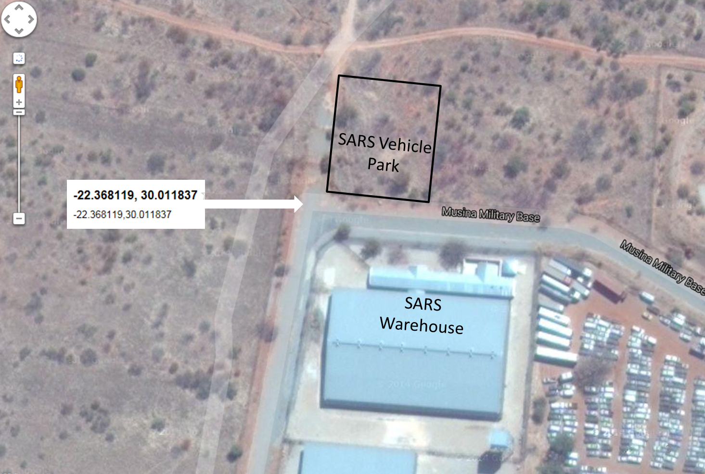
SARS Musina Customs State Warehouse refurbishment, construction of new loading bay and Vehicle Park upgrade (site plan)

Slide 15
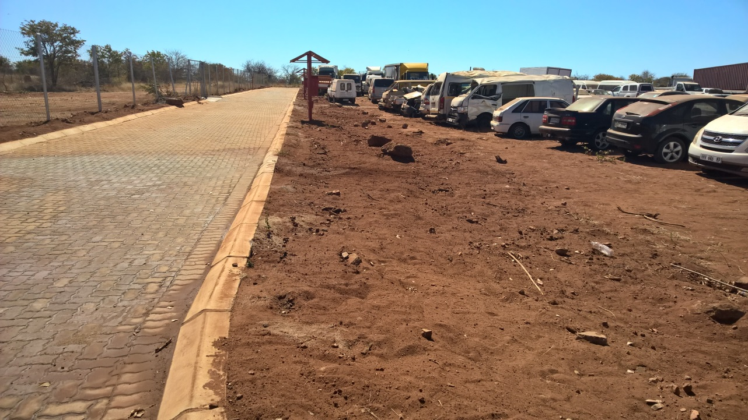
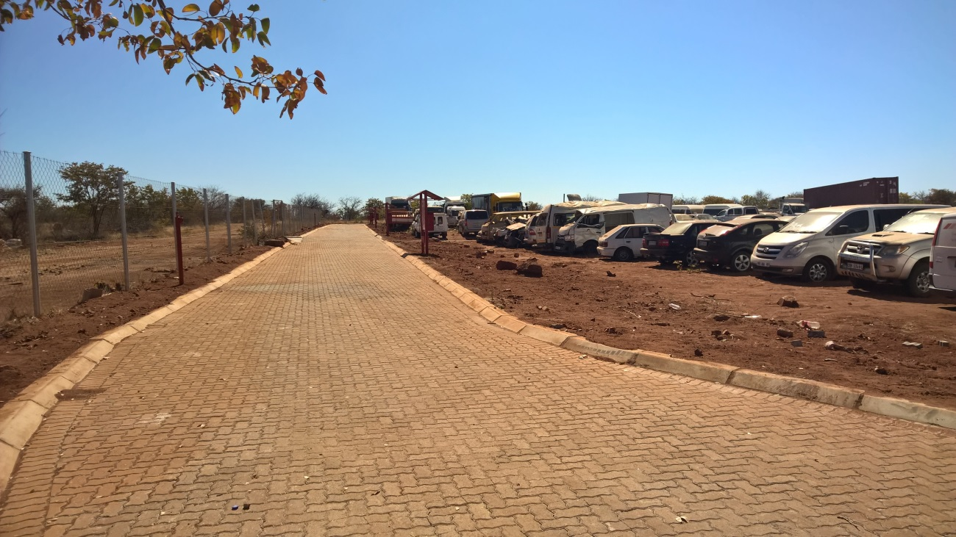
SARS Musina Customs Vehicle Park Paving
(Tender number: RFP 20/2015 A; CIDB ref no: 100024381)

Slide 16
SARS Musina Customs Vehicle Park Paving
(Tender number: RFP 20/2015 A)
The scope of work include:
Excavation to prepare for paving.
Backfill and compacting.
Application of weed killer.
Repair existing paving.
Installation of new paving approximately 4 448m².
General cleaning of the site (rocks, bushes, etc).

Slide 17
SARS Musina Customs Vehicle Park Paving
(Tender number: RFP 20/2015 A)
Challenges:
Schedule work to accommodate moving of vehicles; possibly two to three phases.
No electricity available on site.
Water available from across the road.
No toilette facilities.
Removal of large rocks/builders to be included.
General neatness of site.

Slide 18
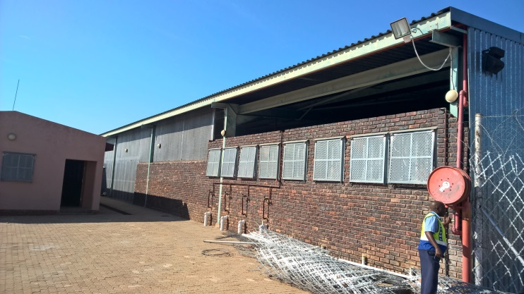
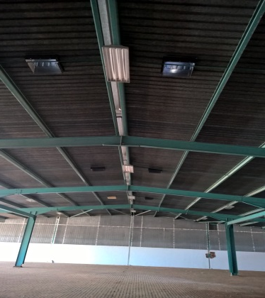
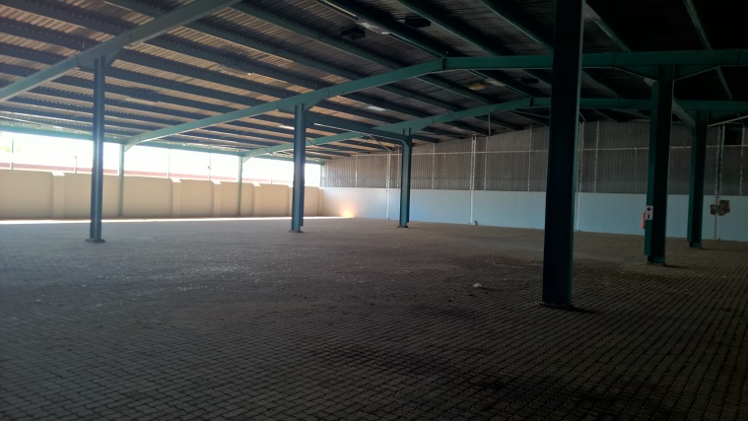
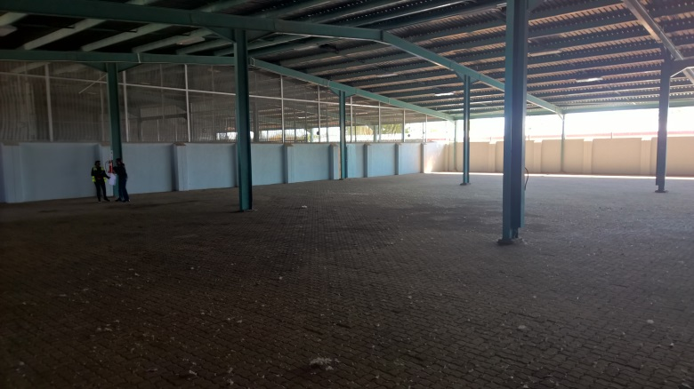
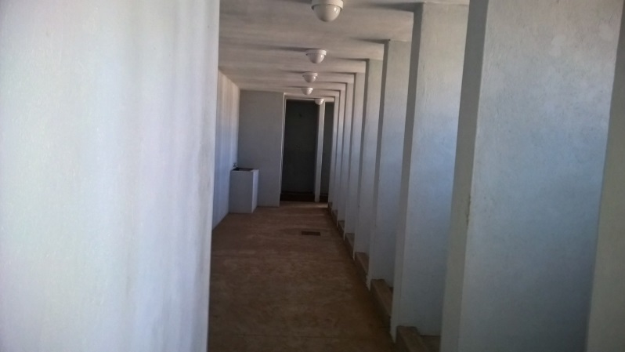
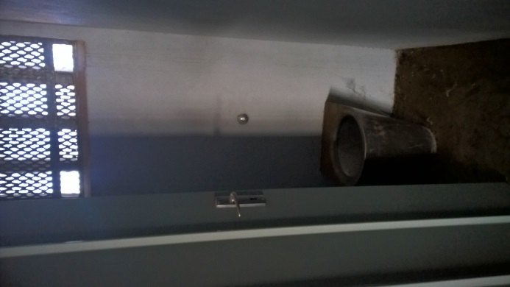
SARS Musina Customs Warehouse Refurbishment
(Tender number: RFP 20/2015 B; CIDB ref no: 100024382)

Slide 19
SARS Musina Customs Warehouse Refurbishment
(Tender number: RFP 20/2015 B)
The scope of work include:
Builder’s work.
Fencing (selected contractor)
Electrical installations.
HVAC installations.
Wet services and hot water generation.
Fire installations.

Slide 20
SARS Musina Customs Warehouse Refurbishment
(Tender number: RFP 20/2015 B)
Challenges:
Schedule work to accommodate possible moving of goods.
No electricity available on site.
No toilette facilities forms part of the refurbishment works.
Important requirements:
Health & Safety file.
Detailed project plan.
Guarantee on all works

Slide 21
SARS Musina Customs Warehouse Refurbishment
(Tender number: RFP 20/2015 B)
SARS direct contractors:
Racks/shelving supplier.
Electrical connection to the building (might not be completed during this project).
Technology.
Security.
Another General Building contractor constructing the new loading bay.

Slide 22
SARS Musina Customs Warehouse Refurbishment
(Tender number: RFP 20/2015 B)
Additional requirements:
Health & Safety compliance.
Detailed project plan.
Guarantee on all works.
JBCC to be signed.
Contractor must have the required cash flow to complete the works. Payments will take 30 calendar days after approval of Invoices.

Slide 23
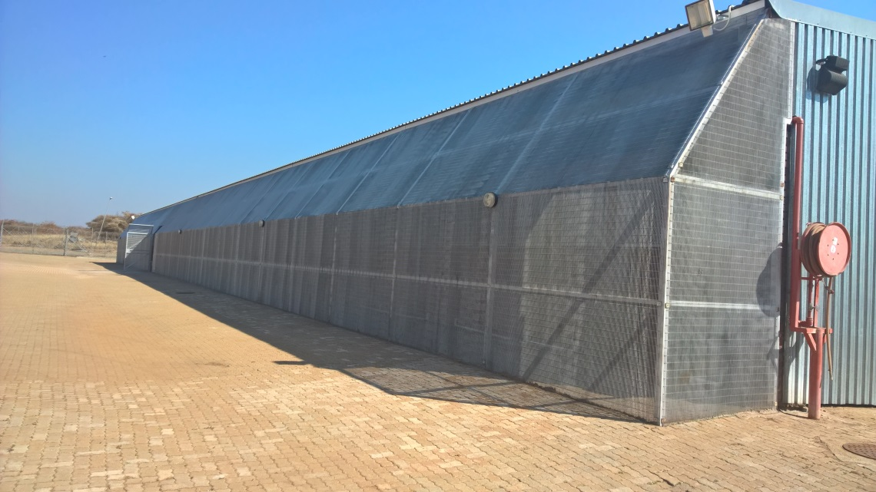
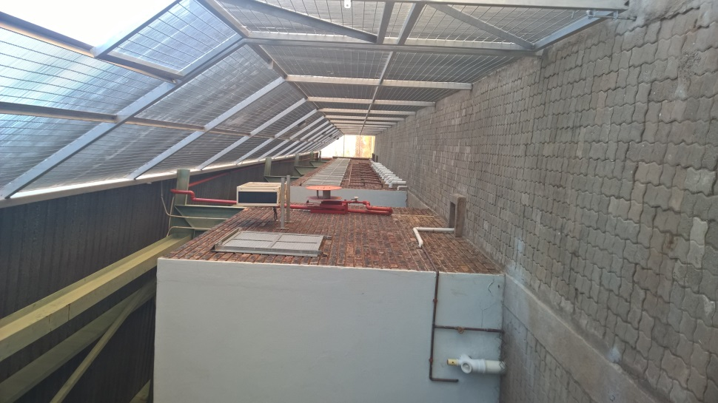
SARS Musina: Construction of new Loading Bay
(Tender number: RFP 20/2015 C; CIDB ref no: 100024384
Outside area
Inside area

Slide 24
SARS Musina: Construction of new Loading Bay
(Tender number: RFP 20/2015 C; CIDB ref no: 100024384
The scope of work include:
Removal of existing work.
Earth works.
Concrete form work and reinforcement.
Masonry.
Water proofing.
Roof coverings.
Structural steel works.
Plastering.
Plumbing and drainage.
Electrical installations.

Slide 25
SARS Musina: Construction of new Loading Bay
(Tender number: RFP 20/2015 C; CIDB ref no: 100024384
Challenges:
No electricity available on site.
No toilette facilities forms part of the refurbishment works.
Important requirements:
Health & Safety file.
Detailed project plan.
Guarantee on all works

Slide 26
SARS Musina: Construction of new Loading Bay
(Tender number: RFP 20/2015 C; CIDB ref no: 100024384
SARS direct contractors:
Racks/shelving supplier.
Electrical connection to the building (might not be completed during this project).
Technology.
Security.
Another General Building contractor refurbishing the warehouse

Slide 27
SARS Musina: Construction of new Loading Bay
(Tender number: RFP 20/2015 C; CIDB ref no: 100024384
Additional requirements:
Health & Safety compliance.
Detailed project plan.
Guarantee on works.
JBCC to be signed.
Contractor must have the required cash flow to complete the works. Payments will take 30 calendar days after approval of Invoices.

Slide 28
B-BBEE
Itumeleng Tlhomelang

Slide 29
B-BBEE = 10 Points
B-BBEE points may be allocated to Bidders on submission of documentation or evidence as follows:
Bidders MUST complete and sign the SBD 6.1 form to claim the Bidder’s B-BBEE preference points, failing which, the Bidder will be scored zero.
ADJUDICATION CRITERIA | POINTS
A duly completed Preference Point Claim Form: SBD 6.1 and a B-BBEE Certificate. | 10

Slide 30
B-BBEE Key Sections to complete in SBD

Slide 31
B-BBEE Certificate
The table below indicates the specific B-BBEE certification documents that must be submitted for this tender. Failure to submit the required certification documents will also result in Bidders scoring zero for B-BBEE.
SARS will accept B-BBEE Certificate issued on the revised B-BBEE Codes.
Classification | Turnover | Submission Requirement
Exempted Micro Enterprise ( EME) | Below R5 million p.a. - (Old Codes) Below R10 million p.a. - (Amended Codes) | Certified copy of B-BBEE Rating Certificate from a SANAS Accredited rating agency or a Registered Auditor approved by IRBA or a letter from an Accounting Officer as contemplated in the CCA. A sworn Affidavit or Certificate from CIPC
Qualifying Small Enterprise (QSE) | Between R5 million and R35 million p.a. (Old Codes) Between R10 million and R50 million p.a. (Amended Codes) | Certified copy of B-BBEE Rating Certificate from a SANAS Accredited rating agency or a Registered Auditor approved by IRBA. A sworn Affidavit or Certificate from CIPC
Large Enterprise (LE) | Above R35 million p.a. (Old Codes) Above R50 million p.a. ( Amended Codes) | Certified copy of B-BBEE Rating Certificate from a SANAS Accredited rating agency or a Registered Auditor approved by IRBA.

Slide 32
USE AND ACCEPTANCE OF AFFIDAVITS
It has been advised that the Verification Professional will need to test the affidavits submitted as part of a company’s procurement rating. All companies will need to request the information which proves Black Ownership and Turnover in addition to the Affidavit, or request that their EME/QSE suppliers be verified and have this confirmed on the Affidavit.
SARS reserves the right to request that bidders submit their Black ownership and turnover information in support of their Affidavits.

Slide 33
B-BBEE
  Joint Ventures and Consortiums
Incorporated JVs must submit the B-BBEE status of the entity. Unincorporated JVs must submit a consolidated B-BBEE certificate as if they were a group structure for every separate Bid.
  Sub-contracting
Bidders who want to claim preference points will have to comply fully with regulations 11(8) and 11(9) of the Preferential Procurement Regulations, 2011 with regard to sub–contracting:
Regulation 11(8)
A person must not be awarded points for B-BBEE status level if it is indicated in the tender documents that such a tenderer intends sub-contracting more than 25% of the value of the contract to any other enterprise that does not qualify for at least the points that such a tenderer qualifies for, unless the intended sub-contractor is an Exempted Micro Enterprise that has the capability and ability to execute the sub-contract.

Slide 34
B-BBEE
Regulation 11(9)
A person awarded a contract may not sub-contract more than 25% of the value of the contract to any other enterprise that does not have an equal or higher B-BBEE status level than the person concerned, unless the contract is sub-contracted to an Exempted Micro Enterprise that has the capability and ability to execute the sub-contract.
  Proof of Existence: Joint Ventures and/or Sub-Contracting
    Bidders must submit concrete proof of the existence of joint ventures and/or sub-contracting arrangements. SARS will accept signed agreements as acceptable proof of the existence of a joint venture and/or sub-contracting arrangement.
    The joint venture and/or sub-contracting agreements must clearly set out the roles and responsibilities of the primary Bidder and the joint venture and/or sub-contracting party. The agreement must also clearly identify the primary Bidder, who shall be given the power of attorney to bind the other party/parties in respect of matters pertaining to the joint venture and/or sub-contracting arrangement.

Slide 35
PRICING AND BOQ
Thabang Thinane
Presented by Faradh Khan

Slide 36
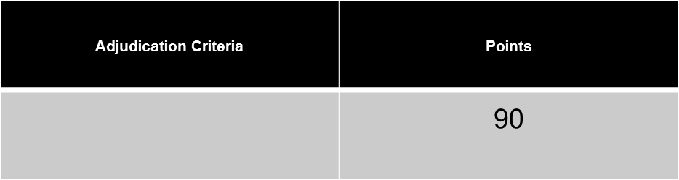

PRICE EVALUATION
The bidders that achieved the set threshold of 70% will be considered for these stage of price evaluation ..
Evaluation criteria:
Where :
Ps = Points scored for price of bid under consideration
Pt = Rand value of bid under consideration
Pmin = Rand value of lowest acceptable bid

Slide 37
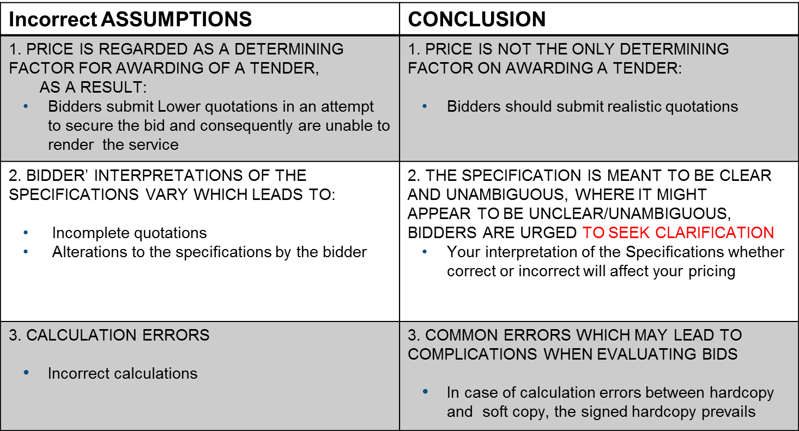
INCORRECT ASSUMPTIONS WITH REGARDS TO PRICING

Slide 38
PRICING CONTINUED
BOQ’S NOTES
Only the PDF version of the BOQ’s is required;
Excel version is attached to assist bidder with calculations only; and
Please attach separate annexure summarising the Preliminaries & General (P & G’s).

Slide 39
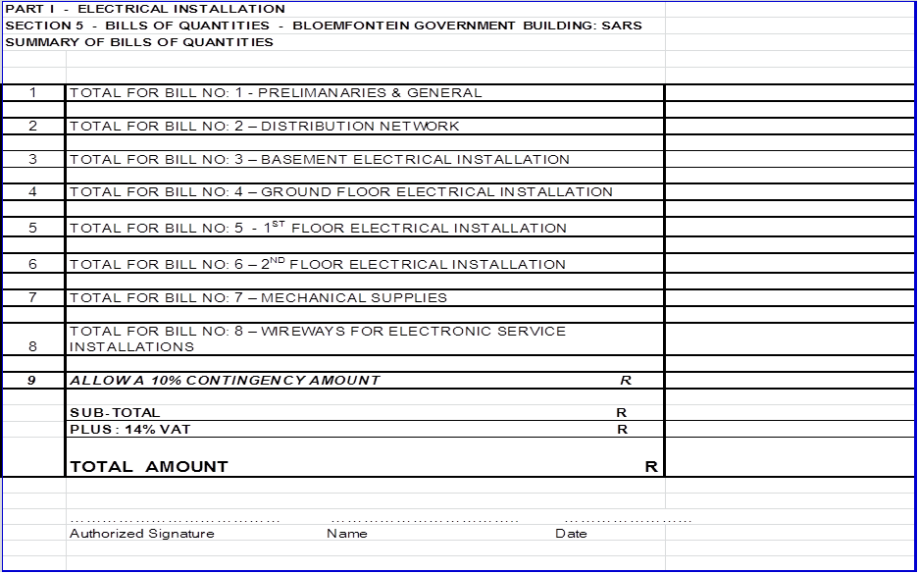
EXAMPLE BOQ

Slide 40
FINANCIAL ANALYSIS
Amanda Magadeni

Slide 41
BACKGROUND
Public Finance Management Act (PFMA)
        Fair
        Equitable
        Transparent
        Competitive
        Cost Effective

Slide 42
PURPOSE
Financially Stable
Financially Viable
Identify Financial Risks
Apply Appropriate Mitigating Strategies

Slide 43
REQUIRED
Complete Sets of Audited/Reviewed Annual Financial Statements
        Signed Auditors / Accounting Officers Opinions
        Statement Of Comprehensive Income (Income Statement)
        Statement of Financial Position (Balance Sheet)
        Statement of Cash Flows (Cash Flow Statement)
        Accompanying Unabridged Notes for ALL of the above documents
Less than 3 Financial Periods
        Explanatory Letter
Joint Ventures
Unincorporated JVs must submit separate F/S for each party to the JV.
Signed JV legal agreement.
Financial statements in Bidding Companies Name
        Subsidiary submitting holding company’s F/S must also furnish a Performance Guarantee

Slide 44
General

Slide 45
RULES OF ENGAGEMENT
  Bidders may not contact SARS staff directly.
All contact relating to RFP matters are only to be addressed to SARS Procurement at tenderoffice@sars.gov.za

Slide 46
TENDER CLOSING AND SUBMISSION
Clarification of queries : 19th – 23rd of October 2015
Tender Closing Date : 02nd November 2015
    : 11H00 AM (late tenders will not be considered)
Responses to questions will be posted on the SARS website : 28th of October 2015
Submissions – BIDS MUST BE SUBMITTED IN HARD (PAPER). Please initial each page of paper format
ALL QUESTIONS SHOULD BE IN WRITING TO ENSURE CONSISTENT RESPONSE TO ALL BIDDERS
Tender Office
Tel: 012 422 6821/4078
E-mail : TenderOffice@sars.gov.za

Slide 47
CLOSURE
Questions & Answers
Questions asked at the briefing sessions as well as via e-mail will be posted on the SARS website

