Slide 1
PROVISION OF FLEET MANAGEMENT SERVICES FOR A PERIOD OF FIVE (5) YEARS
Non-compulsory Briefing Session

Slide 2
Important Dates
No | Activity | Date
1. | Clarification of Queries | 18 April – 22 May 2022
2. | Response to the queries | 25 May 2022
3. | RFP Closing Date | 31 May 2022 @ 11h00
4. | Notice to Bidders | TBC

Slide 3
Bid Evaluation Process
Gate 0
• Invitation to Bid SBD 1
• Central Registration Report (Central Database System) from National
Treasury
• SARS Oath of Secrecy
• Declaration of interest SBD 4
Preference Point Claim Form
• Supplier Risk Assessment Questionnaire
Prequalification Evaluation
Gate 1
Mandatory Evaluation Requirements
Pre- Technical Evaluation
1. Ability to provide Fleet Service Nationally
Achieve overall score
of 70 out of 100
points to proceed to
Gate 2
2. Ability to provide Roadside Assistance Nationally
Gate 2
Technical Evaluation
3. Bidder must have a 24/7/365 call centre.
B-BBEE – 10 points
4. Online / Web based Onsite Vehicle Tracking
Traffic Fines Management System with access to AARTO and all Traffic Authority Systems
Driver identification & Driver Management Tracking system
Gate 3
Pricing – 90 points

Slide 4
Technical Requirements

Slide 5
Scope of Service
The Fleet management services required includes but not limited to the following:
Fleet Management Advisory Services
Vehicle Utilisation Monitoring
Conduct Predetermined Fleet Technical Inspections
Fleet Maintenance and Repairs
Fleet Insurance, Accident Management and Repairs.
Fleet Coordination, Towing Services and Roadside Assistance
Vehicle Registration, Licensing and Compliance Certificates
Fuel Card & Intelligent Fuel Management and Toll Management
Toll Fees Management
Telematics (Vehicle Tracking)
Traffic Fines Management System
Driver Identification Management System
Vehicle Condition Assessment
Call Centre Service Operated 24 Hours a Day, 7 days a Week
Fleet Disposals Management
Onsite Consultant Service
End User Training
Fleet Data Integrator / Management Reports

Slide 6
Technical Evaluation (Desktop)
No. | Description | Weight
1. | Capability (Previous Experience) | 5
2. | Dedicated Onsite Consultant Experience | 7.5
3. | Operations of a call centre service | 5
4. | Toll Management | 5
5. | Fuel Control | 5
6. | Licence Renewal, COFs and Registration | 5
7. | Vehicle Inspections and Technical Audits | 5
8. | Fleet Disposal | 5
Total |  | 42.5
SARS reserves the right to conduct site visit to confirm reliability of information provided

Slide 7
Technical Evaluation (Presentation)
No. | Description | Weight
1. | Online / Web based Onsite GPS Vehicle Tracking System | 7
2. | Driver identification & Driver Management System | 20
3. | Traffic Fines Management System with access to AARTO and all Traffic Authority Systems | 8.5
4. | Comprehensive end-to-end Insurance /Accident Management Process including roadside Assistance Nationally | 12
5. | Online Booking System | 5
6. | Fleet Management Reports | 5
Total |  | 57.5
SARS reserves the right to conduct site visit to confirm reliability of information provided

Slide 8
Pricing Requirements

Slide 9
SARS Preferential Procurement Policy
Preference Point Systems
In the second stage of the evaluation, Tenders that have met the threshold on technical evaluation will be evaluated in terms of the 90/10 preference points system as per SARS Preferential Procurement Policy and SARS Application of Preferential System.

Slide 10
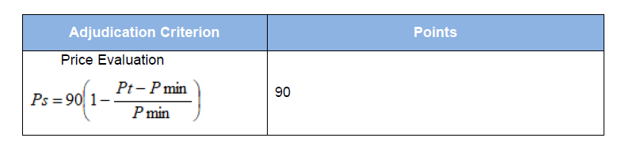
Price Evaluation
Stage 1: Price Evaluation (90 points)

Slide 11
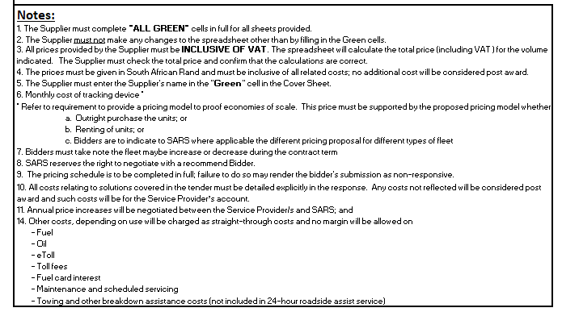
Price Template

Slide 12
B-BBEE Requirements

Slide 13
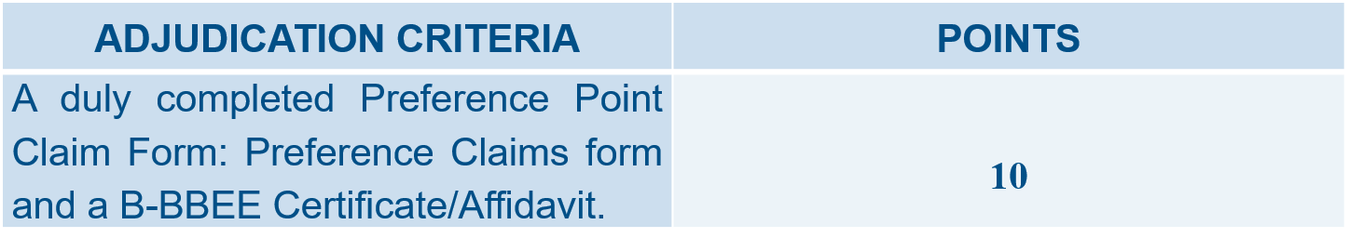
B-BBEE - 10 points
B-BBEE points may be allocated to Bidders on submission of documentation or evidence as follows:
Bidders MUST complete and sign the Preference claims form to claim the Bidder’s B-BBEE preference points, failing which, the Bidder will be scored zero.

Slide 14
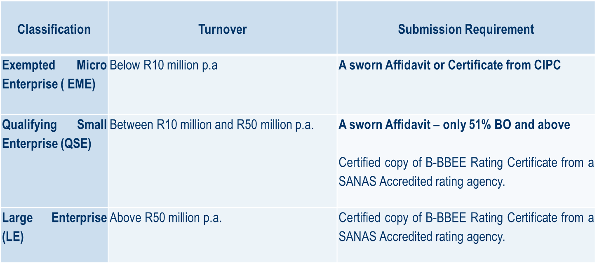
B-BBEE Certificate or Affidavit
The table below indicates the specific B-BBEE certification documents that must be submitted for this tender.
Failure to submit the required certification documents will result in disqualification

Slide 15
Use and acceptance of Affidavits
Section 1.5 of the Preference Points Claim form states.. The purchaser reserves the right to require of a bidder, either before a bid is adjudicated or at any time subsequently, to substantiate any claim in regard to preferences, in any manner required by the purchaser.
SARS reserves the right to request that bidders submit proof of their Black ownership and turnover information in support of their Affidavits.

Slide 16
B-BBEE Key Sections to complete in SBD

Slide 17
Proof of Existence: Joint Ventures and/or Sub-Contracting
Bidders to submit proof of the existence of joint ventures and/or sub-contracting arrangements. SARS will accept signed agreements as acceptable proof of the existence of a joint venture and/or sub-contracting arrangement.
The joint venture and/or sub-contracting agreements must clearly set out the roles and responsibilities of the Lead Partner and the joint venture and/or sub-contracting party. The agreement must also clearly identify the Lead Partner, who shall be given the power of attorney to bind the other party/parties in respect of matters pertaining to the joint venture and/or sub-contracting arrangement.
Incorporated JVs must submit the B-BBEE status of the entity. Unincorporated JVs must submit a consolidated B-BBEE certificate as if they were a group structure for every separate Bid.

Slide 18
Financial Analysis

Slide 19
Purpose
Part of overall risk management strategy of SARS
One of multiple governance steps to assess financial fitness of bidders
Assess financially stability
Identify financial risks that SARS as an organisation is exposed too
Recommend appropriate mitigating strategies

Slide 20
Financial Requirement
Three recent complete sets of Audited/Reviewed Annual Financial Statements comprising of:
  Statement Of Comprehensive Income (Income Statement)
  Statement of Financial Position (Balance Sheet)
  Statement of Cash Flows (Cash Flow Statement)
  Statement of changes in equity / net assets
  Accompanying Unabridged Notes for ALL of the above documents
  Any supplementary information
Entities trading for Less than three years Financial Periods
  Explanatory Letter – Providing reasons why the entity has been trading for less than three financial periods signed by a duly authorised representative of the entity

Slide 21
Financial Requirement
Joint Arrangements (JA)
  Annual financial statements of the JA and legal agreement detailing the percentage of ownership of each entity.
  Unincorporated JAs must submit separate AFS for each party to the JA.
Signed JA legal agreement
  Financial statements must be in name of the bidding entity.
  Subsidiary as the bidding entity submitting holding company’s AFS must also furnish a Performance Guarantee from the holding company, stating that the holding company will undertake to cover any or all risks associated with the bidder.

Slide 22
Navigating eSourcing

Slide 23
Navigating eSourcing
1
Accessing the system
2
Creating log-in details
3
Submitting on the system

Slide 24
Bid Submission

Slide 25
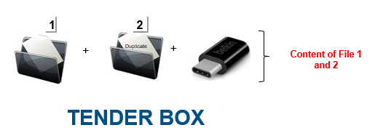
Bid Submission
Bidders must submit copies of each file (Original and Duplicate) and a USB with content of each file
OR
eSourcing System by 31 May 2022 at 11H00
Lehae La SARS, 299 Bronkhorst Street, Nieuw Muckleneuk, Brooklyn, Pretoria

