Slide 1
South African Revenue Service
Tariff Determination Process

Slide 2

Welcome to the
SARS
Taxpayer & Trader Webinar
Purpose:
This presentation seeks to provide clarity on tariff determination procedures as well as making the provisions of the legislation more accessible.
Disclaimer:
The information therefore has no binding legal effect and the relevant legislation must be consulted in the event of any doubt as to the meaning or application of any provision.

Slide 3
To build a smart modern SARS with unquestionable integrity, trusted and admired by Government, the public, as well as our international peers.
For the purpose of this presentation, we focus on 5 of our 9 Strategic Objectives:
SARS Vision 2024
MAKE IT EASY & SIMPLE TO COMPLY
MODERNIZE SYSTEMS TO PROVIDE SEAMLESS ONLINE DIGITAL SERVICES
MAKE IT HARD TO NOT COMPLY
CREATE AWARENESS, CLARITY & CERTAINTY
USE DATA FOR INSIGHTS, RISKS & IMPROVED OUTCOMES

Slide 4
Points of Discussion
Legislation
Harmonised System
Stage Consignment
Revised Kyoto Convention
Disputes
Tariff Determination Process
Non-Compliance

Slide 5
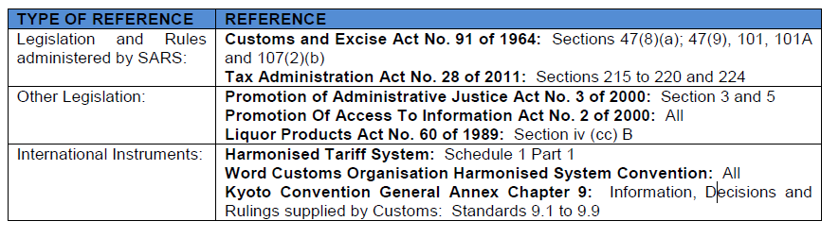
Legislation

Slide 6
Revised Kyoto Convention

Slide 7
Revised Kyoto Convention
Is an update and revision of the International Convention on the Simplification and Harmonisation of Customs procedures and practices
The Revised Kyoto Convention commits contracting parties to the following principles:
Transparency and predictability of Customs actions
Simplified procedures for authorized persons
Partnership with the trade
Coordinated interventions with other border agencies, etc

Slide 8
International Law on Penalties
Customs offences are provided for in Annex H – national legislation to provide for customs offences.
Chapter 9 Standard 9.8 - decisions to be in writing in line with national legislation.
Chapter 10 – the right of appeal, form, grounds, and consideration of the appeal.

Slide 9
What is Tariff Classification?
Is the process whereby any imported, manufactured, and or exported commodity is categorised by virtue of:
What it is
How it is made
What it is used for
Classification of imported or exported goods must be done according to Section 47(9) of the Customs and Excise Act ( the Act); the General Rules of Interpretation and the other principles of the Harmonised System (HS)

Slide 10
Why do we need to Classify Goods?
To establish the applicable rates of duty
To establish which additional duties are payable for the imported commodities
International trade statistics purposes
Trade Agreements
Prohibited and Restricted goods
Rebates

Slide 11
Stages of Tariff Classification
Classification of goods is a 3 stage process:
Firstly, ascertain the meaning of the words used in the headings and relative section as well as the chapter notes, which may be relevant to the classification of the goods concerned.
Secondly, considers the nature and characteristics of the goods
Thirdly, select the heading which is most appropriate to the goods, taking the relevant headings, as well as the section and chapter notes into consideration. There are explanatory notes to clarify the above in conformity with the above

Slide 12
Harmonised System

Slide 13
Harmonised System
It includes availability of sufficient national tariffs i.e. product list or Nomenclature
It is a source of many trade policies etc. – international agreements and regulations
Proper classification principles
Clear instructions through circulars (up-to-date amendments)
Adequate communications systems e.g., HS Committees
Harmonised System is a multi-purpose legal tool

Slide 14
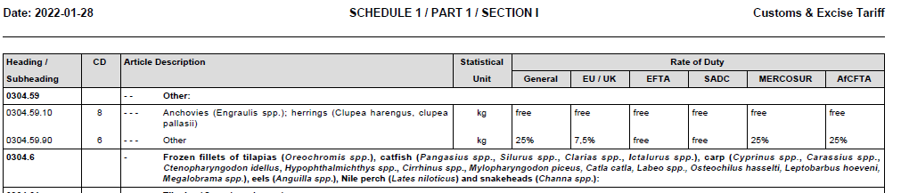
Tariff Book
Example

Slide 15
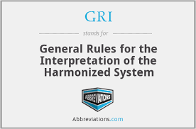
GRI’s Harmonised System
HS has six General rules for the interpretation (GRI 1 to 6)
They are the main tool for the daily application of the HS
GRI 1 stipulates that classification is determined according to the terms of the headings and of any relevant Section or Chapter notes
Apply GRI 2 to 5 in consequential order if classification cannot be so determined
According to GRI 6 Rules 1 to 5 govern classification at subheading levels within the same headings and only subheadings at the same level are comparable

Slide 16

GIR’s Harmonised System
Rule 1: The titles of sections, chapters, and sub-chapters are provided for ease of reference only. Terms of the headings and any relative section or chapter notes
Examples:
Section XV - Base metals and articles of base metal
However, many articles of base metal are classified elsewhere, e.g.
  Revolvers: Section XIX
  Machinery: Section XVI
Chapter 44 – Wood and articles of wood
However, wooden furniture is
classified in chapter 94

Slide 17
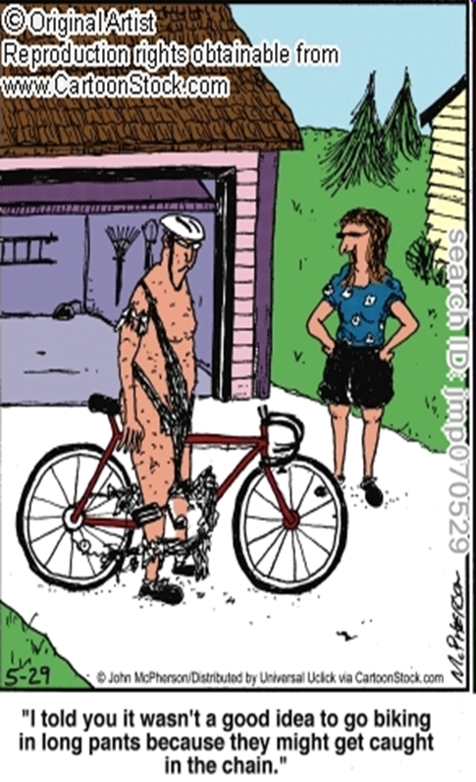
GIR’s Harmonised System
Rule2a: Incomplete or unfinished articles provided having the essential character of the complete or finished article
Incomplete bicycles that have the essential
characteristics of complete bicycles if it consists
of the frame, the fork, and at least two of the
following components:
  a set of wheels
  a crank-gear
  a steering unit (including handlebar and
  handlebar stems)
  a brake system

Slide 18

GIR’s Harmonised System
Rule 2b: Mixtures or composite articles -- > GIR 3
Examples:
a consignment of dried peas
(51%) and sugar (49%)

Slide 19

GIR’s Harmonised System
Rule 3: Classification of goods classifiable under two or more headings
Three methods of classification in the following order of priority:
Rule 3(a) – most specific description
Rule 3(b) - essential character
Rule 3(c) - heading which occurs last
in numerical order

Slide 20


White tea
GIR’s Harmonised System
Goods newly appeared on the world market, not specifically covered by any heading of the HS shall be classified in the heading appropriate to the goods to which they are most akin
A handle made of moulded plastic roll with a self-adhesive paper (so-called ‘textile roller’).
Not classifiable under a specific heading, most akin to brushes of heading 9603
Rule 4: Most akin
Cannot classify in terms of GRI 1 to 3 and then compare the goods with similar goods.

Slide 21
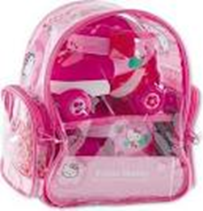
GIR’s Harmonised System
Rule 5a: Containers:
Camera cases, musical instrument cases, gun cases, etc, shall be classified
with such articles when of a kind normally sold therewith.
Example:
Set put up for retail sale consisting of:
pair of plastic roller skates, adjustable in length
durable plastic wheels, knee, and elbow protectors
protective plastic helmet
special designed plastic transparent rucksack

Slide 22
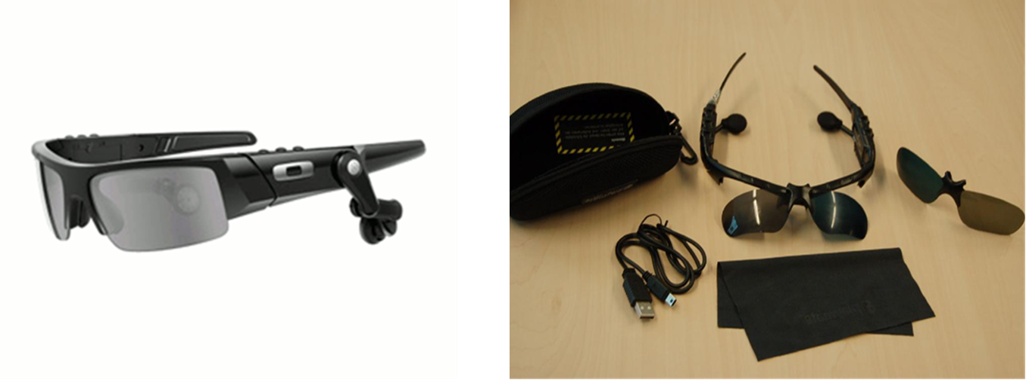
GIR’s Harmonised System
Rule 5b: Subject to the provisions of Rule 5 (a) above, packing materials and packing containers presented with the goods therein shall be classified with the goods if they are of a kind normally used for packing such goods.
Example
1) MP3-sunglasses
Top brand sunglasses with incorporated MP3 player with headset and Bluetooth

Slide 23
GIR’s Harmonised System
RULE 6
For legal purposes, the classification of goods in the subheadings of a heading shall be determined according to the terms of those subheadings and any related Subheading Notes and, mutatis mutandis, to the above Rules, on the understanding that only subheadings at the same level are comparable.

Slide 24
Example of Subheading
  09.01 Coffee, whether or not roasted or decaffeinated; coffee husks and skins; coffee substitutes containing coffee in any proportion:
  0901.1 - Coffee, not roasted:
  0901.11 - - Not decaffeinated:
  0901.11.10 9 - - - Of the species Coffea arabica kg free
  0901.11.20 6 - - - Of the species Coffea robusta kg free
  0901.11.90 7 - - - Other kg free

Slide 25
Other WCO HS Tools

Slide 26
Other Classification Principles
Sections – 21 Sections
Legal Notes – Chapter and Section Notes.
General Rules of Interpretation – GRI 1 to GRI 6
Tariff subheadings – 6-digit and 8 digit tariff codes
Tariff headings – 4-digit tariff headings
Chapters - there are 99 Chapters, Chapter 77 reserved for future use and Chapters 98 and 99 reserved for national use

Slide 27

Other Classification Principles Continuing
Arrangement of Sections and chapters is based on:
Material content
Legal Notes
It is based on usages
Stage of processing
Sections, Chapters, and subheading notes provide the legal basis for the classification of goods.

Slide 28
Non-Compliance

Slide 29
Penalties
Failure to adhere to the provisions of the Act is considered an offence
Offences may render the recipient or importer liable to, as provided for in the Act:
Monetary penalties
Criminal prosecution
Suspension or cancellation of registration, license, or accreditation

Slide 30
Tariff Determination

Slide 31
Tariff Application Process
Any person intending to import or export must register with SARS in terms of the Act
Registration can be done:
via eFiling or
Customs Branch Office
In the event that clients are unable to classify goods, they must apply for tariff determination
A tariff determination process can arise either from the client or as a departmental submission

Slide 32
Tariff Determination Process
Role players
Customs Declaration
External & Internal Stakeholders
Customs & Excise Audit
Customs Inspections

Slide 33
Determining Tariff Heading
A declaration released as entered or an opinion given verbally is not deemed to be a tariff determination
Once a tariff determination is issued, the Commissioner may amend or withdraw it to make a new determination for reasons stipulated in the Act
Any determination that has been made is deemed to be correct subject to an internal dispute resolution or litigation process
Goods are classified as presented during the declaration process

Slide 34
Tariff Determination Process
Client submits tariff determination application to Customs Office
Customs Officer checks the tariff determination application
Information Sufficient?
Customs Officer captures the application details on the TDN system (DA314)
Yes
Customs Officer rejects the application
Officer sends the application manually to HO
No
Branch provides outcomes to the trader
HO issues a determination & sends it back to the branch
HO assesses the application for a determination
Tariff Determination External Policy: http://intranet/ProdQMS/Ops/CD/SC-CR-A-09%20-%20Tariff%20Classification%20-%20External%20Policy.pdf

Slide 35
Tariff Determination for Alcoholic Beverages
In terms of the Act, first-time importers, exporters, or manufacturers of alcoholic beverages require a tariff determination
An application must be submitted at any regional office or Head Office for consideration
The application must be accompanied by a signed certificate from the Department of Agriculture, Forestry, and Fisheries (DAFF) confirming that, the alcoholic beverage complies with the Liquor Products Act

Slide 36
Tariff Determination for Alcoholic Beverages
Information to be enclosed in the submission is:
  the brand name
  process of the manufacturer, the ingredients used, and the proportion in which they are used
  the alcoholic strength; and
  any other information as may be required by the Commissioner

Slide 37
Staged Consignment

Slide 38
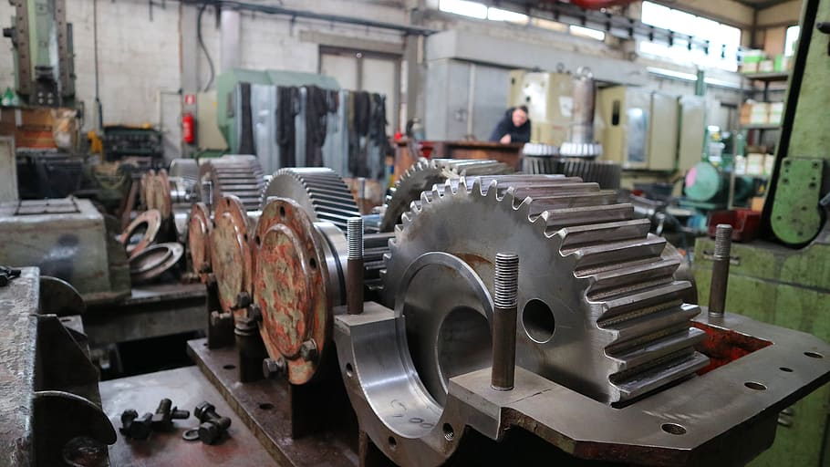
Staged Consignments
What is it?
An importation of unassembled or dissembled machinery for industrial purposes in different consignments but classified as one machinery/product

Slide 39
Staged Consignments
In instances where the mass exceeds 500 tons or if the measurements for shipping purposes exceed 500 cubic metres, the Commissioner may allow the importation in staged consignment as provided for in terms of Additional Note 1 to Section XVI of part 1 of Schedule No 1 to the Act
Goods in transit or bond through South Africa and goods exported from South Africa may not be classified as staged consignments
NB: The application must reach SARS prior to the importation of the first consignment and must comply with the requirements as set out in the Staged Consignment External Policy ( SC-CR-48)

Slide 40
Internal Dispute Processes

Slide 41
Internal Administrative appeal (IAA) Process
If aggrieved by the decision of the Commissioner, the recourse is:
  To appeal within 30 days from the date of the tariff determination
  Alternative Dispute Resolution (ADR) within 30 days from the date of appeal outcome, or
  Litigation within 1 year from the date of appeal, ADR, or tariff decision
The submission must be made at the office where the decision was issued.
No duties, levies, or taxes, which are due and payable, may be waived; however, these amounts may be suspended pending the outcome of the applicable appeal committee’s decision.

Slide 42
Litigation
Section 96 (1) (a) of the Act makes provision for appellants to litigate once all the internal dispute processes have been explored.
Applicants exercising these rights are required to give the Commissioner a notice in writing prior to instituting legal proceedings.
The notice must be given within a year from the date of receipt of the ADR outcome or to the address stipulated in the ADR notice.

Slide 43
Prescribed Turnaround Times

Slide 44
Finalisation of Tariff Determination Processes
  SARS will endeavour to finalise applications within timelines as stipulated in the Service Charter provided all required information is submitted
  Tariff determination within 90 days
  Appeal within 60 business days
  ADR within 90 business days
  Notice to litigate to be finalised within 30 days from date of receipt of such notice, subject to extension agreed between the parties
http://intranet/sites/InFocus/Documents/InFocus%20and%20Newsflash%20documents/Service-Charter_2022-Final.pdf

Slide 45
Other Search Engines for Tariff Determination
Census Bureau Schedule B Search Engine (3ceonline.com)
Eurostat (3ceonline.com)
https://ec.europa.eu/taxation_customs/dds2/ebti/ebti_consultation.jsp?Lang=en
http://harmonizedsystem.wcoomdpublications.org
http://www.itac.org.za/upload/43361_28-5_TradeIndustry.pdf
https://sars.mylexisnexis.co.za/
https://www.sars.gov.za/legal-counsel/primary-legislation/schedules-to-the-customs-and-excise-act-1964/
Schedules to the Customs and Excise Act, 1964 | South African Revenue Service (sars.gov.za)
http://intranet/ProdQMS/Ops/CD/SC-CF-48%20-%20Staged%20Consignment%20-%20External%20Policy.pdf

Slide 46

Go Digital
Remember our Digital Channels
We’ve made it easier for you
Go Digital!
  Register for eFiling
  Contact us:
  tdnquery@sars.gov.za
Visit us on our Social Media platforms
  LinkedIn Facebook Twitter
For more information on Tariff Determination, please visit:
SARS website: www.sars.gov.za

Slide 47



